Slide 1
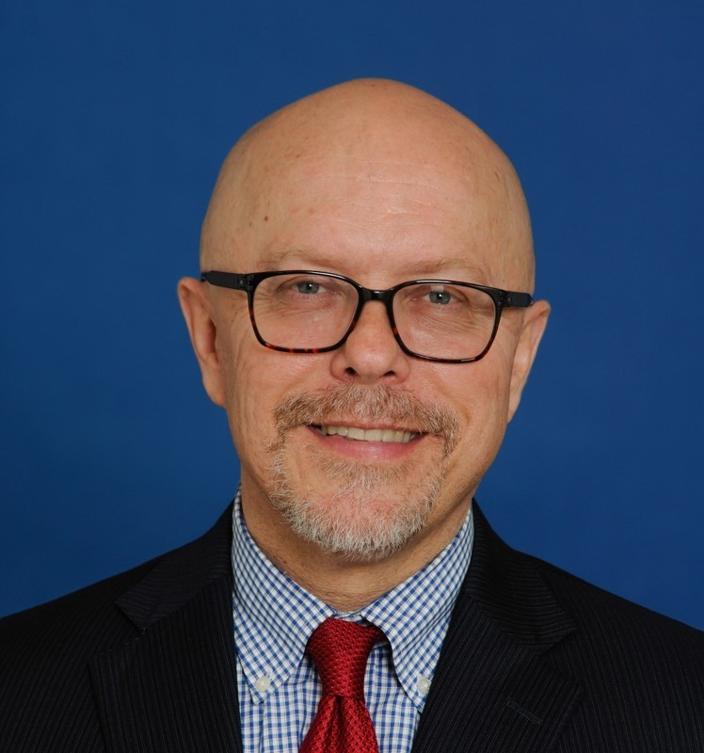

Graduate Student Orientation
Welcome!
Welcome to the Graduate Student Orientation! My name is Robert Wojtowicz and I am Vice Provost & Dean of the Graduate School here at Old Dominion University. The modules you are about to experience were developed by colleagues with expertise in various fields from across the campus. They distill the most essential information you’ll need for a successful start to your graduate program. In addition, they’ll lead you to other resources you may find helpful down the road. Let’s get started!
Robert Wojtowicz, Ph.D.
Vice Provost & Dean of the Graduate School
2102 Monarch Hall I 757-683-3085 l rwojtowi@odu.edu
Fall 2022
Notes:
Welcome to the Graduate Student Orientation! My name is Robert Wojtowicz and I’m Vice Provost & Dean of the Graduate School here at Old Dominion University. The modules you are about to experience were developed by colleagues with expertise in various fields from across the campus. They distill the most essential information you’ll need for a successful start to your graduate program. In addition, they’ll lead you to other resources you may find helpful down the road. Let’s get started!

