Slide 1



Welcome International and Graduate Students!
Sexual Harassment and Title IX
Presented by:
Office of Institutional Equity & Diversity
Notes:
Welcome International and Graduate Students to this presentation on sexual harassment and Title IX

Slide 2


How do you define sexual harassment?
What is sexual harassment anyway?
Notes:
You may be wondering, what is sexual harassment anyway? In today’s information age, there are a lot of sources that can characterize sexual harassment as this or that. Sources like social media and the me-too movement can shape what we believe are acts of sexual harassment. Also, we may have personal experiences that shape how we think about what sexual harassment means. Each and every one of us may have a different understanding of what sexual harassment is.
That is why it is important to have a clear understanding of how the law and ODU define sexual harassment.
Unfortunately, the courts have not given us a consistent legal definition. However, it is clear that sexual harassment is recognized as a form of sex discrimination that is prohibited by federal law. Specific congressional acts prohibit sexual harassment in settings such as the workplace (Civil Rights Act of 1964) and educational institutions (Title IX of the Educational Amendments of 1972).

Slide 3
TITLE IX
Harassment is a form of discrimination
Sexual harassment is a form of harassment
Sexual violence is a form of sexual harassment
Rape, sexual assault, battery and coercion are forms of sexual violence
Discrimination is prohibited by Title IX
Notes:
Title IX is a federal law that prohibits gender or sex discrimination, including sexual harassment.
Sexual Harassment again is unwelcome conduct of a sexual nature.
Sexual Violence is an extreme form of sexual harassment.
And sexual assault is an example of sexual violence.
Title IX also prohibits stalking and dating/domestic violence.

Slide 4

Sexual Harassment Defined
Any of three types of misconduct on the basis of sex which jeopardize equal access to education:
Quid pro quo
Hostile environment sexual harassment
Any instance of sexual assault, dating violence, domestic violence, or stalking.
Notes:
The Office for Civil Rights in the US Department of Education defines sexual harassment as any of three types of misconduct on the basis of sex which jeopardize equal access to education:
Quid pro quo, which involves an employee of the University conditioning the provision of an aid, benefit, or service on an individual's participation in unwelcome sexual conduct.
Hostile environment, which is unwelcome sex-based conduct that a reasonable person would find so severe, persistent/pervasive and objectively offensive that it denies a person equal educational access, and
Any instance of sexual assault, dating violence, domestic violence, or stalking.

Slide 5

The Reasonable Person Standard
Would a reasonable person in the victim’s shoes find the conduct to be offensive or unwelcome?
Notes:
In order for conduct to constitute sexual harassment, it must be both subjectively and objectively offensive. Courts and federal agencies use the “reasonable person standard” to assess if conduct is objectively offensive. For example, if the woman pictured on this slide alleged she was sexually harassed, the question is whether the conduct would be offensive to a reasonable female college student.

Slide 6
Sexual Assault
Under Title IX, sexual assault is an egregious form of sexual harassment. It occurs any time there is sexual contact without consent.
Sexual assault can include rape and other non-consensual sexual acts.

Slide 7

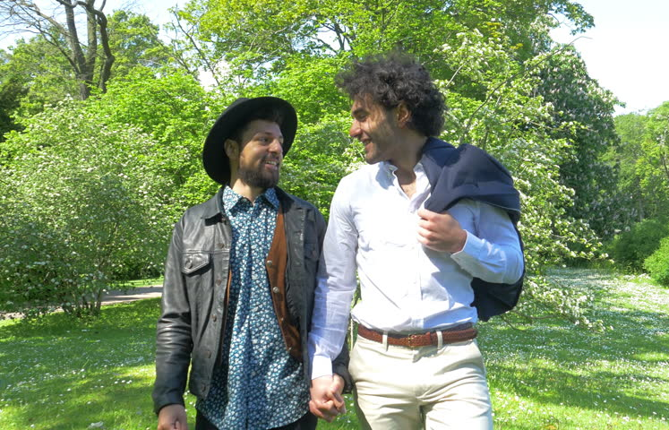

Consent
Consent is defined as knowing, voluntary, and clear permission by word or action, which a reasonable person would interpret as a willingness to participate in mutually agreed-upon sexual acts.
Consent is the basis for all healthy sexual interactions with your partner(s)!
Notes:
The University defines sexual assault as any sexual contact with a person who does not or is unable to consent. Consent is a two-way street. Make your limitations known to your partner(s) by communicating clearly what you do and do not like.
ODU defines consent as knowing, voluntary, and clear permission by word or action, which a reasonable person would interpret as a willingness to participate in mutually agreed-upon sexual acts. If your partner(s) does not or is unable to consent, you should not engage in sexual activity with them.

Slide 8
Title IX Compliance
Once the University has notice of a potential violation, it must:
  Take immediate and appropriate steps to investigate what happened
  Take prompt and effective action to end the harassment, remedy the effects, and prevent recurrences as well as prevent retaliation.
Notes:
All students and employees are highly encouraged to report suspected incidents of sexual harassment and sexual violence. Many ODU employees are required to report information to the University’s Title IX Coordinator. Mandated reporters, or “responsible employees,” include employees who have the authority to take action to redress incidents in violation of the University's Interim TIX Policy, who have been given the duty of reporting such incidents or any other misconduct to the Title IX Coordinator or designee; or whom an employee or student could reasonably believe have this authority or duty. All employees in a supervisory role including but not limited to all teaching and research faculty, administrative professional faculty, and classified and hourly employees; graduate teaching assistants; graduate research assistants; residential assistants; law enforcement; and campus security authorities are Responsible Employees.

Slide 9
Remember:
If you are both a student and an employee, you may have a reporting obligation if you work in certain areas of the University, such as Housing.
Notes:
If you are both a student and an employee, you may have a reporting obligation if you work in certain areas of the University, such as Housing.

Slide 10
To Whom Should You report?
Title IX Coordinator
  Ariana Wright, Office of Institutional Equity & Diversity
  Deputy Title IX Coordinators & Liaisons
  Student Athletes: Annamarie Ginder, Associate Athletic Director/Student –Athlete Academic Services
  757--683-3375
  aginder@odu.edu
  All other students: Traci Daniels, Special Assistant to the Vice President for SEES
  757-683-5890
  tdaniels@odu.edu
  For Faculty: Kate Hawkins, Vice Provost for Faculty Affairs and Strategic Initiatives
  757-683-4423
  kwhawkin@odu.edu
  For Administrative & Professional Faculty and All Other Employees
  JaRenae Whitehead
  AVP of Human Resources
  757-683-4564
  jwhitehe@odu.edu
  If you have a concern you would like to report, you can do so electronically: https://cm.maxient.com/reportingform.php?OldDominionUniv&layout_id=9
Notes:
You may report electronically on our website, or to the Title IX Coordinator Ariana Wright, Deputy Coordinators For Student Athlete Anna Marie Ginder, or all other students Traci Daniels, , or Liaisons for Faculty Kate Hawkins, and for administrative and professional faculty and all other employees JaRenae Whitehead. Also please visit our Equity and Diversity Website for further reporting.

Slide 11

Filing a Complaint
Title IX Policy (Policy #1008)
Discrimination Policy (Policy #1005)
Informal & Formal processes
There are NO time restrictions for filing a complaint
Complaints may be anonymous
The complaint form can be found on our website at https://www.odu.edu/equity
Notes:
The Title IX and Discrimination Policy, available online, can be used by any member of the University community, including students, employees, visitors, and volunteers.

Slide 12
Confidentiality Issues
Confidentiality vs. privacy
Confidentiality is a balancing act between the interests of the injured party, the rights of the accused party, safety concerns, and the interests of the University community

Slide 13

Barriers to Disclosure
Fear of not being believed
Self-blame
Concerns about getting in trouble
Not knowing how to disclose or to whom
What other things may deter a person from coming forward?
Notes:
There are a lot of reasons why someone may not come forward. If you have experienced gender discrimination, sexual harassment, or sexual violence, you are encouraged to seek help. There are many resources on our campus that can assist you.

Slide 14
Resources
ODU Women’s Center
  Confidential victim counseling and support. Must be requested.
  Non-confidential services are also be available.
ODU Police Department
  Active threat response
  File criminal charges
  Protective orders
  Safety escort services
Office of Counseling Services
  Confidential counseling
  Emergency mental health crisis response
Student Outreach & Support
  Help with absences, missed work, etc.
  Administrative withdrawals
Student Conduct & Academic Integrity
  No-contact orders
Student Health Center
  Confidential healthcare
Community resources also available
Notes:
When a report or complaint of a TIX violation is made, the University may provide supportive measures to ensure the safety and well-being of the parties involved and of the campus community. Students can contact these on-campus resources to receive support.

Slide 15
Summary
Sexual harassment is any unwelcome conduct of a sexual nature that interferes with a student’s education or an employee’s job.
Sexual harassment is considered a type of discrimination and is prohibited by federal law.
Title IX prohibits sexual harassment, including acts of sexual violence such as sexual assault.

Slide 16

You play a vital role!
Thank you for attending.
Further questions:
683-3141
equityanddiversity@odu.edu
Notes:
The university is committed to providing a learning and living environment where every person is treated with dignity and respect. You play a vital role in making this happen.

