Slide 1
Old Dominion University Student Health Services Graduate & International Student Orientation

Slide 2
Holistic Health and Wellness
This Photo by Unknown Author is licensed under CC BY

Slide 3
ODU Student Health Services
Location:
1007 South Webb Center
Norfolk, VA. 23529
Telephone: 757-683-3132 – CALL AHEAD for AN APPOINTMENT
Email: studenthealth@odu.edu
Hours:
Fall 2022 & Spring 2023 – Academic Semester Hours:
Monday thru Thursday- 8 a.m. to 7 p.m. Friday 8 am -5 pm.

Slide 4
Who is Eligible for Our Services?
Full-Time Graduate Students
Part-Time students pay a service fee during clinic visits
Student Health Services DOES NOT require health insurance to be seen; the United Healthcare Plan is available to students through the office of Graduate Studies; https://www.odu.edu/graduateschool/graduate-student-health-insurance

Slide 5
Fees
Full time graduate students are charged the $135.00 per semester health fee
Part-time graduate students are charged the $ 135.00 health fee upon seeking services per semester
Late or re-schedule fee is $10.00
Fees are charged for physicals, immunizations, labs, and some medical supplies
Student Health Services does NOT require insurance

Slide 6
Services Provided
Primary Care
Acute Care
Telehealth/Telemedicine
Immunizations
Sexually Transmitted Disease Testing
Family Planning/Contraception
Women’s Health
Laboratory Services

Slide 7
How to Schedule An Appointment
Walk-In or Same Day Appointments
Self-Schedule
Call Student Health Services
Schedule via the Monarch Wellness Portal at MyOdu | Main view
Please memorize your MIDAS ID & University Identification Number (UIN) and have a photo ID upon arrival to SHS

Slide 8
Health Care Providers
Physicians
Nurse Practitioners
Physician Assistants
Registered Nurses
Licensed Practical Nurses
Medical Assistants
Medical Laboratory Technicians
Patient Care Specialists

Slide 9
ODU Health Entrance Requirements
The Student Health Center is required by the Commonwealth of Virginia Law 23.1-800 to require the following upon admission (Undergraduate and Graduate students)
1.) Completed Health History
2.) Current Immunizations Diphtheria, Tetanus, Poliomyelitis, Measles (Rubeola), German Measles (Rubella), Mumps, Meningococcal, Hepatitis B
(per the American College Health Association)
3.) Tuberculosis Screening
4.) COVID-19 Vaccine (Strongly Recommended)
Due Date: August 1st
DUE DATE: August 1st
This Photo by Unknown Author is licensed under CC BY

Slide 10
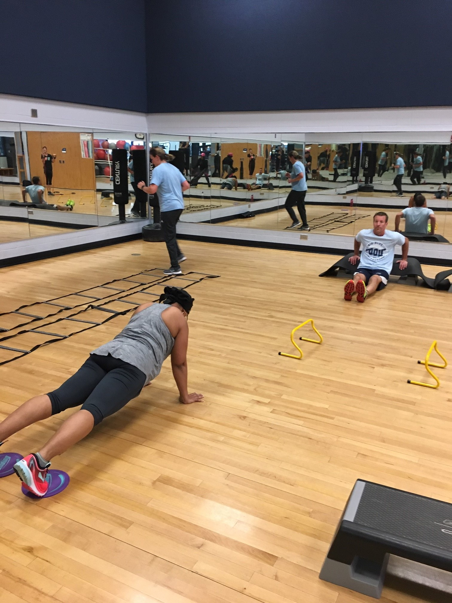
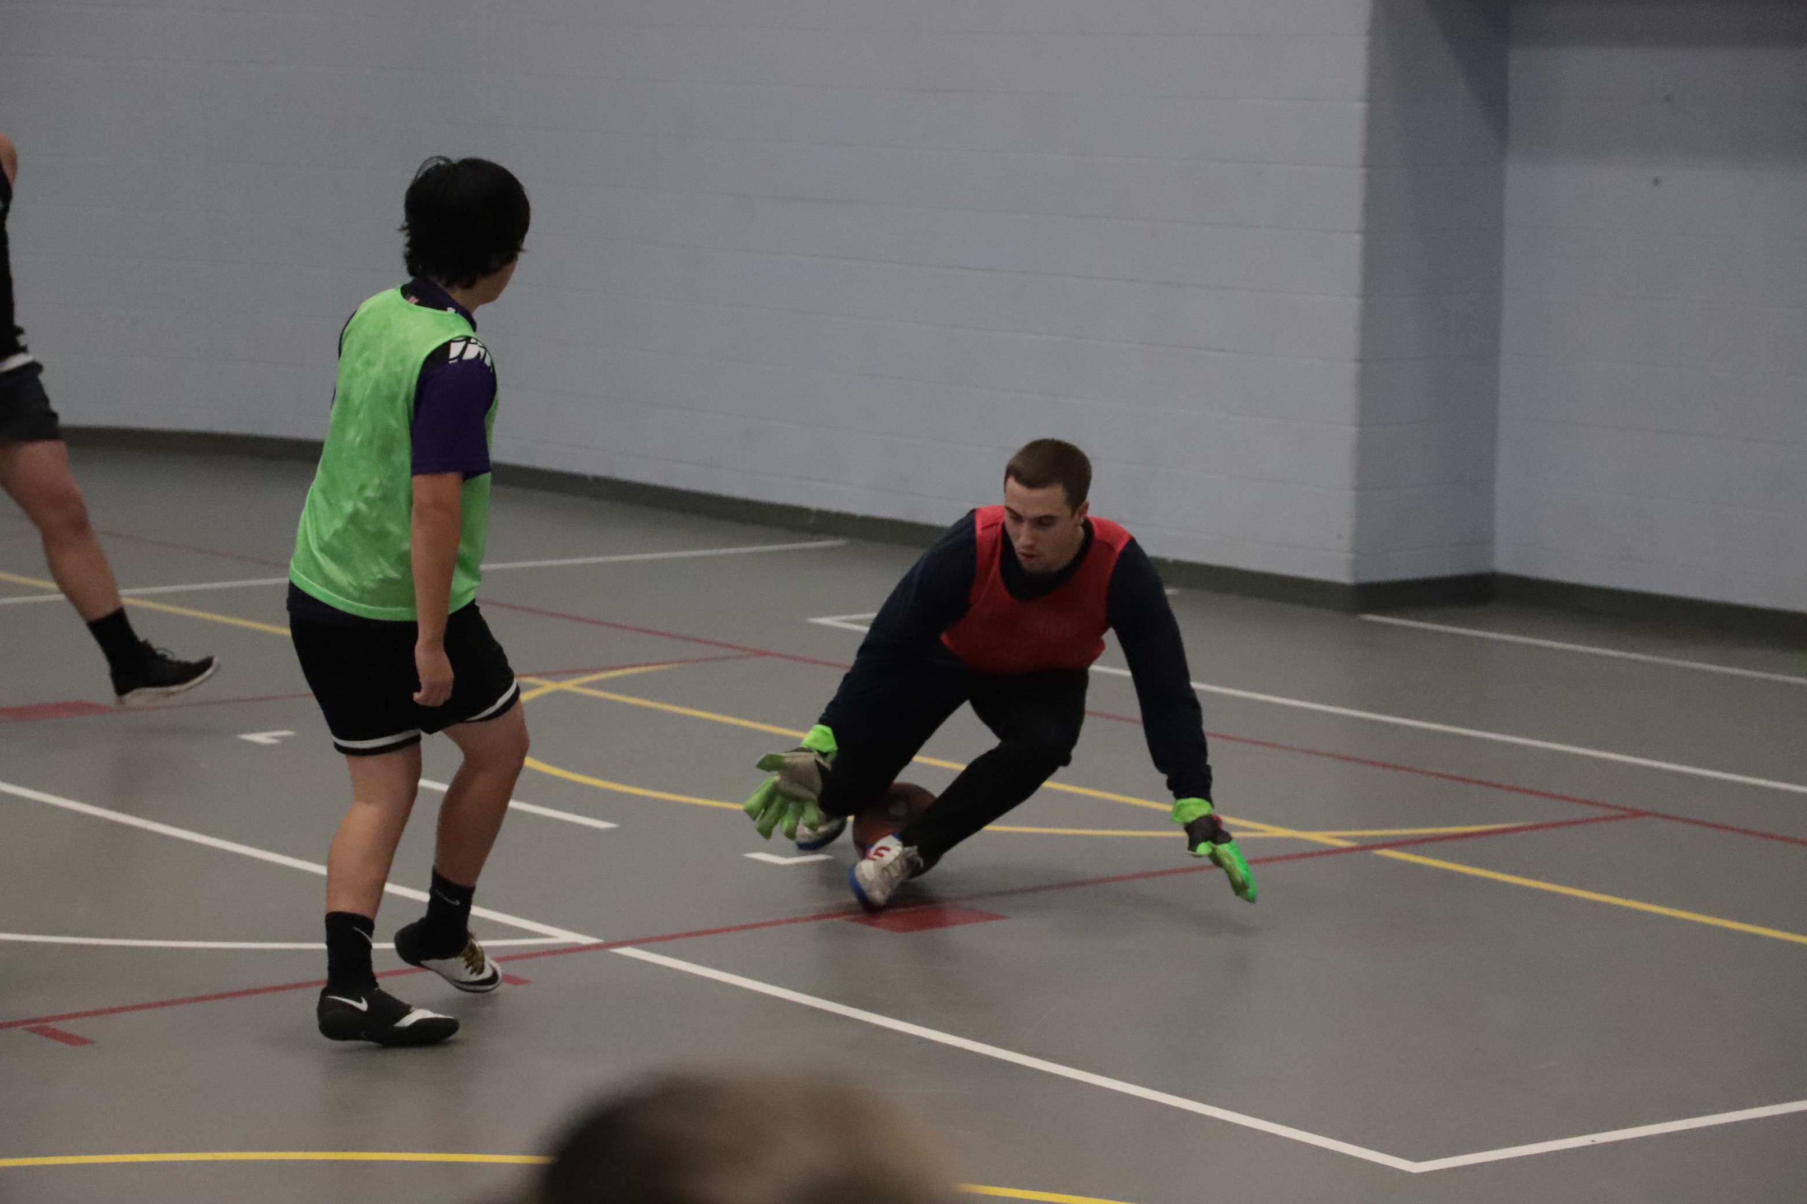
Wellness Services
Health Promotion
Women and Gender Equity Center
Recreation and Wellness
Registered Dietician

Slide 11
Monarch Wellness Portal
ODU Monarch Wellness Portal
Access to review secure records
COVID-19 off campus test results upload
View and Print Immunization Records
Health Education Sites
Update contact address and phone number
Schedule appointments online (telehealth currently)

Slide 12
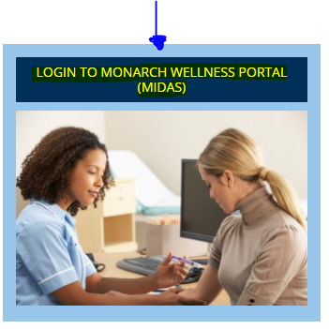
How to Schedule An Appointment
Walk-In or Same Day Appointments
Self-Schedule
Call Student Health Services
Schedule via the Monarch Wellness Portal at MyOdu | Main view
Please memorize your University Identification Number (UIN)

Slide 13
How to Protect Yourself from COVID-19
Get vaccinated with the COVID-19 vaccine/booster
Wash your hands often with soap and water for 20 seconds; if soap is unavailable use hand sanitizer
Avoid direct contact with people outside of your household (6ft distance from other people)
Cover your mouth and nose with a mask/face cover when around others
Cover coughs and sneezes
Clean and disinfect frequently touched surfaces daily (cell phone, computer, desk, doorknobs)
Monitor your health and if you feel sick stay in your residence hall/home; do not go to class. Coordinate your absence with your professor/supervisor.
This Photo by Unknown Author is licensed under CC BY-ND

Slide 14
International Student Travel Information
If you are not vaccinated: (Recommended)
Get tested for COVID 3-5 days after arrival, unless you had COVID in the past 90 days.
Self-Quarantine upon arrival to the US for 5 days even if negative – Isolate if your test is positive.
Get vaccinated!
If you are vaccinated and up to date: (Recommended)
Get tested 3-5 days after arrival, unless you had COVID in the past 90 days.
Self monitor for symptoms. No Quarantine needed.
If you show COVID symptoms, self quarantine and retest.
If you test positive, self isolate for 5 days.

