Slide 1
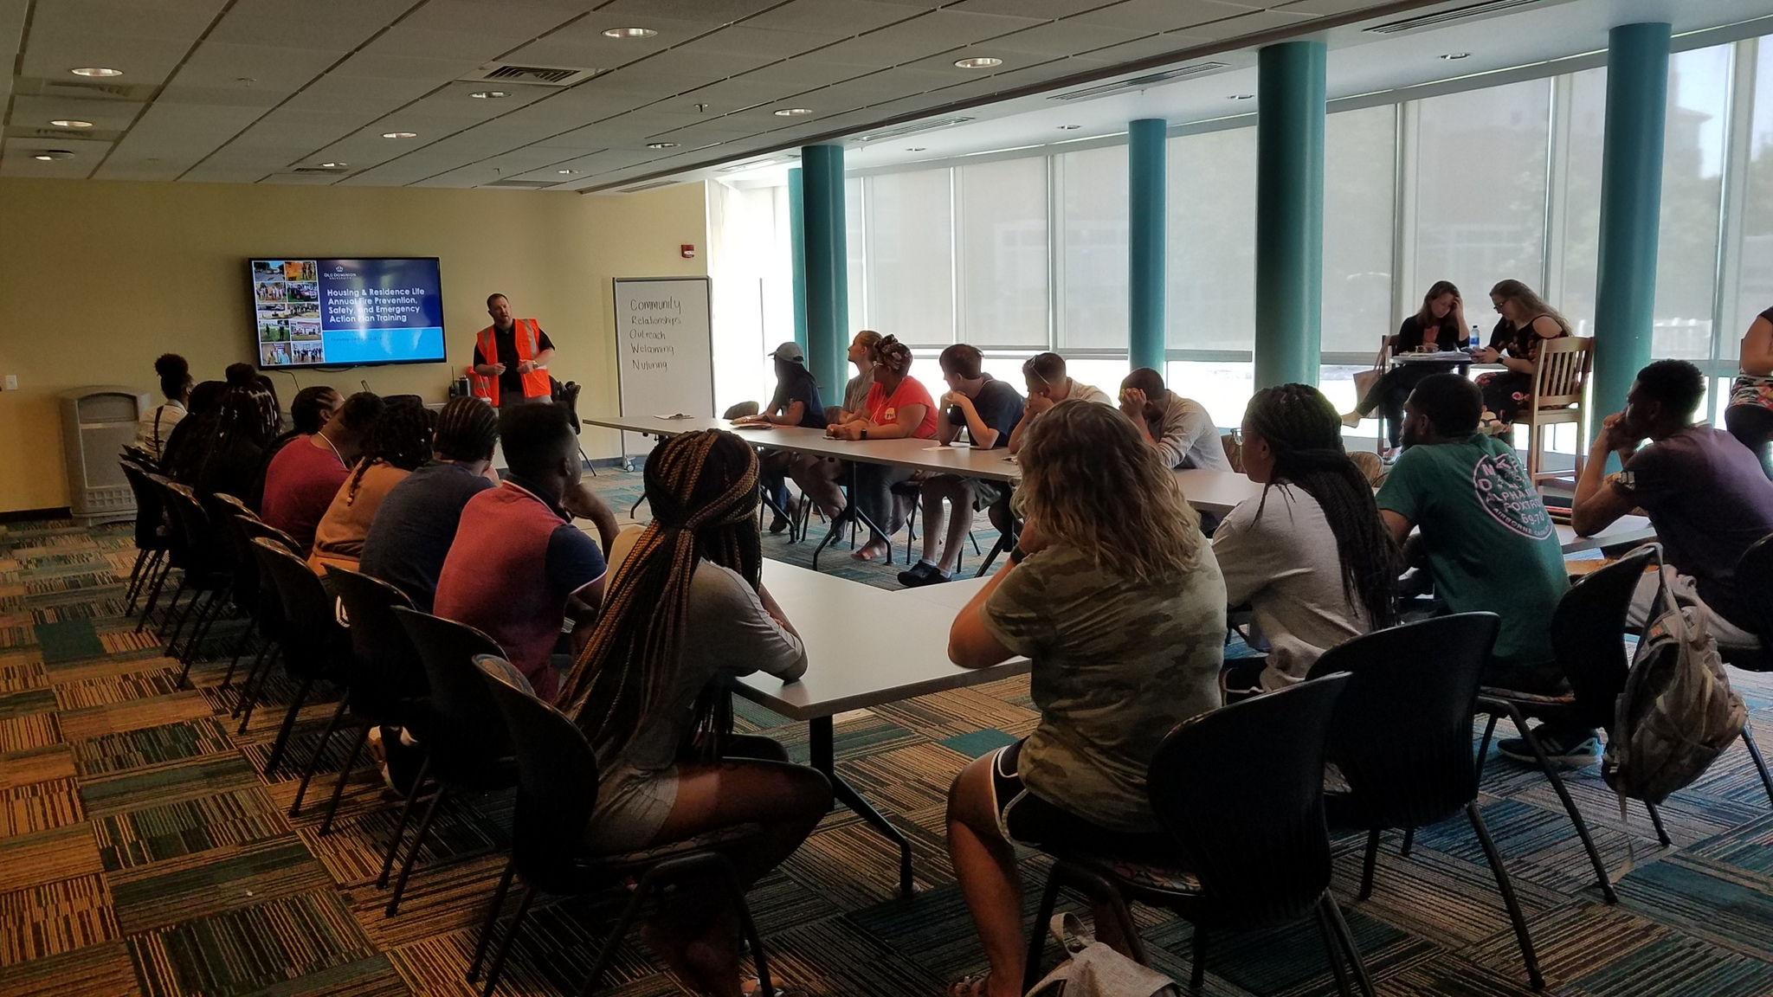
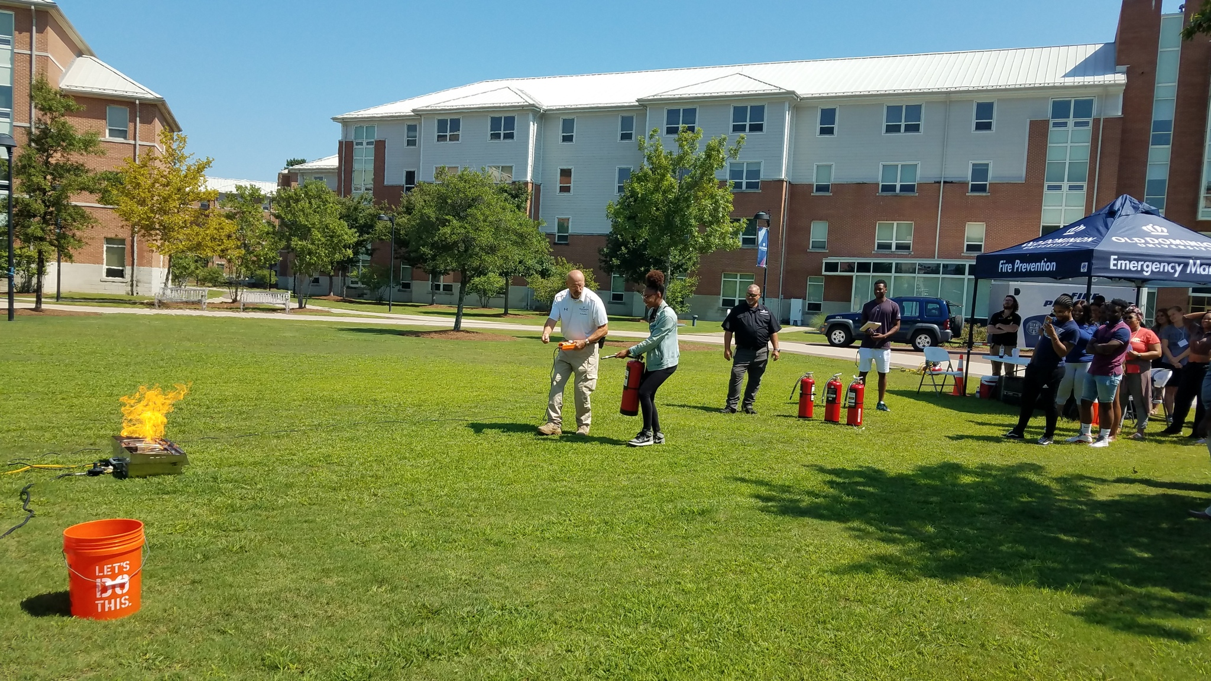
Residence Life Training
Old Dominion University

Slide 2
Agenda
1.Residence Hall Buildings & Maps
2.Reporting a Fire
3. According to FEMA
4. Campus Fire Statistics
5. Evacuation Procedures
6. Fire Extinguishing Policy
7. Fire Prevention
8. Fire Watch Forms and Signage
9. Nuisance Alarm Prevention
10. Fire Safety Regulations
11. Prohibited Items
12. Contact Information
13. Closing
14. Contact Information

Slide 3
Residence Halls
Whitehurst Hall
The Inn (Old Dominion Inn)
Powhatan I & II
Village Apartments
Nusbaum Apartments
Scholarship House
Rogers Hall/Rogers East
Gresham Hall/Gresham East
University Village Apartments
Owens House- New Construction

Slide 4
Residence Halls cont.
The Quad of 6 Complex
Scotland House
Ireland House
Virginia House
England House
France House
Dominion House

Slide 5
Example of Internal Assembly Areas (IAA) Go here when sheltering in place
Shelter internal areas away from windows.
Mainly used during a sudden severe storm event (tornados, earthquake, etc.)
NOAA Weather Radios at RA desks sound an alarm during severe weather events.

Slide 6
Example of Evacuation Map/Emergency Assembly Areas (EAA) Go here during fire alarms/drills
Review your Building Emergency Action Plan to determine where your Primary and Secondary Emergency Assembly Areas are located.
Remain 50 feet away from building.
Keep roads/driveways clear.

Slide 7
Building Emergency Coordinator
Usually the Residence Hall Director
Main building Point of Contact in an emergency.
Wears an orange vest and carries an orange drawstring bag with basic emergency supplies.

Slide 8
Whitehurst Hall
Fire Alarm System
No Sprinkler System
Room smoke detector alarm in room only; they do not report to Public Safety
Detectors in common areas & pull stations all report to Public Safety
EAA-parking lot parallel to 48th street or Whitehurst beach area by volleyball area

Slide 9
Rogers Hall/Rogers East Gresham Hall/Gresham East
Fire Alarm System
No Sprinkler System
Room smoke detectors alarm in room only; they do not report to Public Safety
Detectors in common areas & pull stations alarm to Public Safety
EAA- Rogers Main and East WHRO parking lot (Lot 1)
EAA-Gresham Main and East– Parking lot on west side of building in the back (Lot 16)

Slide 10
Powhatan Village Apartments
No automatic sprinkler system
Smoke detectors alarm in apartments only; they do not report to Public Safety
Pull stations are in common areas and they do report to Public Safety
EAA-Powhatan I – Parking lot adjacent to building A-G (Lot 32)
EAA-Powhatan II – Parking lot adjacent to Facilities Management building (Lot 41)

Slide 11
The Quad Complex
Automatic Sprinklers throughout
Fully Addressable Fire Alarm System Safety
All alarms report to Public Safety
EAA-Center of quad (grassy area)

Slide 12
Old Dominion Inn – “The Inn”
Fire Alarm System
Automatic Sprinkler System Throughout
All detectors and pull stations report to Public Safety
EAA– Parking area left (street side) of front entrance

Slide 13
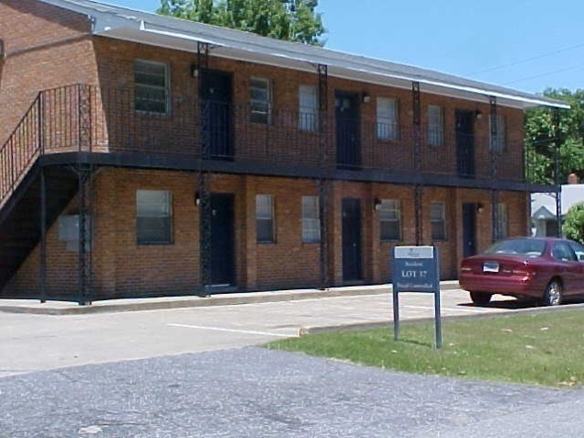
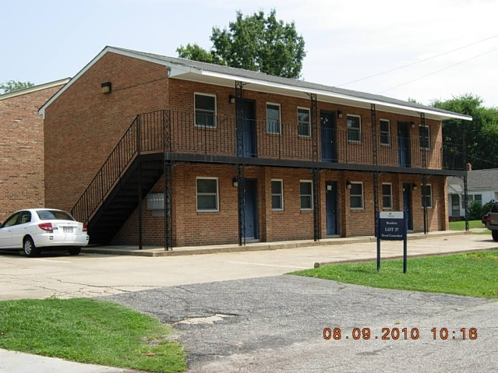
Nusbaum Apartments

Slide 14
Nusbaum Apartments cont.
These buildings do not have an automatic fire alarm system or automatic sprinkler systems
These buildings do have smoke detectors in rooms and halls.
Any emergencies will require physically notifying police or fire
All sleeping areas have battery powered smoke detectors
For A-N apartments beside the VAPBW house, evacuate to opposite side of 49th Street
For O-V apartments, evacuate to parking lot across 49th Street – Lot 37.

Slide 15
Scholarship House
Automatic sprinkler system throughout
Automatic fire alarm system that reports to Public Safety
Accommodations for 9 students
EAA-Gresham Hall side of 49th street

Slide 16
University Village Apartments
10 Buildings/3 Stories/960 Beds
Automatic Sprinkler System
Fully Addressable/Networked Fire Alarm System
Monitored by campus police
Buildings 1,4,5,8 & 9 have retail spaces on the first floor
The residential areas are separated from the retail spaces by a fire barrier
EAA- Across the street from their building and or in the 2nd row of parking closet to the building.

Slide 17
Owens House- New Construction
Automatic Sprinklers throughout
Fully Addressable Fire Alarm System Safety
All alarms report to Public Safety
EAA- Left of Building in parking lot, and in front of SRC.

Slide 18
According to FEMA
In cases where fatalities occurred on university campuses, alcohol was a factor.
In 50% of dorm fire fatalities, victims were under the influence at the time of the fire.
Cooking is the leading cause of fire injuries on university campuses.

Slide 19
Campus Fire Statistics
From January 2000 to present 92 fatal fires have been documented that occurred on a college campus, in Greek housing or in off-campus housing within 3-miles of the campus – claiming a total of 132 victims:
• 79 fires have occurred in off-campus housing claiming 113 victims • 7 fires have occurred in on-campus building or residence halls claiming 9 victims • 6 fires have occurred in Greek housing claiming 10 victims
Of the 92 fires documented: • 14 were intentionally set claiming 22 victims • 38 were accidental – includes cooking, candles, smoking or electrical claiming 51 victims • 40 of the fires the cause was never determined – These fires claimed 59 victims

Slide 20
Common Causes of fire in a Dormitory are:
Candles
Smoking
Overloading Outlets
Unattended Cooking Items

Slide 21
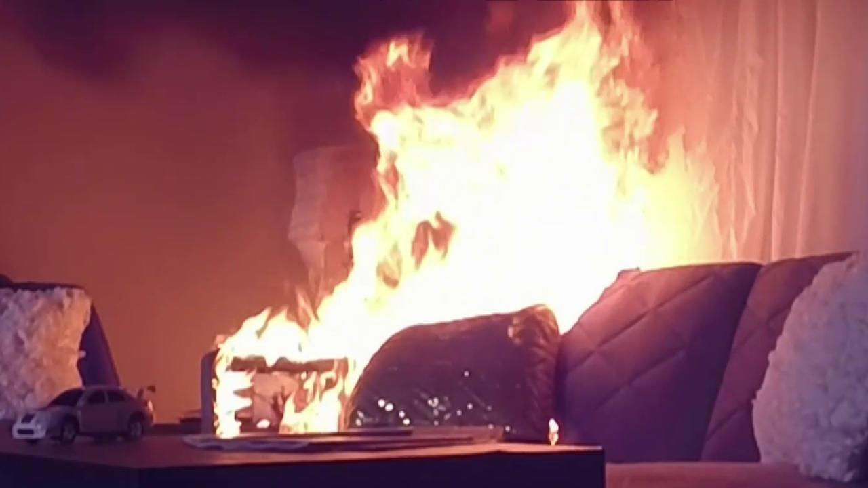
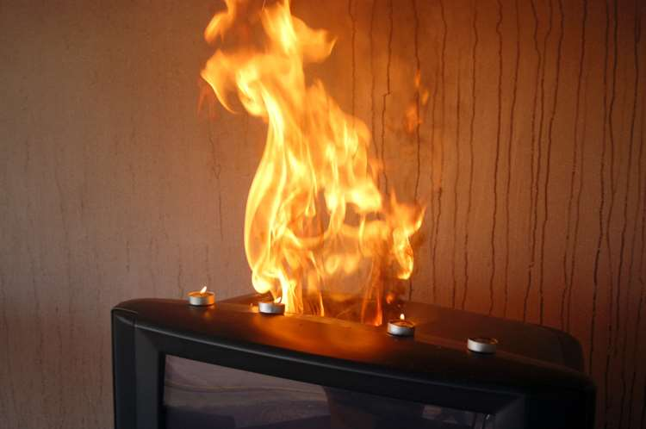
Candles

Slide 22
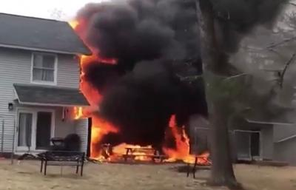
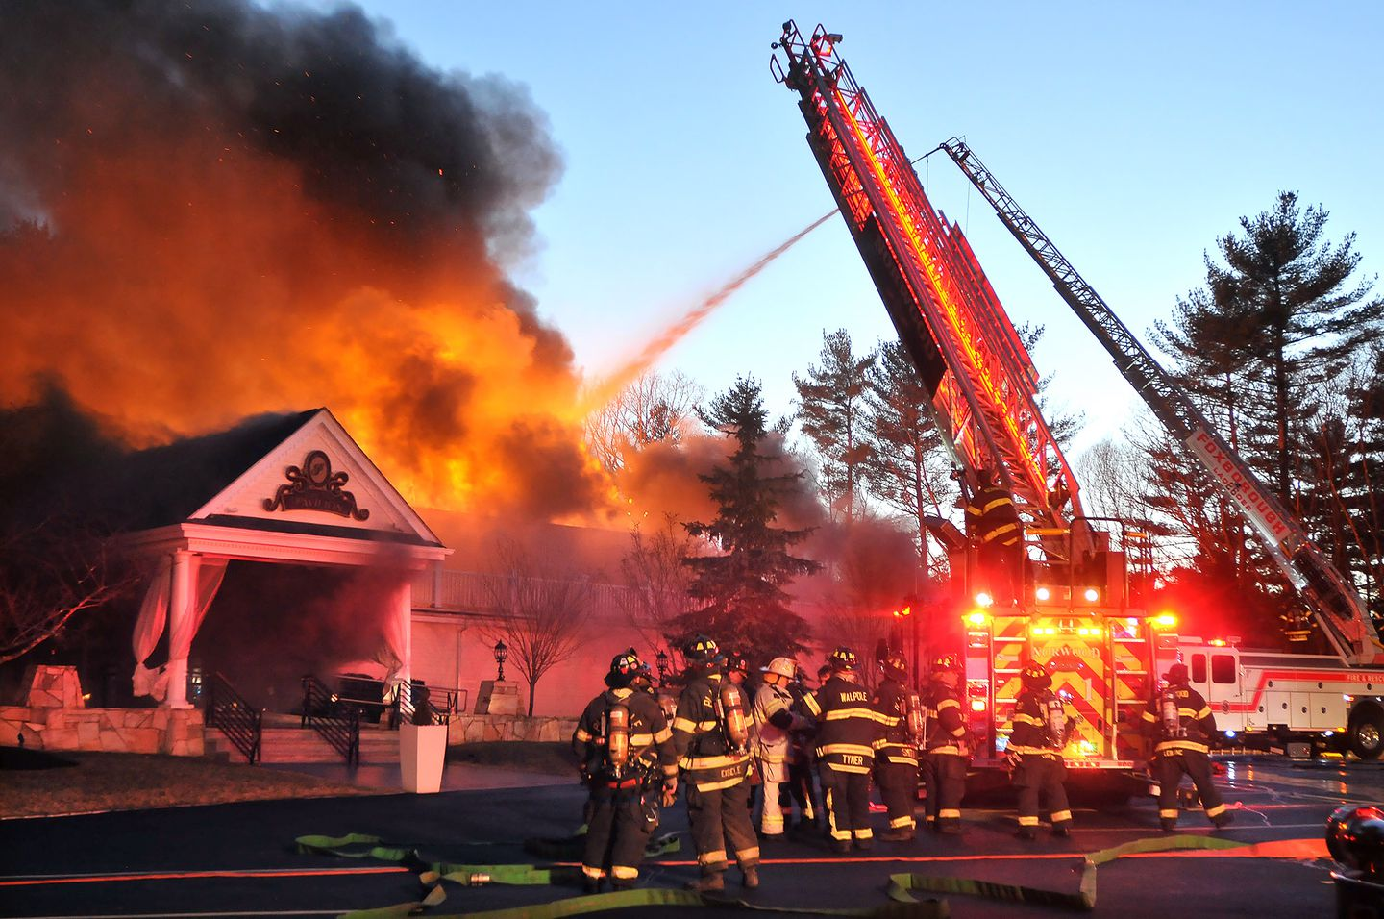
Careless Smoking

Slide 23
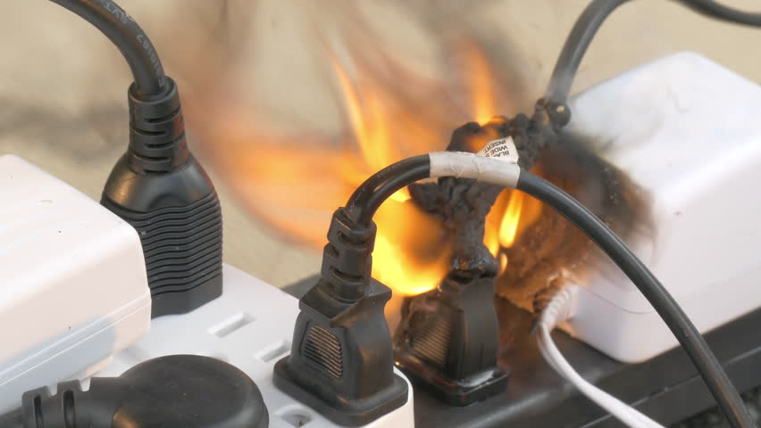
Overloading Outlets

Slide 24
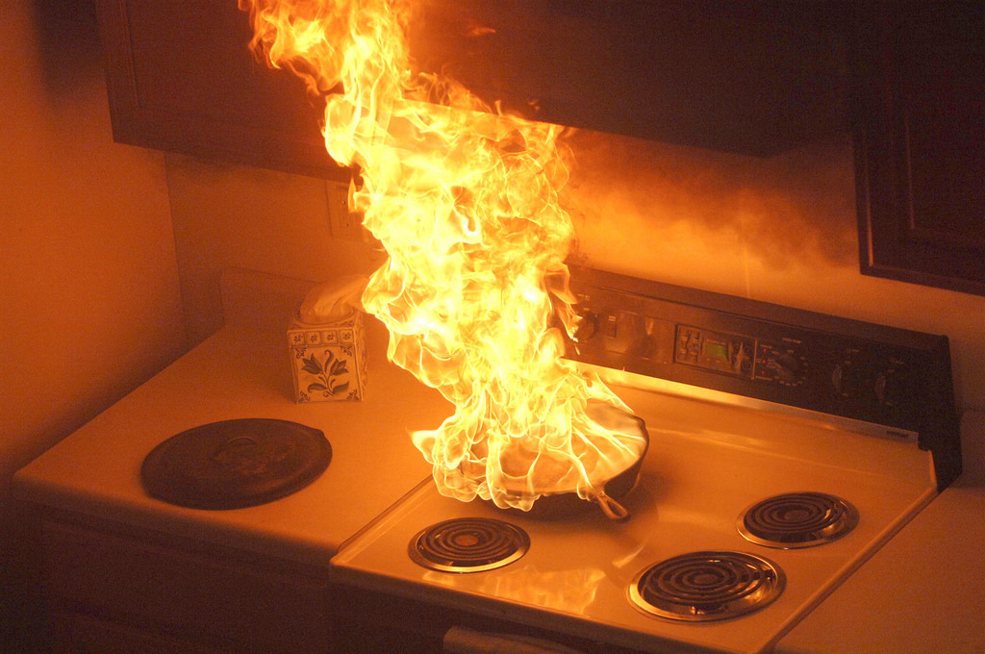
Unattended Cooking

Slide 25
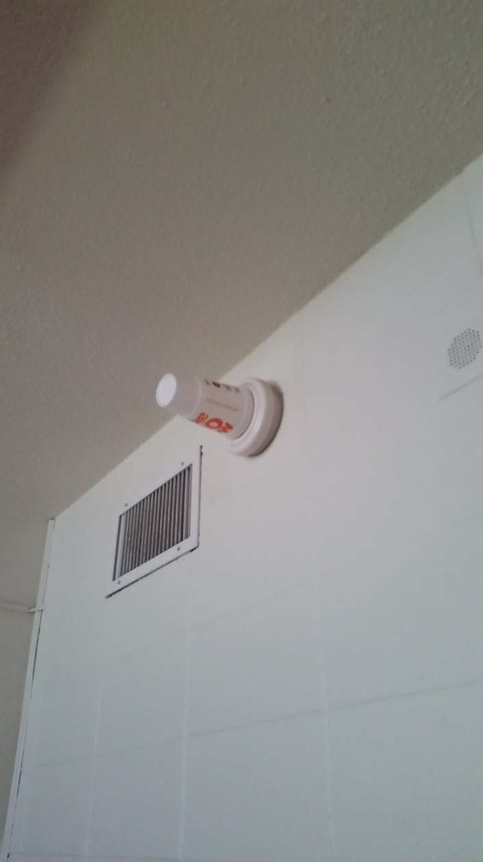
Fire Prevention
Smoking (including hookahs and vapes) is prohibited in all University buildings including residence halls and apartments.
Tampering with fire protection equipment is strictly prohibited and is considered a Class 1 Misdemeanor.
Fine of up to $2500 and/or 12 months in jail.
Cooking is allowed in kitchens and other approved locations only.
Refer to Housing & Residence Life Policies & Procedures Manual for more information.

Slide 26
Nuisance Alarm Prevention #1 Cause: Burned Food or Hairstyling
Cooking
Turn on range hood fans
Don’t leave food unattended when preparing on range or in microwave
Follow directions on packaging (ever smell burned popcorn?)
Hairstyling
Use exhaust fans in restrooms
Don’t stand directly under smoke detectors when styling hair

Slide 27
False Fire Alarms
Any student or person found responsible for causing a false fire alarm will fully be expelled from the University and/or prosecuted of the law.
Class 1 Misdemeanor Penalties
Fine of up to $2500 and/or 12 months in jail

Slide 28
Fire Watch Form

Slide 29
Fire Watch Log

Slide 30
Fire Watch Signage

Slide 31
Reporting a Fire
Dial 757-683-4000 or 911
If the fire alarm system is activated, you should always call campus police from a safe location
Norfolk Fire/Rescue are our First Responders. They will be responding to all fire alarms
Campus police will also be responding

Slide 32
Fire Safety Awareness
Don’t be complacent! SOUND THE ALARM!
If an alarm is activated……..Don’t ignore it!
Listen for public address announcements and directions. Do NOT USE ELEVATORS, unless instructed to do so.
Public Safety personnel will use the public address system to let you know if there is an actual fire or smoke condition.
If the fire alarm sounds, proceed to your door and check it for heat with the back of your hand.
If the door is HOT, do not open it.

Slide 33
Fire Safety Awareness cont.
If there is heavy smoke in the hallway, stay in the room and pack towels and blankets under your door to keep smoke out of your room.
Call 911 and notify dispatcher that you can not evacuate and what room number you are in.
If able to evacuate, follow the directions from your Building Emergency Coordinator.
Look out for your neighbor, bang on doors while evacuating and/ or assist anyone in need if you can safely do so.

Slide 34
Fire Safety Awareness cont.
Know where your nearest exit stairways are so you can locate them even in the dark.
Establish a “buddy system” with your neighbor or roommate.
Go to your Emergency Evacuation Area so the Building Emergency Coordinator can have a proper head count.

Slide 35
If a Fire Occurs
R-RESCUE- someone who needs help.
A-ALARM- alert everyone in the building.
C-CONFINE- the fire by shutting door or using a fire extinguisher.
E-EVACUATE OR ESCAPE- the building.

Slide 36
Evacuation Procedures
You must assume there is an emergency any time the fire alarm sounds
Remain Calm – Don’t Panic - Act Quickly
Always close doors behind you
If smoke is encountered during egress, crawl – the air is cooler & less toxic near the floor
Call ODU Public Safety – 757-683-4000 or 911

Slide 37
Evacuation Procedures cont.
Go to the nearest exit
Never use the elevator, go to the nearest stairwell
Report to the designated outside assembly area
Do not re-enter the building for any purpose until directed to do so by the proper authorities
Be available to assist emergency personnel as needed
FAILURE TO EVACUATE THE BUILDING FOR ANY REASON WILL RESULT IN DICIPLINARY ACTION AND POSSIBLE MONETARY FINES

Slide 38
Fire Extinguishing Policy
It is the desire of the University that you leave the fire fighting to the professionals. We have no problem with a person attempting to extinguish a small fire or using an extinguisher to clear your way to an exit if needed. Our primary concern is YOUR safety.
If an emergency situation arises when you need to use a fire extinguisher, you must notify your RA or Staff member immediately after the incident.Other notifications must include ODU Police and notify Maintenance Direct.

Slide 39
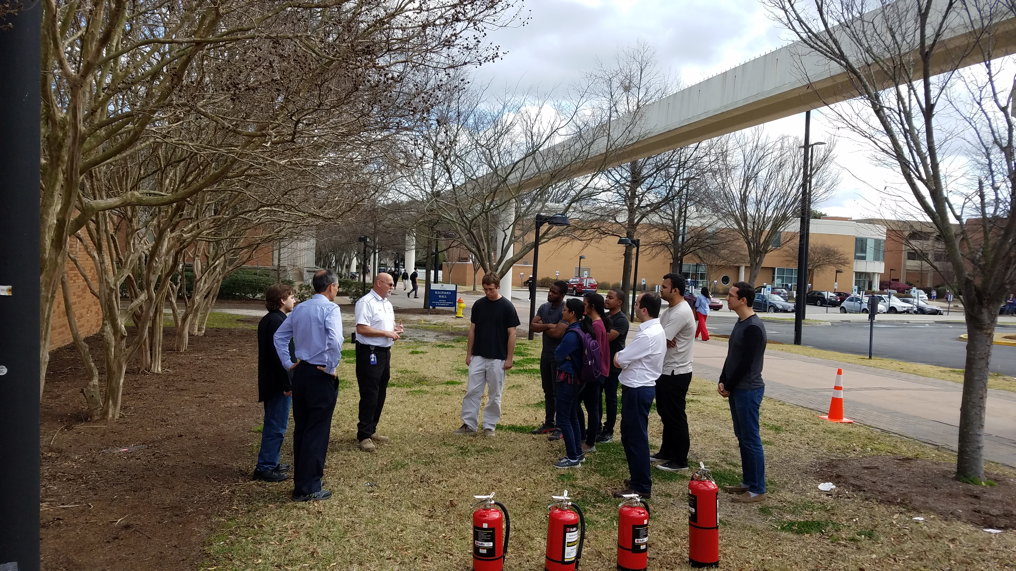
Proper use of a Portable Fire Extinguisher
P-PULL THE PIN
A-AIM THE NOZZLE AT THE BASE OF THE FIRE
S-SQUEEZE THE HANDLE
S-SWEEP THE NOZZLE SIDE TO SIDE

Slide 40
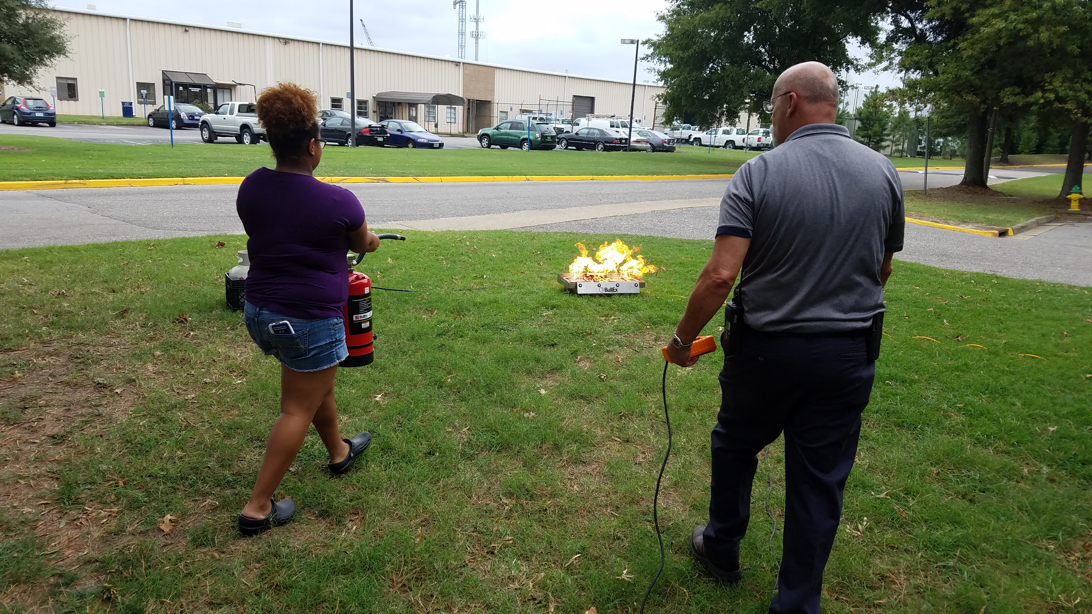
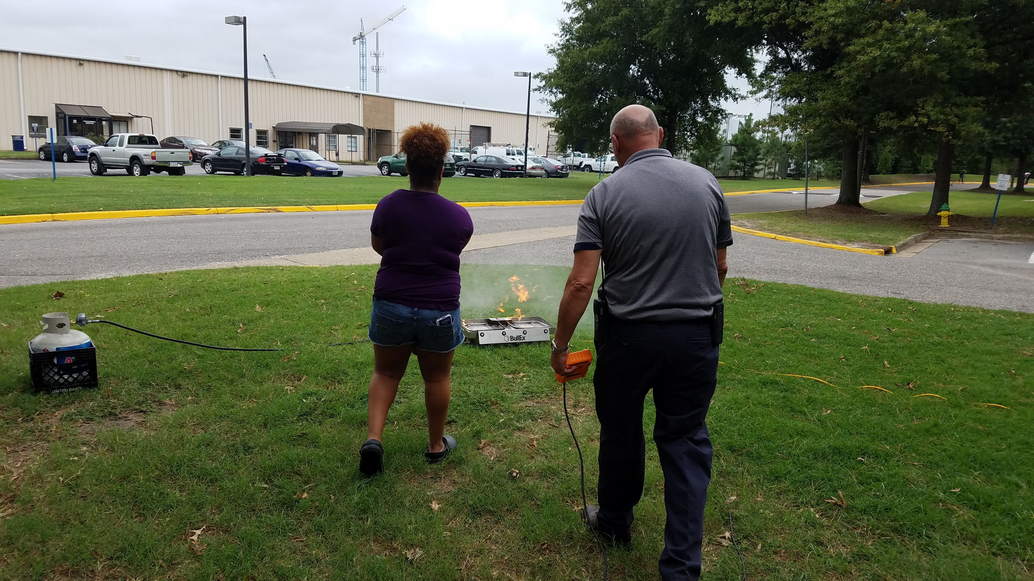
Previous RA Training

Slide 41
Fire Safety is Everyone’s Concern
Please Be safe and Think Smart

Slide 42
Closing
Please feel free to contact Old Dominion University Fire Prevention Bureau and/or Emergency Management for any questions, comments, or concerns. Thank you for your time and attention to this very important matter.

Slide 43
Contact Information
Fire Prevention Bureau - 757-683-5166
Greg Wooldridge
Fire Prevention Manager
757-683-3023
gwooldri@odu.edu
Karen Barnes
Fire Prevention Inspector
757-683-4087
kmbarnes@odu.edu
Emergency Management - 757-683-5116
Jared Hoernig
Director Emergency Mgmt.
757-683-35116
jhoernig@odu.edu
Jerry Reed
Emergency Planner
757-683-3109
j1reed@odu.edu

