Slide 1

Graduate Student Orientation:
The University Libraries
Are Here for You
August 2021
Notes:
Welcome to Old Dominion University Libraries. As you begin your graduate studies here at ODU, we want you to know that the Libraries offer access to a rich array of resources and expert services designed for your success. This presentation provides an overview of what we offer and tells you how you can get the support you need from the Libraries.

Slide 2
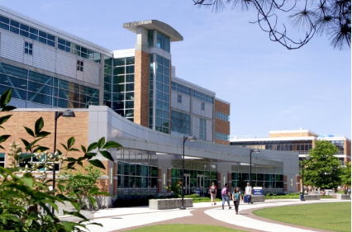
Three locations
  Perry Library = main library
  Two branch libraries:
    Music and Art
Patricia W. and J. Douglas Perry Library
F. Ludwig Diehn Composers Room
Elise N. Hofheimer Art Library
Multiple resources
books, journals, scores, recordings, digital collections, online journals, e-books, streaming media, special collections relating to Virginia and Tidewater History, University archives …
Notes:
ODU Libraries include our main library, the Perry Library, and two specialized libraries for music and art. We offer a large and comprehensive collection of books, journals, musical scores, recordings, and more, along with extensive digital collections, online journals, e-books, streaming media, and other electronic resources in wide-ranging fields of research. We also have special collections relating to Virginia and Tidewater History, and we house the University archives. https://www.odu.edu/library

Slide 3
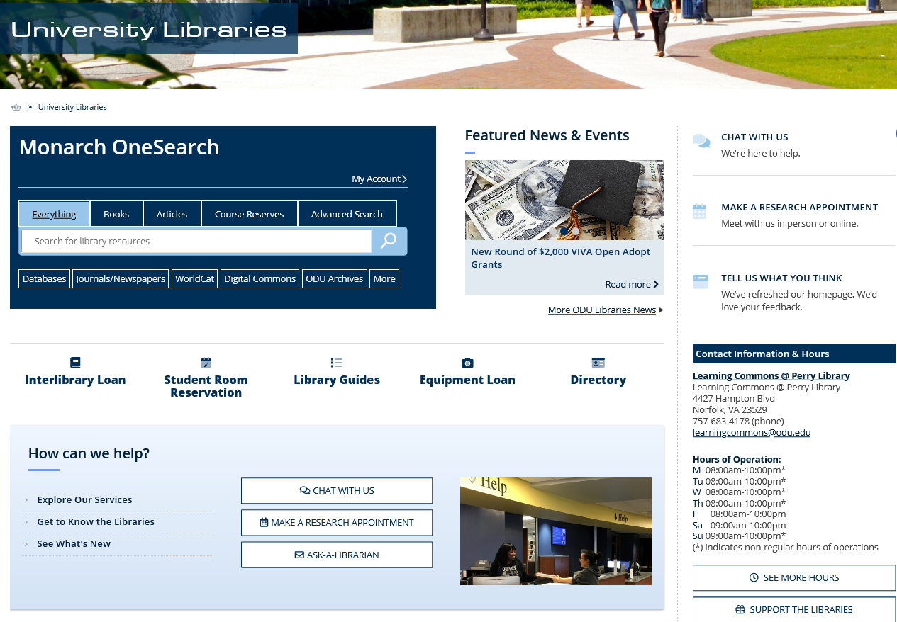
Libraries Web Site
Use Monarch OneSearch for books and other physical materials, and for many journal articles, streaming media and other electronic resources
For Subject-Specific Research Tools
  Databases
  Library Guides (by subject)
  Google Scholar
  (configure for ODU resources)
Notes:
All of these resources are available from our Web Site.
On our webpage, Monarch OneSearch is the place to search for books and other print materials we own, and it can help you find many but not all journal articles, streaming media, and other electronic resources.
As you advance in your graduate studies, you will need to familiarize yourself with the specialized peer-reviewed literature in your discipline and know which databases scholars use to locate these resources. ODU Libraries subscribes to a large number of research databases covering all of our disciplines, and many of them include full text. These can be found through our Databases A to Z link on the Libraries’ website http://guides.lib.odu.edu/az.php.
We know that many students also use Google Scholar to search for research in their field. Check with the Libraries to find out how to configure Google Scholar so it directs you to resources owned by ODU Libraries.

Slide 4
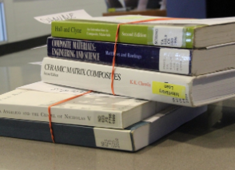



Access to more resources
Use Interlibrary Loan & Document Delivery
  Fast
  Efficient
  Easy to use
  Free
Notes:
You aren’t limited to resources that we have at ODU. ODU Libraries offer our students and faculty an interlibrary loan service that is fast, efficient, easy to use, and free to you as a student https://www.odu.edu/library/services/interlibrary-loan. ODU Libraries is a member of the Virtual Library of Virginia, a network of more than 70 college and university libraries in Virginia that encompass truly outstanding collections, and if we don’t have what you need here at ODU or in Virginia we can obtain books and journal articles for you from libraries all over the world. Books are delivered to Perry Library for pick-up or can be mailed to you if you are learning remotely. Journal articles are delivered to you electronically through your interlibrary loan account. You’ll be surprised at how quickly you receive most items you request.

Slide 5
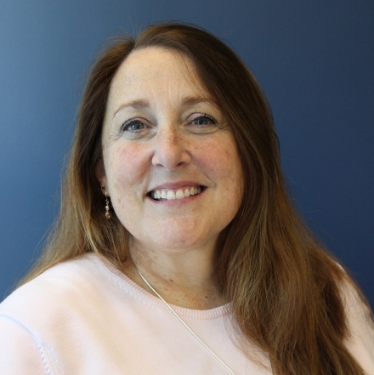
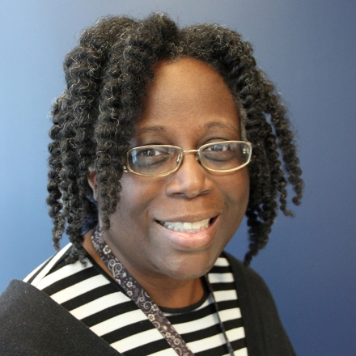
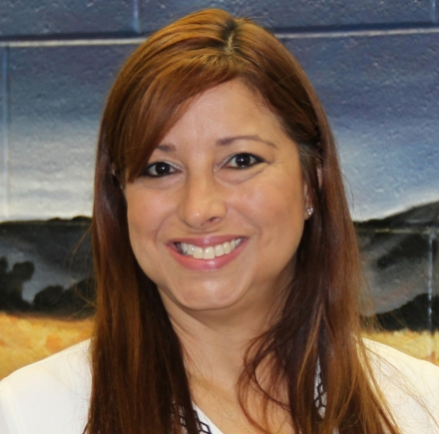
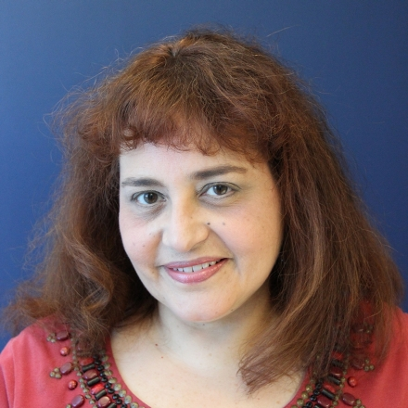
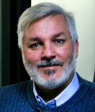
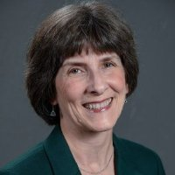
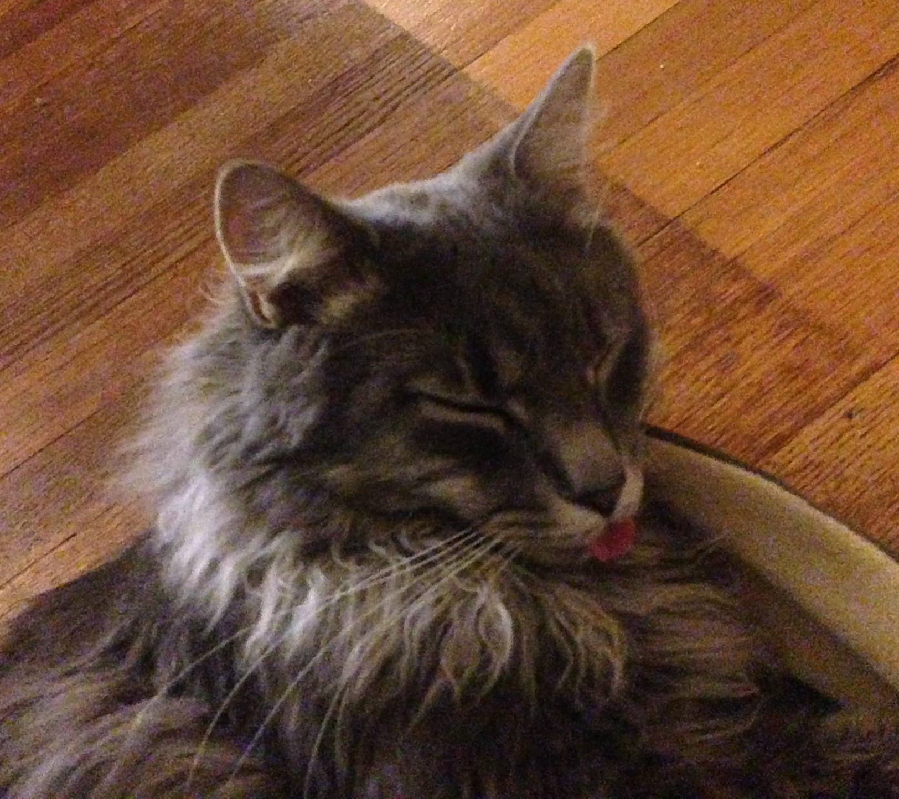
We’re here to help
Contact us
Chat
Email
Phone
Research
Consultation
Abbie Basile
Engineering/Phys Sci
Miriam Bridges
Business
Karen Centeno
Education
Elizabeth Hogue
Arts & Humanities
Joleen McInnis
Health/Life Sci
James Rhoades
Social Sciences
Dot Lockaby
Head, Liaison Svcs.
Notes:
Most importantly, the Libraries offer People who can help you. Any librarian or staff member in the ODU Libraries is ready and willing to help, but the Libraries offer subject specialist liaison librarians who are assigned to specific colleges and departments to offer expertise in the literature of your discipline. It would be to your advantage to contact your liaison librarian, who will be able to help you throughout your graduate research process. https://www.odu.edu/library/help/librarians

Slide 6
Liaison librarians can help you:
Use databases and other research tools
Devise search strategies
Identify key concepts, authors, and keywords
Manage research citations
Use appropriate citation style
Locate and request articles and books
Find research guides to help you navigate the research process
Notes:
By contacting a liaison librarian, you can:
Schedule a one-on-one consultation session with the librarian who supports your department
Get help identifying and using databases and other research tools specific to your discipline
Get advice on search strategies and identify key concepts to conduct literature searches
Receive tips on managing your research citations, using the appropriate citation style, and obtaining articles and books
Learn about research guides prepared by ODU librarians to help you navigate the research process http://guides.lib.odu.edu/sb.php?subject_id=97191

Slide 7

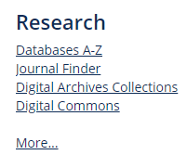
Other research services
Citation management
with EndNote
Electronic Theses and Dissertations in
Digital Commons
Use scholarly communication & publishing services:
  get an ORCID ID, which differentiates you from every other researcher
  learn about data management planning
  avoid predatory journals and conferences
  get answers to your copyright questions
Notes:
The Libraries also offer other services to support your research.
EndNote Citation Management Software is a powerful tool for organizing and managing your research references. Old Dominion University has a site license for EndNote that you can use as a benefit of your status as an ODU student, and it will be very useful as you prepare to write your thesis or dissertation. The Libraries offer workshops to help you make the most of EndNote’s features and you can register for these through the Libraries whenever you are ready. https://guides.lib.odu.edu/endnote.
It’s never too early to think about your dissertation or thesis. Since 2016, the university’s official copy is available in ODU Digital Commons, our institutional repository. You can go there to view dissertations and theses produced by graduate students in your department.
The Libraries can also help with scholarly communication issues. We recommend getting an ORCID ID early in your scholarly career – the ID attaches to all of your scholarly work and differentiates you from every other researcher. We can help you with devising data management plans, handling publishing issues, avoiding predatory journals and conferences, and understanding copyright.

Slide 8
We want you to remember -
Expertise
Resources
Portal to the world of scholarly information
We’re here and ready to help
www.odu.edu/library
Notes:
We want you to know that ODU Libraries have the expertise and resources to support your graduate work. We are your portal to the world of scholarly information. Visit us or contact us at https://www.odu.edu/library and we’ll help you on your way to academic success.

