Slide 1
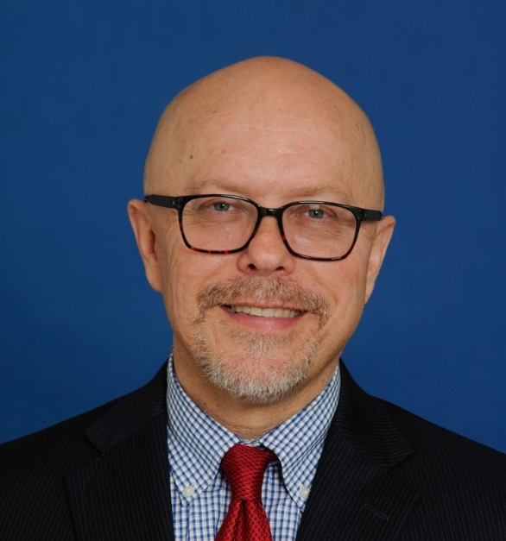
Keys to Graduate Academic Success
Robert Wojtowicz, Ph.D.
Vice Provost & Dean of the Graduate School
2102 Monarch Hall I 757-683-3085 l rwojtowi@odu.edu
This is Robert Wojtowicz, vice provost and dean of the Old Dominion University Graduate School. I’ll conclude this Graduate Student Orientation with some keys to ensuring your graduate academic success.
Notes:
This is Robert Wojtowicz, vice provost and dean of the Old Dominion University Graduate School. I’ll conclude this Graduate Student Orientation with some keys to ensuring your graduate academic success.

Slide 2
The Graduate School
Overview
Policies & Procedures
I’ll begin with a general overview of the University’s graduate profile and proceed to a discussion of several pertinent graduate policies and procedures.
Notes:
I’ll begin with a general overview of the University’s graduate profile and proceed to a discussion of several pertinent graduate policies and procedures.

Slide 3
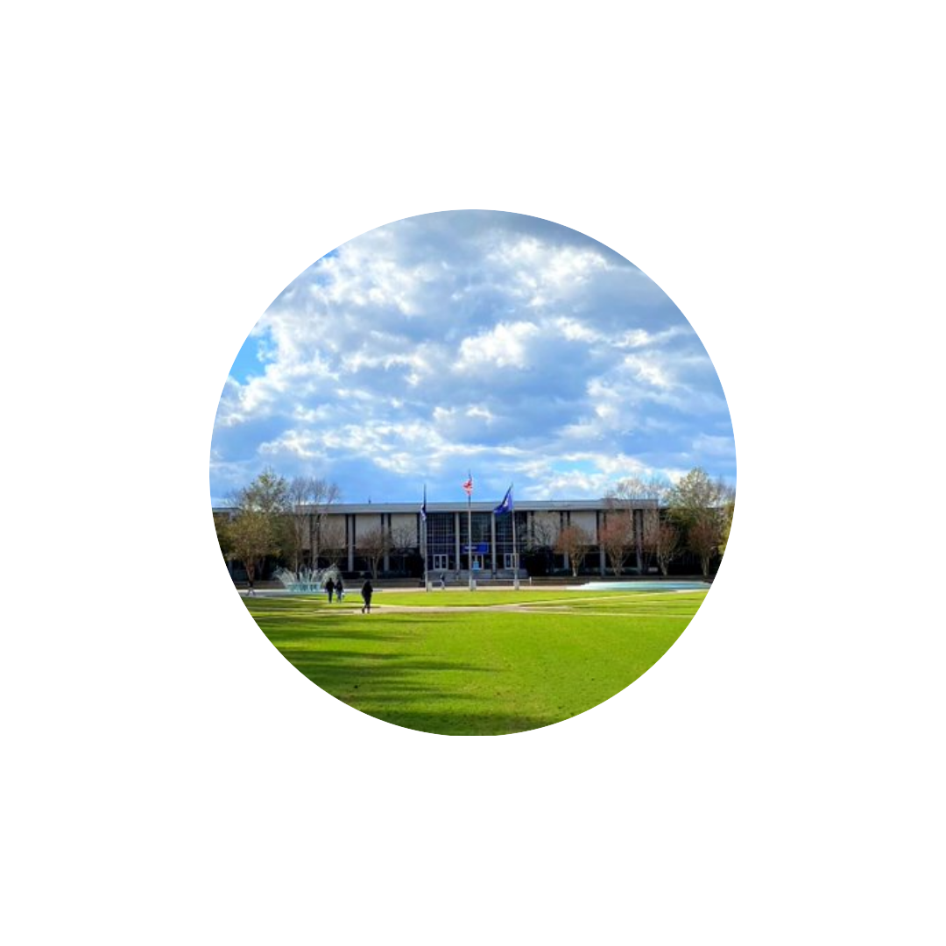
First, an overview.
Notes:
First, an overview.

Slide 4
Old Dominion University At a Glance
Carnegie Classification
Doctoral Universities: Very High Research Activity (R1) – January 2022
Research Doctoral: Comprehensive Programs, no medical and/or veterinary school
Enrollments
(Fall 2021 official census)
23,494 students overall with 18,678 classified as undergraduate and 4,816 as graduate
Elective Classification for Community Engagement – January 2020
Research universities in the United States are ranked by the Carnegie Commission on Higher Education. Old Dominion University’s Carnegie Research classification is comprehensive, very high research activity – what’s commonly known as R1. At the last official census taken in fall 2021, just over 4,800 graduate students were enrolled out of a total student population of more than 23,000.
Notes:
Research universities in the United States are ranked by the Carnegie Commission on Higher Education. Old Dominion University’s Carnegie Research classification is comprehensive, very high research activity – what’s commonly known as R1. At the last official census taken in fall 2021, just over 4,800 graduate students were enrolled out of a total student population of more than 23,000.

Slide 5
Graduate Education - I
Degree and Certificate Offerings*
22 Doctoral Degrees
2 Education Specialist Degrees
45 Master’s Degrees
50+ Graduate-Level Certificates and Licenses
* Not including concentrations
Old Dominion University offers 22 doctoral degrees, 2 education specialist degrees, 45 master’s degrees, and more than 50 graduate-level certificates and licenses.
Notes:
Old Dominion University offers 22 doctoral degrees, 2 education specialist degrees, 45 master’s degrees, and more than 50 graduate-level certificates and licenses.

Slide 6
Graduate Education – II
Degrees Conferred – 2020-2021
Master’s – 980
Education Specialist – 44
Doctoral – 233
During the 2020-2021 academic year, the University conferred 980 master’s degrees, 44 education specialist degrees, and 233 doctoral degrees.
Notes:
During the 2020-2021 academic year, the University conferred 980 master’s degrees, 44 education specialist degrees, and 233 doctoral degrees.

Slide 7
Graduate Education – III
The Graduate School
College of Arts & Letters
Strome College of Business
Batten College of Engineering & Technology
College of Sciences
College of Health Sciences
Darden College of Education & Professional Studies
The Graduate School works collaboratively with the six colleges and two schools to ensure quality graduate education.
School of Data Science
School of Cybersecurity
Notes:
The Graduate School works collaboratively with the six colleges and two schools – Arts & Letters, Business, Education & Professional Studies, Engineering & Technology, Health Sciences, and Sciences, as well as the Schools of Cybersecurity and Data Science – to ensure quality graduate education.

Slide 8
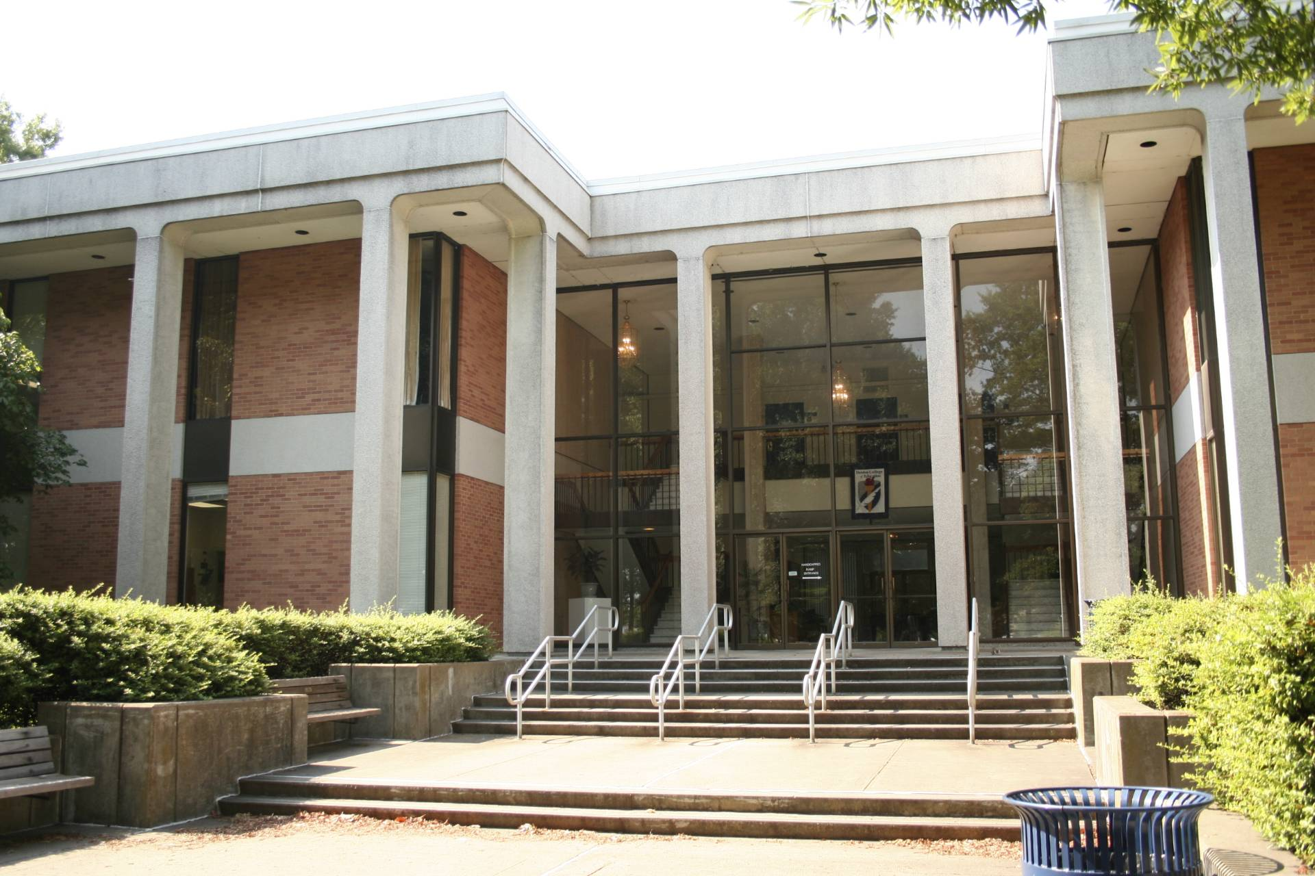
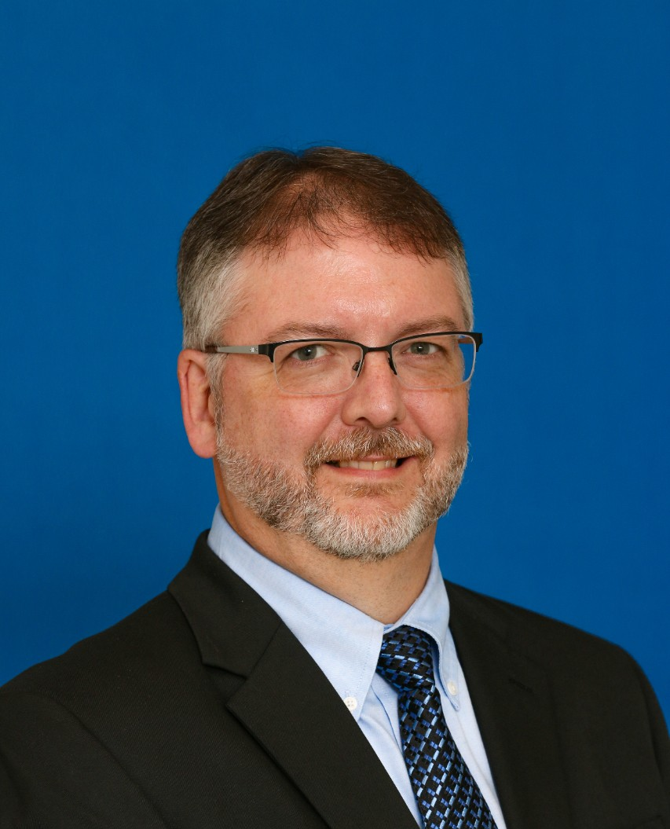
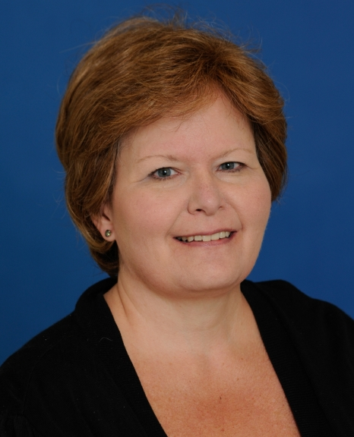
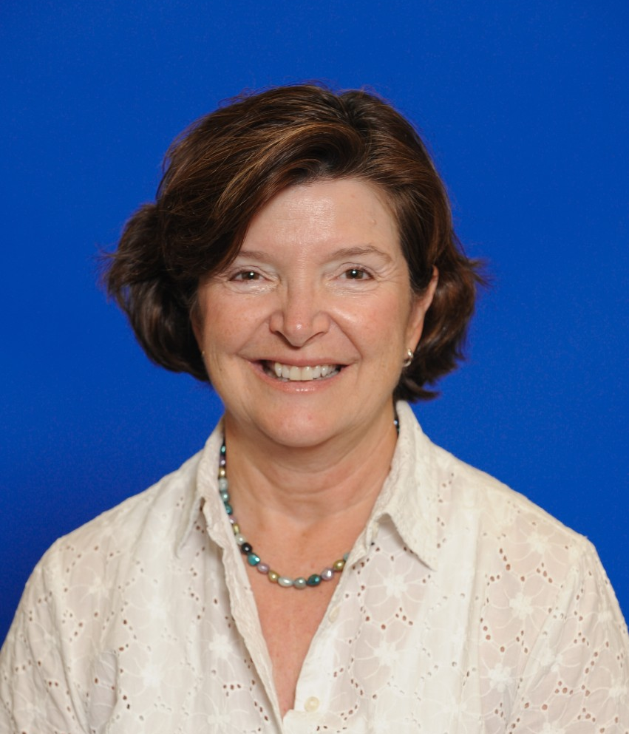
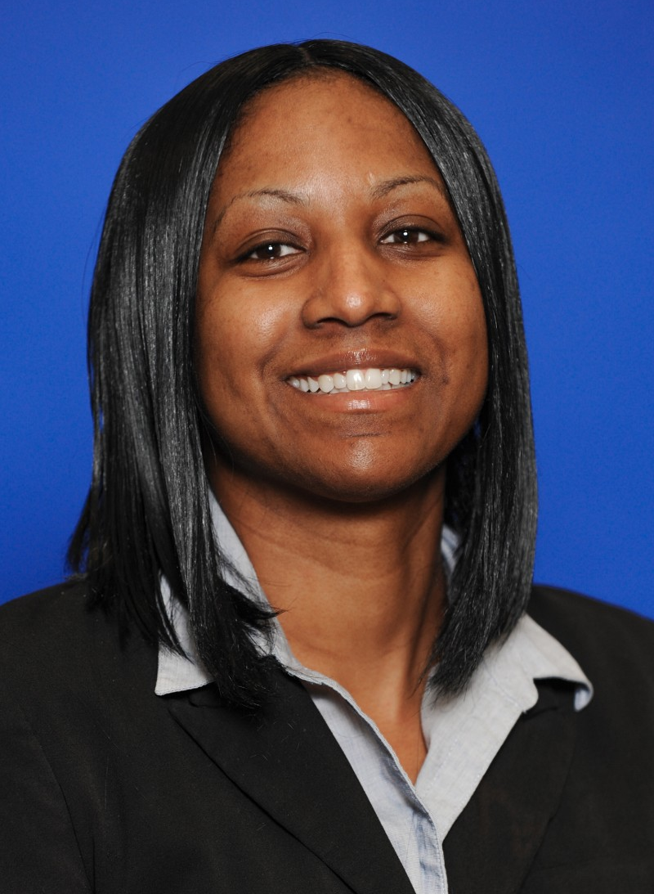
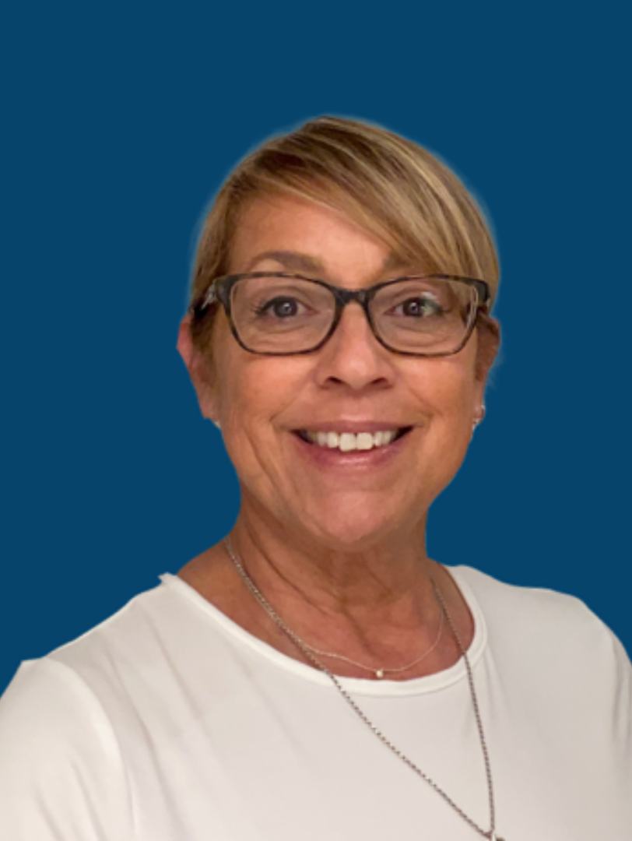
Graduate Education – IV
Robert Wojtowicz
Vice Provost & Dean
Bryan Porter
Associate Dean
Missy Barber
Associate Director for Administration & Academic Services
Liz Smith
Director Interdisciplinary Initiatives
Genny Conwell
Coordinator of Graduate Interdisciplinary Programs & Executive Assistant
Liza Flores
Administrative Assistant
Notes:
The Graduate School staff stands ready to assist you during the upcoming academic year: Bryan Porter, Associate Dean; Missy Barber, Associate Director for Administration & Academic Services; Liz Smith, Interdisciplinary Initiatives Administrator; Genny Conwell, Coordinator of Graduate Interdisciplinary Programs & Executive Assistant; Liza Flores, Administrative Assistant; and yours truly.

Slide 9
Now on to pertinent graduate Policies and Procedures.
Notes:
Now on to pertinent graduate policies and procedures.

Slide 10
Student Status
Degree-Seeking: Students who have been formally admitted into a degree program.
Non-Degree-Seeking: Students who have not been formally admitted into a degree program, including those who are pursuing a certificate or licensure program.
For registration purposes, graduate students are divided into two broad categories: degree-seeking students are those who have been formally admitted into a degree program; non-degree-seeking students are those who have not been formally admitted into a degree program, including those who are pursuing a certificate or license.
Notes:
For registration purposes, graduate students are divided into two broad categories: degree-seeking students are those who have been formally admitted into a degree program; non-degree-seeking students are those who have not been formally admitted into a degree program, including those who are pursuing a certificate or license.

Slide 11
Continuance – I
Circumstances whereby a student may continue graduate study or may be placed on probation or suspension.
Applies to ALL students who enroll in graduate courses.
Provides the minimum standards for students to continue their graduate study; some degree programs may have higher standards.
Continuance is a policy that refers to the circumstances whereby a student may continue graduate study or may be placed on probation or suspension. It applies to ALL students who enroll in graduate courses, and it provides the minimum standards for students to continue their graduate study; some degree programs may have higher standards for continuance.
Notes:
Continuance is a policy that refers to the circumstances whereby a student may continue graduate study or may be placed on probation or suspension. It applies to ALL students who enroll in graduate courses, and it provides the minimum standards for students to continue their graduate study; some degree programs may have higher standards for continuance.

Slide 12
Continuance – II
All courses count in the cumulative GPA calculation.
All grades stay on the academic record.
Records are reviewed at the end of each semester, and those students who have not maintained a 3.0 GPA are placed on probation.
Notes:
All courses count in a student’s cumulative GPA calculation, and all grades stay on a student’s academic record. Records are reviewed at the end of each semester, and those students who have not maintained a 3.0 GPA are placed on probation.

Slide 13
Continuance – III
Degree-seeking students have 12 credits from the time they fall below a 3.0 GPA to return to good academic standing.
Non-degree-seeking students have 6 credits from the time they fall below a 3.0 GPA to return to good academic standing.
Degree-seeking students have 12 credits from the time they fall below a 3.0 GPA to return to good academic standing, whereas non-degree-seeking students have only 6 credits.
Notes:
Degree-seeking students have 12 credits from the time they fall below a 3.0 GPA to return to good academic standing, whereas non-degree-seeking students have only 6 credits.

Slide 14
Continuance – IV
If the 3.0 GPA is not attained within the allotted time, the student will be suspended.
When applicable, a student’s assistantship may be terminated if the GPA falls below 3.0.
If the 3.0 GPA is not attained within the allotted time, the student will be suspended. When applicable, a student’s assistantship may be terminated if the GPA falls below 3.0.
Notes:
If the 3.0 GPA is not attained within the allotted time, the student will be suspended. When applicable, a student’s assistantship may be terminated if the GPA falls below 3.0.

Slide 15
Enrollment Policies
Master’s and Education Specialist Students
Must be enrolled in the semester of their graduation.
Doctoral Students
Must be enrolled continuously for at least 1 credit following their advancement to candidacy.
When it comes to registration, master’s and education specialist students must be enrolled in the semester of their graduation. Doctoral students must be enrolled continuously for at least 1 credit following their advancement to candidacy.
Notes:
When it comes to registration, master’s and education specialist students must be enrolled in the semester of their graduation. Doctoral students must be enrolled continuously for at least 1 credit following their advancement to candidacy.

Slide 16
Time Limits
Master’s, Education Specialist, and Doctoral Students – 8 years
If a degree is not completed within the eight-year time limit, a student’s courses will be subject to re-validation by examination.
All graduate students have eight years to complete their degrees. Those overstaying the time limit will have their courses subjected to re-validation by examination.
Notes:
All graduate students have eight years to complete their degrees. Those overstaying the time limit will have their courses subjected to re-validation by examination.

Slide 17
Helpful Hints
Consult regularly with your Graduate Program Director (GPD).
Take responsibility for monitoring your own academic progress.
Do NOT wait until it is too late; seek assistance early if you are having trouble.
Read and understand the policies in the Graduate Catalog.
Lastly, here are some helpful hints to ensure your graduate academic success: consult regularly with your graduate program director (GPD); take responsibility for monitoring your own academic progress; do NOT wait until it is too late – seek assistance early if you are having trouble in your program of study; and read and understand the policies contained in the Graduate Catalog.
Notes:
Lastly, here are some helpful hints to ensure your graduate academic success: consult regularly with your graduate program director (GPD); take responsibility for monitoring your own academic progress; do NOT wait until it is too late – seek assistance early if you are having trouble in your program of study; and read and understand the policies contained in the Graduate Catalog.

Slide 18
Thank you!
The Graduate School
Telephone: 757-683-4885
Email: graduateschool@odu.edu
Thank you and best wishes for a successful graduate school experience!
Notes:
Thank you and best wishes for a successful graduate school experience!

