Slide 1
Office of Counseling Services
1526 Webb Center
Norfolk, VA 23529
(757) 683-4401
Press option #1 for general requests/appointments,
Press option #2 for immediate assistance, 24-7

Slide 2
Services Offered through OCS
Individual Counseling (brief treatment model)
Group Counseling
Couples Counseling
Crisis Intervention
Psychiatric Services
Outreach & Workshops
All services are free and confidential!
Our staff consists of full-time mental health professionals, as well as graduate-level trainees.

Slide 3
How to Access Services
We are offering services through a hybrid model, including HIPAA-compliant Zoom and in-person.
Call our office at (757) 683-4401 & press option #1 to schedule an initial consultation appointment.
A front office staff member will schedule you for a date & inform you about the paperwork you’ll be required to fill out on the morning of your appointment.
In your initial consultation appointment, you & a counselor will talk to identify which service is best suited to meet your needs (i.e. group counseling, individual counseling, workshops, medication evaluation, referrals to other campus offices or organizations, etc.).

Slide 4
OCS Contact Information
Main Office: 757-683-4401
Press Option #1 to speak with a front desk staff member to schedule an appointment or with any general questions
Press Option #2 if you would like to speak with a counselor on the phone immediately, available 24-7 (urgent care counseling)
Our office is open:
Monday-Thursday: 8am-7pm
Friday: 8am-5pm
www.odu.edu/counselingservices
Instagram: @ODU_CounselingServices

Slide 5
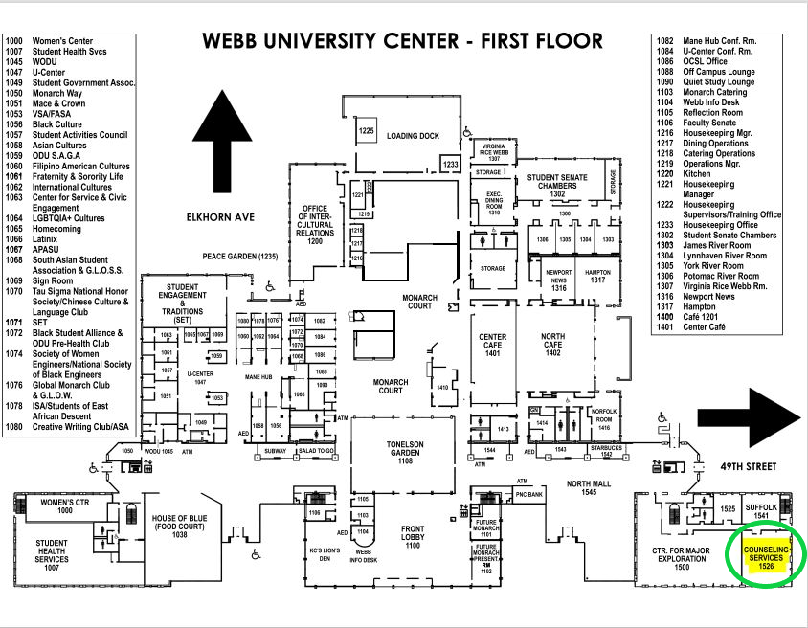
We are located here!
←

Slide 6
Resources for ODU Students

Slide 7
Who attends therapy?
Someone trying to learn more about themselves
Someone who wants to learn how to cope with their mental health concerns/symptoms
Someone who wants assistance achieving their goals
Someone who needs to process major life events
Someone who needs a person to listen to them without judgement
Therapy isn’t only for when you’re struggling, in crisis, or as a last resort. Therapy can be helpful to learn new skills, unlearn unhelpful behavior patterns, and become a healthier version of you. Anyone can attend therapy!!

Slide 8
It might be time to check up on your mental health if:
This will look different for everyone, but here are some general signs to look out for:
It’s suddenly hard to focus on work or school
Your hobbies & interests bore you
You have changes in appetite, sleep, and/or other behaviors
You are isolating yourself more
You experience irritability/mood changes

Slide 9
If you are feeling off, ask yourself:
-How am I spending my time?
-Am I taking care of myself?
-How am I treating/nourishing my body?
-Am I drinking enough water?
-Who am I spending time with?
-What thoughts do I entertain the most?
-What/who/where am I giving my energy?
-What am I watching/listening to?

Slide 10
General tips to improve mental wellness:
- Get enough sleep - Stretch & move your body
- Stay hydrated - Listen to your favorite music
- Exercise - Reach out to social supports
- Clean, clear, & declutter your environment - Track your emotions
- Eat well - Spend time in nature
- Utilize affirmations that resonate with you - Determine your goals & set your boundaries
- Try thought-dumping/writing out your thoughts - Don’t forget to breathe!

Slide 11
How to support a friend/partner who is struggling…
Listen nonjudgmentally
Use open-ended questions
Listen to understand, rather than respond
Ask them how you can help them to feel heard, validated, and supported
Let them know that you’re there for them & offer reassurance
Avoid sayings like “look on the bright side” or “just try to think positively” (while these statements may not have any bad intention, they could be invalidating for the person who is struggling)

Slide 12
Resources for Faculty/Staff
Having OCS contact information on hand and/or in syllabus (demonstrates acceptance, communicates openness, helpful for referral purposes)
Utilizing open communication & having good referral resources on hand
Listen to understand, rather than respond, when a student is in distress
Let students know they can talk to you when they are having issues (creates safety & trust)
Have additional supportive office numbers/information on hand and readily available
ODU’s Student Outreach and Support (Dean of Students):
If faculty, staff, or fellow students are concerned about a student’s well-being, you can report this concern to Student Outreach and Support via the web: Dean of Students Student Outreach & Support - Old Dominion University (odu.edu)
757-683-3442
SOS will follow-up with the student, provide additional care and support, and connect the student to appropriate resources & referrals

Slide 13
Mental Health Resources
ODU Counseling Services: 757-683-4401
Press 1 to schedule an appointment
Press 2 to speak with a counselor immediately
Find a tele-provider for mental health:
https://www.psychologytoday.com/us/psychiatrists/online-counseling/virginia
National Suicide Prevention Lifeline: 1-800-273-TALK (8255)
Crisis Text Line: Free counseling via text messaging
Text ‘’HOME’’ to 741741 (https://www.crisistextline.org/)
The Steve Crisis Text Line: Offering support for students of color: Text STEVE to 741741

Slide 14
Mental Health Resources cont.
Norfolk Emergency Services performs pre-admission screening evaluations, provides short term crisis counseling services, & provides referrals and linkage on an emergency basis for individuals in the City of Norfolk: (757) 664-7690.
The Trevor Lifeline (Suicide Prevention for LGBT Youth): 866-4-U-TREVOR (1-866-488-7386)
National Sexual Assault Hotline: 24-Hour online hotline: https://ohl.rainn.org/online/ 1-800-656-HOPE (4673)
National Domestic Violence Hotline: 1-800-799-7233 or chat at www.thehotline.org or text LOVEIS to 22522
LGBTQ Life Center: (757) 640-0929

Slide 15
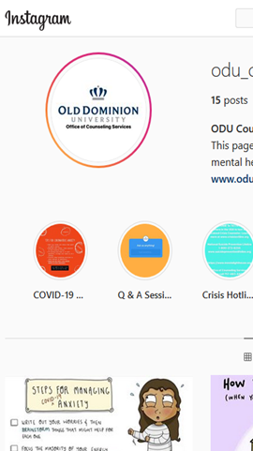
FOLLOW US ON SOCIAL MEDIA!
JOIN US ON INSTAGRAM! @ODU_COUNSELINGSERVICES
https://www.instagram.com/odu_counselingservices/

Slide 16
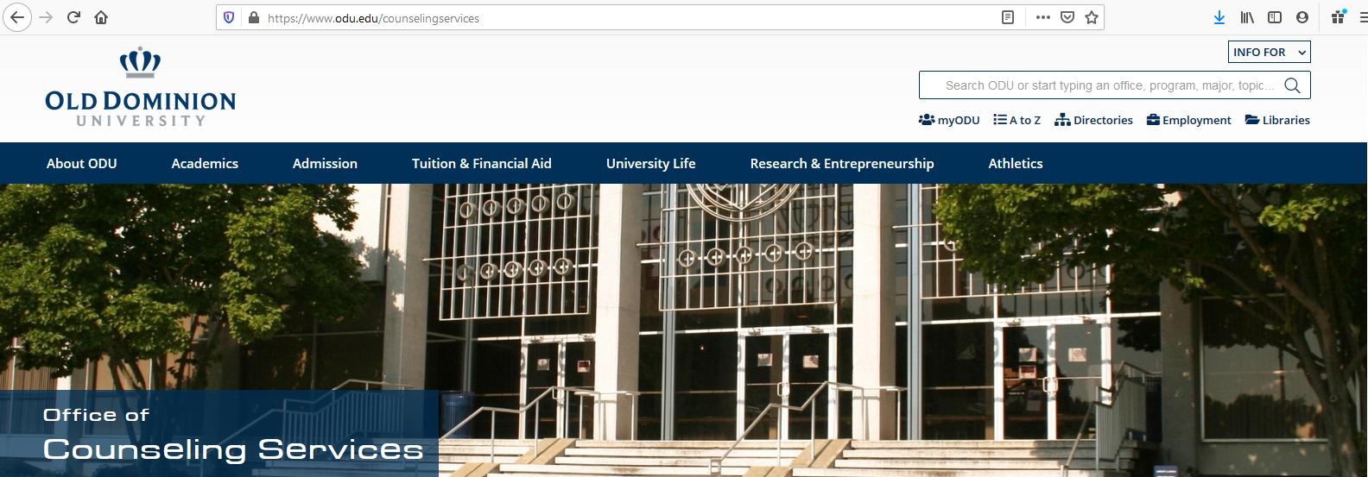
Visit our Website!
https://www.odu.edu/counselingservices

Slide 17
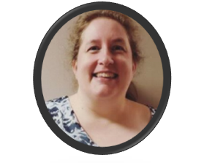
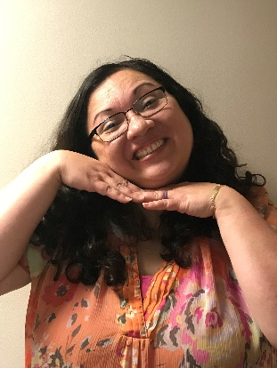
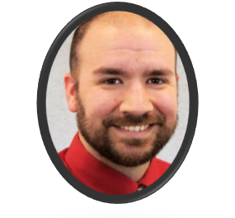
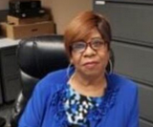
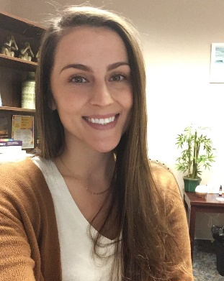
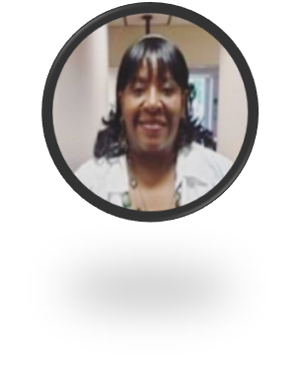
ODU’S Counseling Center Staff is excited to work with you! We are here for you and wish you all a safe & successful semester.

