Slide 1
Responsible Conduct of Research
Adam J. Rubenstein, Ph.D.
Assistant Vice President for Research Compliance

Slide 2
Training Requirement
“All graduate students who were admitted or readmitted to a degree or graduate licensure program as of fall 2010 must complete the Collaborative Institutional Training Initiative (CITI) basic course…
Completion of the RCR modules will be tracked through the CITI website and is a graduation requirement.
The RCR modules must be completed prior to completion of 12 semester hours..”
- Responsible Conduct of Research Policy, Graduate Catalog

Slide 3

Responsible Conduct of Research (RCR)
“The responsible conduct of research means the functioning of the research process meets the professional obligations of scientists and contributes to the perpetuation of science as a social institution held in high regard.”
Lawrence Rhodes, Office of Research Integrity

Slide 4
Shared Values*
Honesty – conveying information truthfully and honoring commitments
Accuracy – reporting findings precisely and taking care to avoid errors of omission and commission
Objectivity – letting the facts speak for themselves and avoiding improper bias.
Efficiency – using resources wisely, appropriately, and avoiding waste
*Introduction to the Responsible Conduct of Research, N. Steneck, ORI, 2004

Slide 5
RCR Core Elements
Human subjects
Animal subjects
Data acquisition, management, sharing, ownership
Publication practices/responsible authorship
Peer review
Mentor/trainee responsibilities
Conflict of interest/commitment
Collaborative science
Research misconduct

Slide 6

Satisfying the training requirement
Register for a CITI account at http://www.citiprogram.org

Slide 7
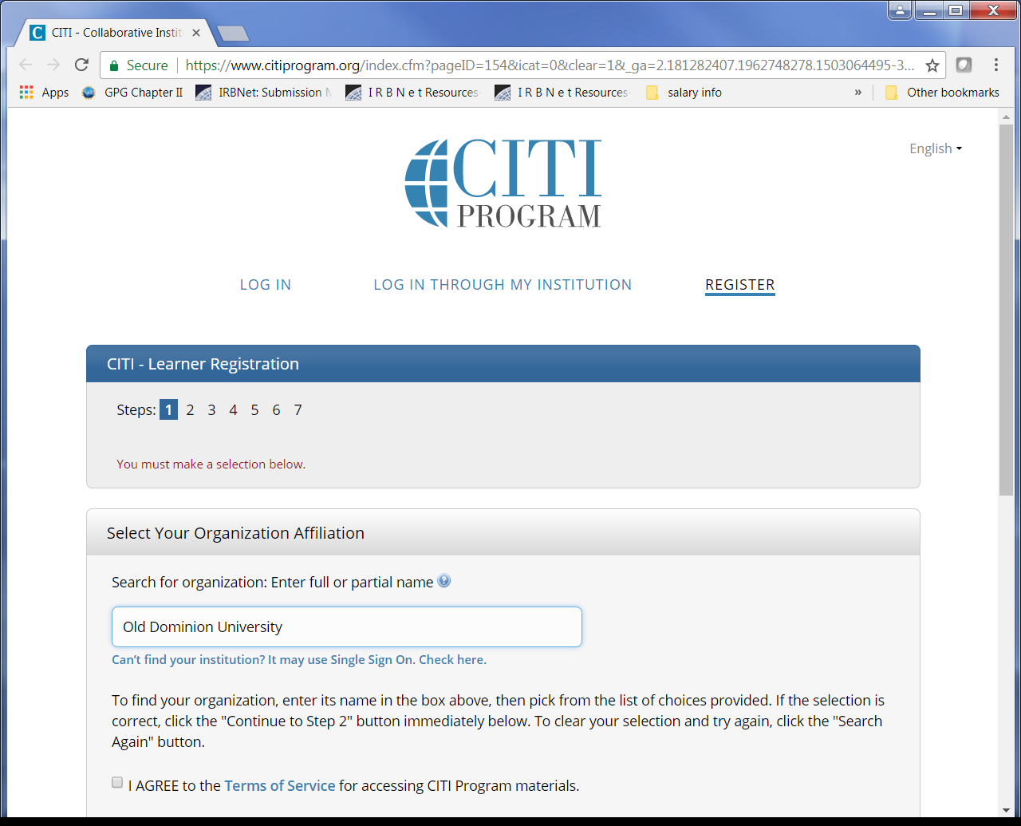
CITI Training
Affiliate with ODU!

Slide 8
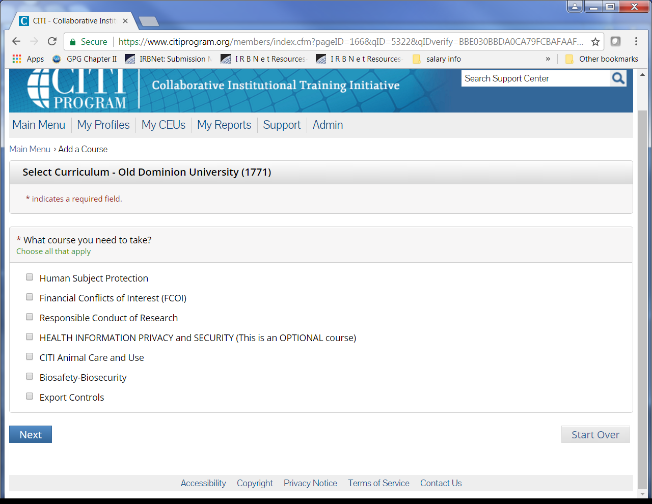
CITI Training
Select Responsible Conduct of Research

Slide 9
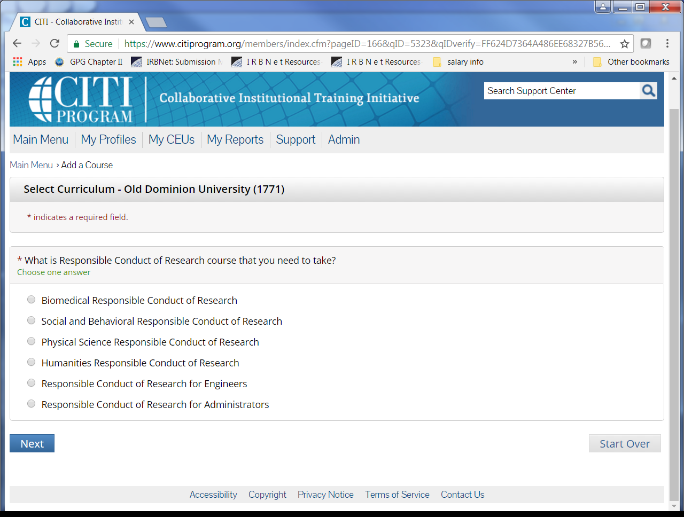
CITI Training
Select your RCR curriculum

Slide 10
CITI Training
Detailed instructions can be found online at http://www.odu.edu/impact/responsible-conduct-of-training
Complete the training at your own pace (allow for 3-4 hours)
Office of the University Registrar will be tracking completion of this requirement and typically updates your status within 24-48 hours of completion
Holds can only be lifted by the Registrar

Slide 11
Research Compliance
Conformance with Federal, State, and Local Regulations and University Policies
Protection of human subjects
Institutional Review Board (IRB)
Welfare of laboratory animals
Institutional Animal Care and Use Committee (IACUC)
Safe use of radioactive material &radiation-producing machines
Radiation Safety Committee (RSC)
Safe conduct of recombinant DNA research
Institutional Biosafety Committee (IBC)
Attention to safety and integrity issues
Export Controls
Conflict of Interest

Slide 12
Remember…
All researchers are expected to uphold the same standards of scientific integrity when conducting research
Be aware of Federal, State, Local, and Institutional regulations and guidelines
Ask questions

Slide 13
Resources
Office of Research – Research Compliance
http://www.odu.edu/research
Collaborative Institutional Training Initiative (CITI)
http://www.citiprogram.org/
Adam J. Rubenstein, Ph.D.
Assistant Vice President for Research Compliance
arubenst@odu.edu
757-683-3686
Danielle Dady, B.S.
Senior Research Compliance Coordinator
ddady@odu.edu
757-683-5451
Danielle Faulkner, B.S., CIP
Senior Research Compliance Coordinator
dcfaulkn@odu.edu
757-683-4636

