Slide 1
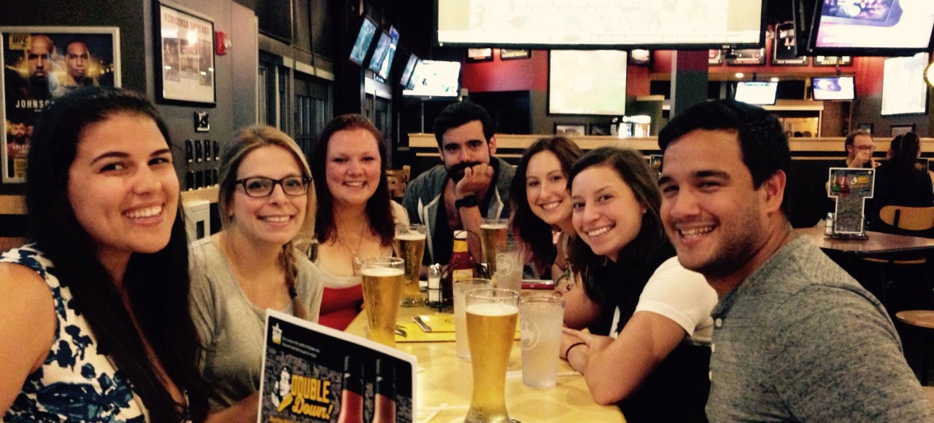
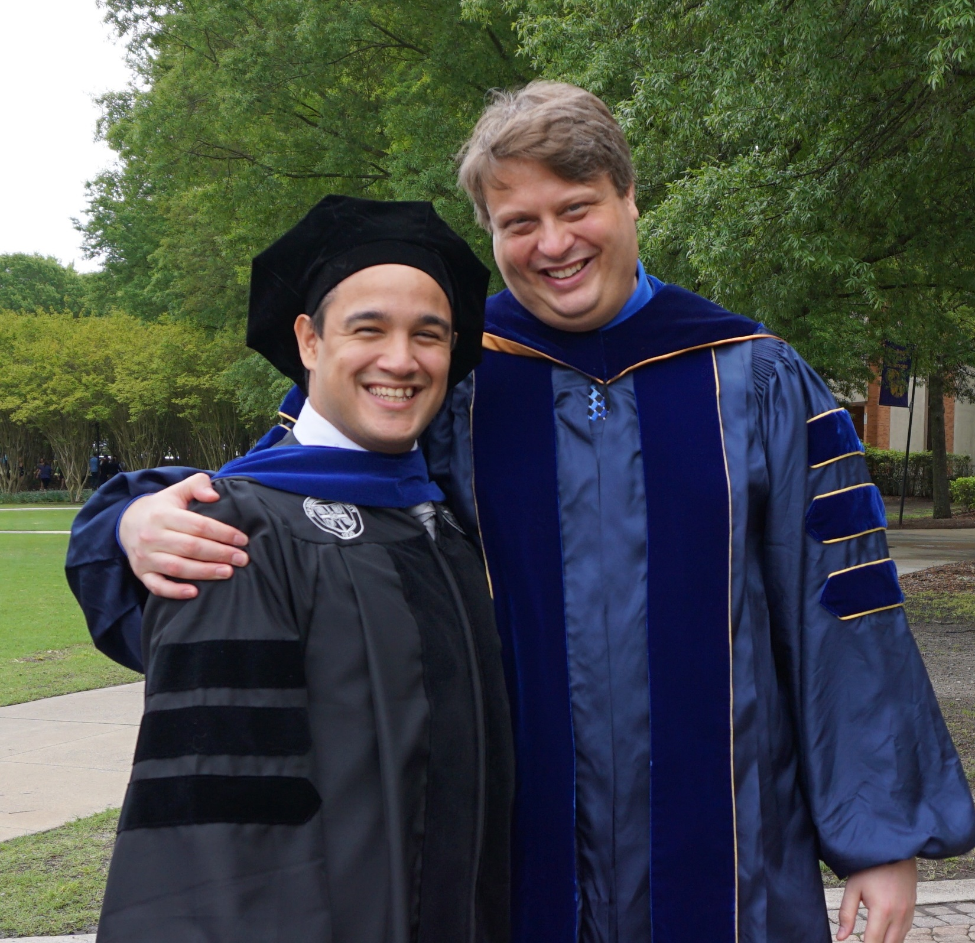
ODU Health Psychology Alumni
Testimonial #1
“The ODU Health Psychology program helped shape my research and professional development in numerous ways. From learning differing statistical approaches to grant writing, I am indebted to the great mentors/researchers that lead this program. I had the best time in this program, and it shaped my career and research.”
Adrian Bravo, class of 2016

Slide 2

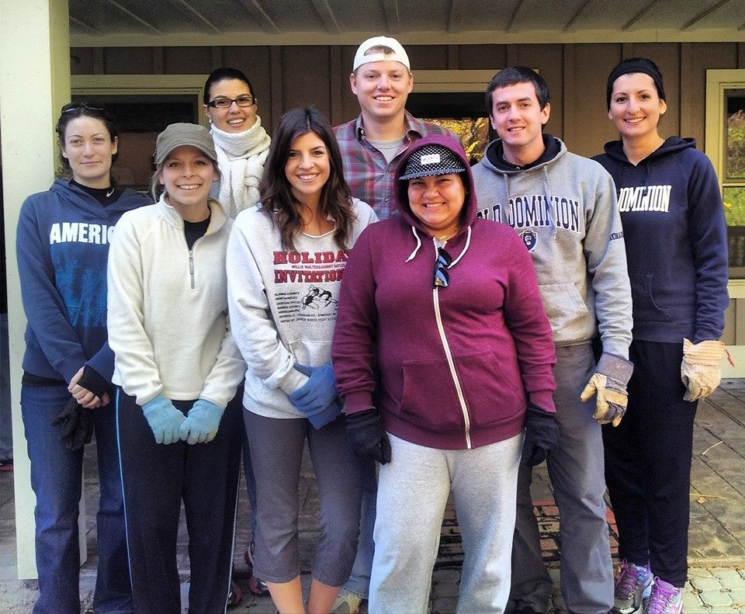
ODU Health Psychology Alumni
Testimonial #2
“The Health program provided me with an environment to build and nurture productive research relationships with professors, peers, and undergraduate students, and made me excited to conduct research. I had strong one-on-one mentoring, strong formal statistical training, and many opportunities to conduct research, publish, and build my own program of research. I was well prepared to continue on into a faculty position directly after finishing the program, and I am grateful for my graduate experience at ODU.”
Amy Stamates, class of 2019

Slide 3


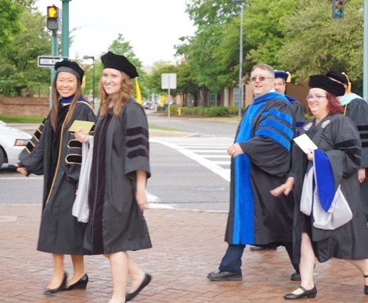
ODU Health Psychology Alumni
Testimonial #3
“The program is incredibly well-rounded: it helped me hone skills in quantitative methods, health psychology, and other important topics including ethics and teaching psychology that serve me well today. My advisor, Cathy Lau-Barraco, was highly supportive in helping me develop my program of research, pushing my critical thinking, and teaching me to write scientifically. During my time in the program I received an NIH-funded dissertation award (F31) that was instrumental in launching my career. I owe a lot of my success to my formative training and am thus incredibly glad I chose ODU for grad school. I'd recommend it to anyone looking to launch a productive and impactful research career!”
Ashley Linden-Carmichael, class of 2016

Slide 4

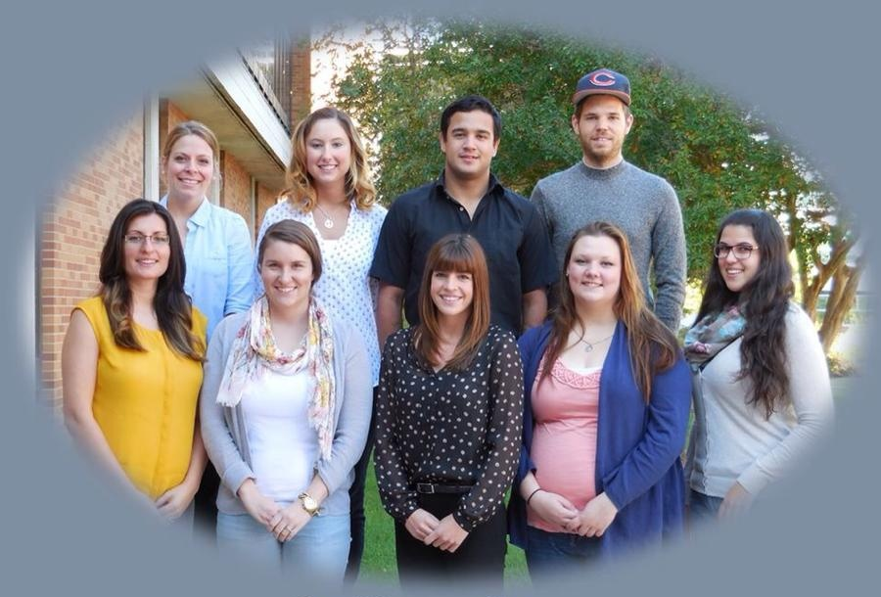
ODU Health Psychology Alumni
Testimonial #4
“I’m insanely grateful to ODU, the health program, and Michelle Kelley (my mentor). I had such an incredible experience getting to do important research (the prevention of sexual misconduct on campus) and being a part of the ODU community. It has set me up for success in my role as an assistant professor of health psychology at a university in upstate NY. Michelle, and the program, took a chance on me when not doing so would’ve been completely understandable. For that I have so much appreciation and gratitude. I would not be where I am today without the experience, mentorship and colleagues I had at ODU.”
Brittany Hollis, class of 2018

Slide 5
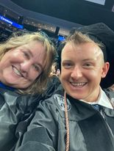
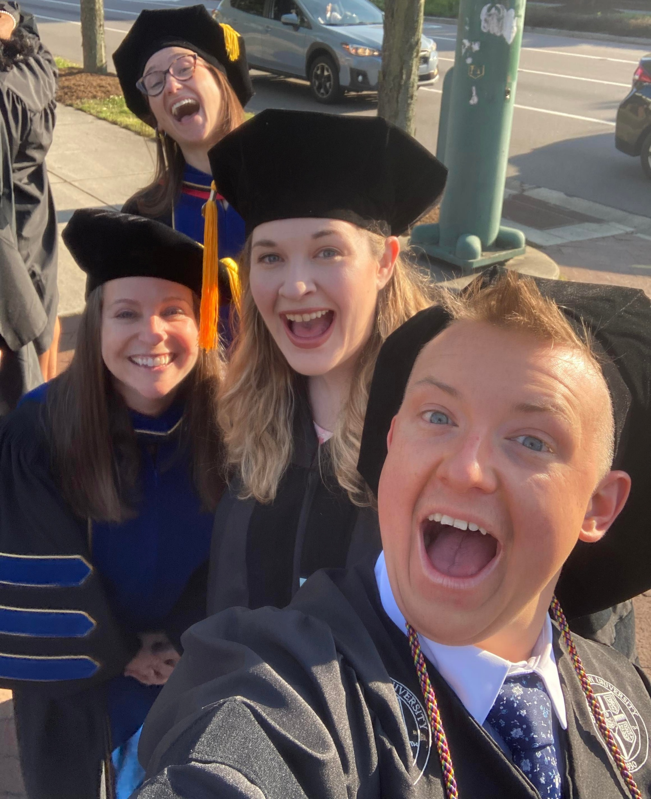
ODU Health Psychology Alumni
Testimonial #5
“The Heath Psychology program at ODU provided me with an opportunity to grow professionally as a student, instructor, and researcher. I am incredibly grateful to my professors and my mentor, Dr. Michelle Kelley, who has provided endless support of my research and spent countless hours reviewing my work, writing recommendations, and guiding me toward my teaching goals. During my time at ODU, I received two classroom instructor awards and the diversity champion award. The HP program also provided a strong research foundation including formal statistical training and coursework which greatly increased my critical thinking skills. The program prepared me for my dream career as an assistant professor in northwestern NY and has given me the tools I need to succeed as an educator in the classroom. I am forever grateful to the HP program at ODU and I will forever cherish the memories that I made.”
Lee Golembiewski, class of 2023

Slide 6
Virtual Open House for
Psychology Ph.D. - Health
Admissions Cycle for Fall 2027

Slide 7
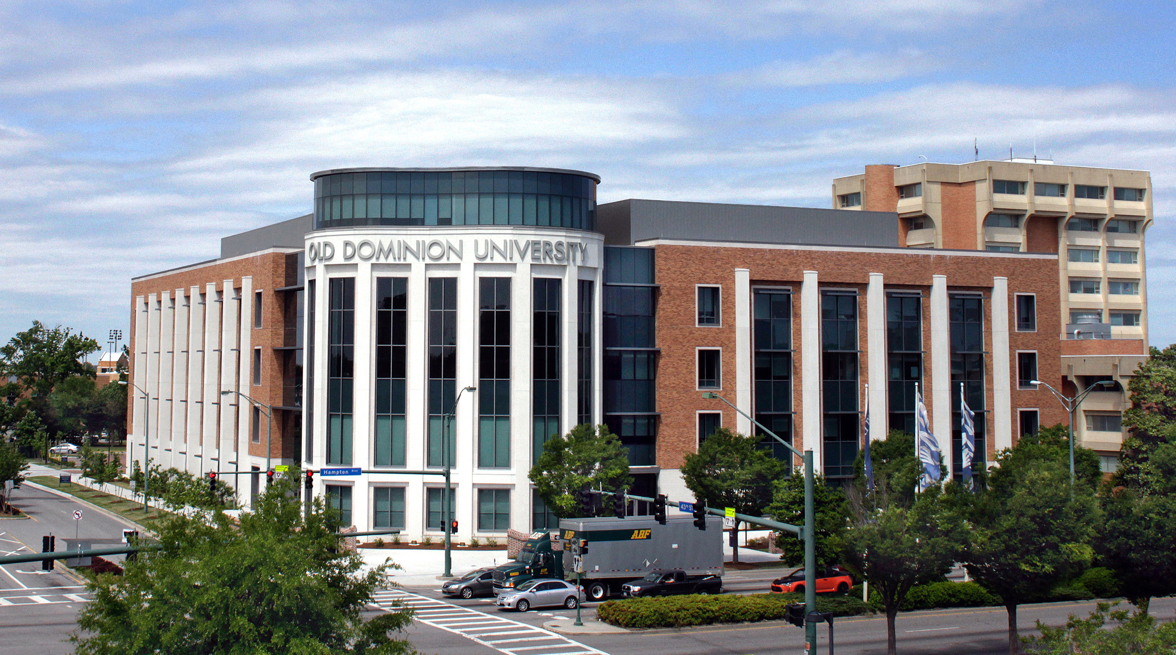
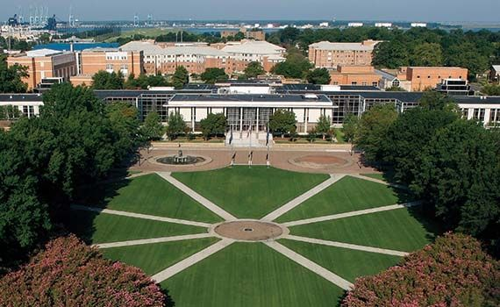

Old Dominion University
Large, public, minority-serving university in southeastern Virginia
Designated an R1 research institution (Carnegie)
~18k undergraduate students, ~6k graduate students, ~600 medical students
Awarded $89.6M in research funding last year

Slide 8
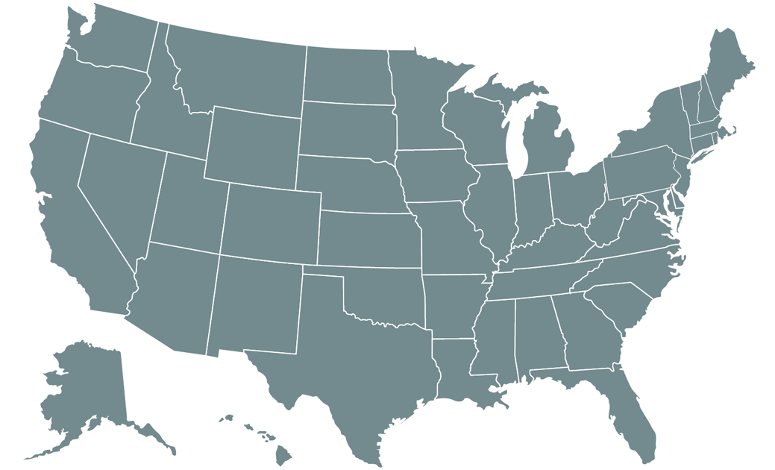


Hampton Roads, VA

Slide 9
ODU Psychology Department
Undergraduate Psychology enrollment: ~1250 Majors
Graduate enrollment: ~70 across programs
  M.S., Experimental Psychology
  Ph.D., Psychology
    Health Psychology
    Clinical Psychology
    Human Factors Psychology
32 full-time faculty positions

Slide 10
Discipline Diversity and Collaborations
ODU Psychology represents many sub-disciplines
  Health
  Clinical
  Developmental
  Cognitive
  Industrial/Organizational
  Human Factors
  Quantitative
  Others
Diversity is reflected by our research projects and funding sources
This diversity makes us broader, more innovative, and more resilient

Slide 11


Faculty Research Funding
Faculty members have obtained grants and contracts from federal, state, local, and campus sources:
  National Institutes of Health
    National Institute of Alcohol Abuse and Alcoholism
    National Institute of Drug Abuse
    National Institute of Mental Health
    National Center for Complementary and Integrative Health
    National Institute on Minority Health and Health Disparities
  National Science Foundation
  Department of Defense
  US Department of Transportation / Department of Motor Vehicles
  Naval Air Warfare Center
  US Army Robotic Systems Joint Projects Office
  US Army Aeromedical Research Laboratory
  Air Force Office of Scientific Research
  Virginia Department of Transportation / Department of Motor Vehicles
  Internal awards (ODU Summer Fellowship Program, Junior Faculty Research Mentoring Program)

Slide 12
Student Research Funding
Students have secured research funds from:
  Federal agencies
    F31 pre-doctoral fellowships from NIH
  Nonprofit corporations
    P.E.O. Scholar awards
  National/international societies (e.g., American Psychological Association & specific divisions)
  Internal awards
    Summer funding from the ODU Graduate School

Slide 13
Research: Regional Relationships
Many faculty have collaborations with healthcare systems and other organizations
Eastern Virginia Medical School (now part of ODU)
Children’s Hospital of The King’s Daughters
Sentara Healthcare
U.S. Department of Transportation /DMV
Dominion Virginia Power
Northrop Grumman
Veteran’s Administration
NATO
Norfolk Southern Railroad
Cities of Norfolk, Virginia Beach, Chesapeake

Slide 14

What is Health Psychology?
Focus of Health Psychologists:
Health promotion and maintenance
  Helping individuals make good choices (to minimize addictive substances, etc.)
Prevention and treatment of illness
  How can one avoid auto-related fatalities?
  What can improve patient prognosis?
Etiology and correlates of health, illness, and dysfunction
Improvement of the health care system and formulation of health policy

Slide 15

Health Psychology Curriculum at ODU
Coursework includes:
  Strong foundation in statistics and research methods
    Numerous advanced statistics courses available as electives
    ANOVA, Regression, Research Methods, Psychometrics, Structural Equation
    Modeling, Multilevel Modeling, Longitudinal Data Analysis
  Theories of Health Psychology
  Health Disparities
  Evaluation of Community Health Programs
  Grant and Manuscript Writing
More flexible course requirements than other concentrations to leave ample time for research

Slide 16
Health Psychology at ODU
Competitive funding packages with tuition waivers
  Typically, 4-5 years of guaranteed stipends earned through teaching
  assistantships or research assistantships, pending reasonable academic
  progress
  Opportunities for advanced students to teach their own undergraduate
  course (if desired)
Funding to attend conferences
  Provided directly through the department
  Additional opportunities through student organizations

Slide 17
ODU Health Psychology Alumni
Alumni have secured position in various settings
Academic
  Brown University, University of Oregon, University of New Mexico, Penn State University, University of Rhode Island, Northern Arizona University, William & Mary, Chowan University, University of Chicago, etc.
Healthcare focused
  Sentara Healthcare
  Optima Health
Applied
  Neuropsychiatric Research Institute
  Booz Allen Hamilton
  Amazon, Tesla, PepsiCo, etc.
Government agencies
  National Highway Traffic Safety Administration
  Virginia Beach Public Schools
  U.S. Navy
Nonprofits
  Homeward

Slide 18
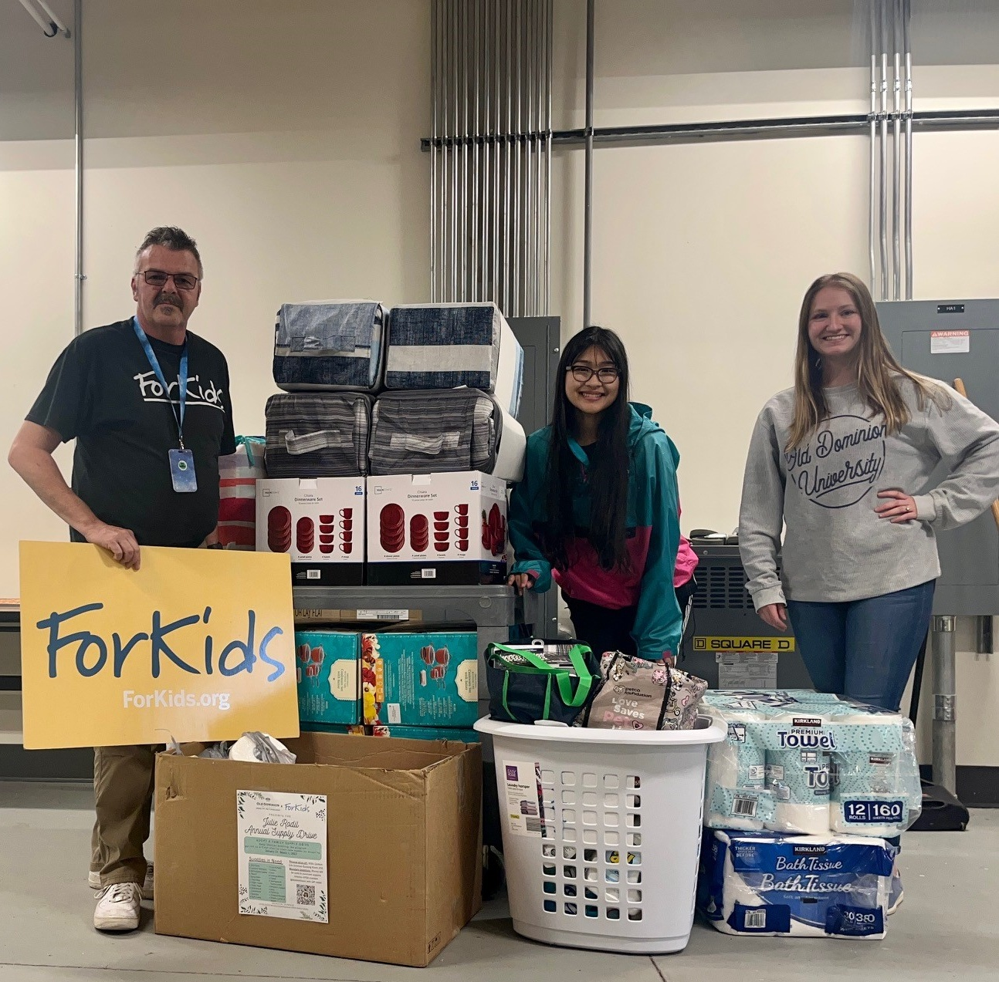
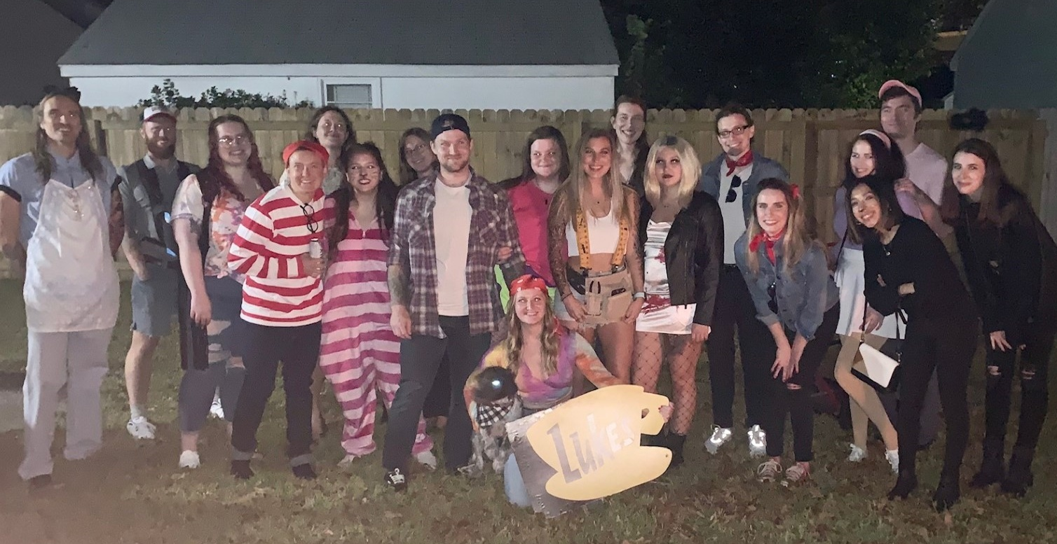

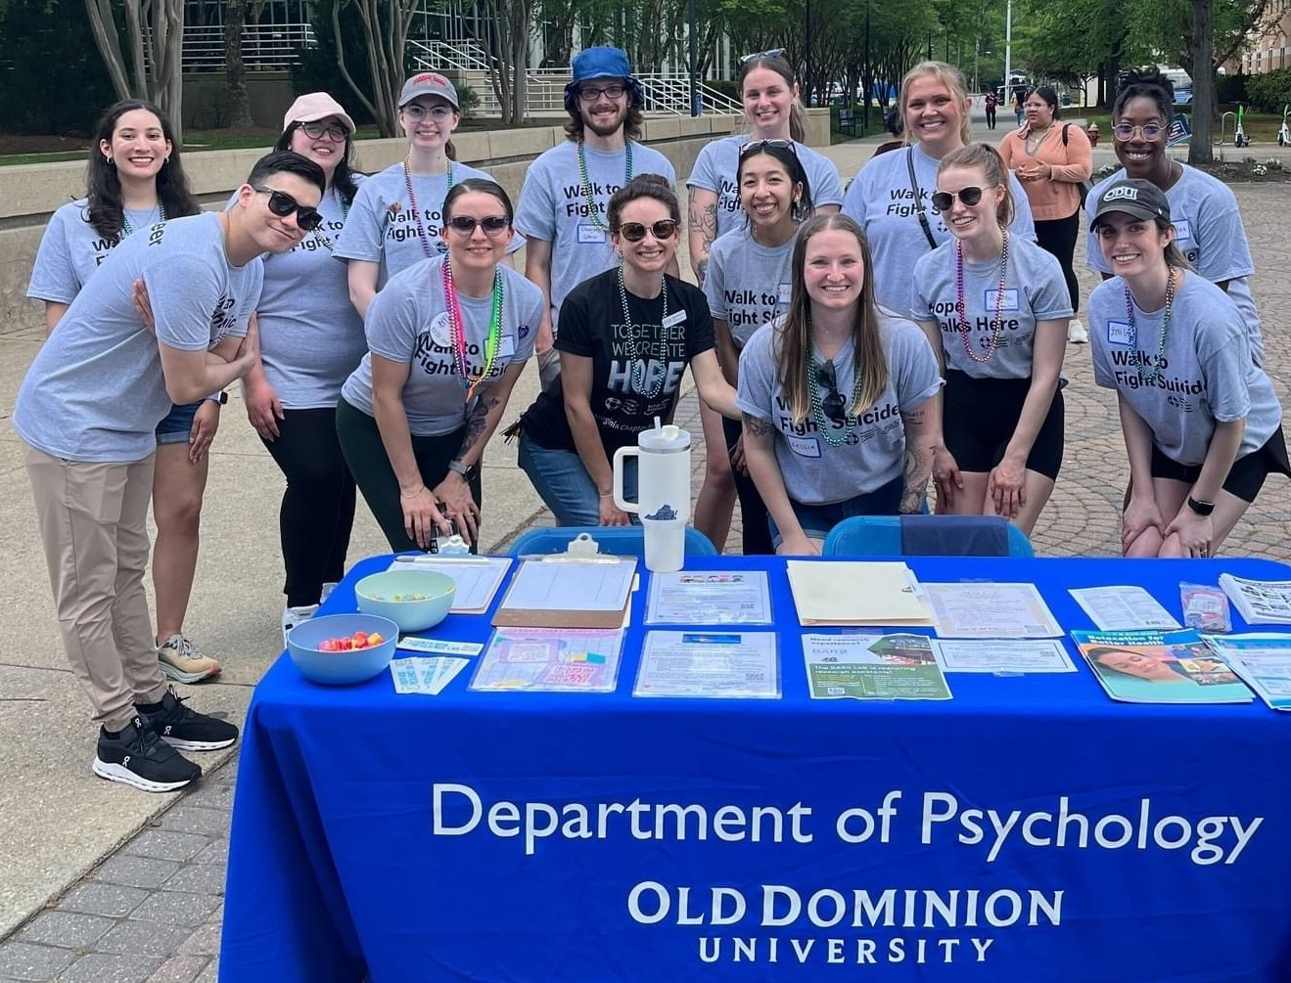
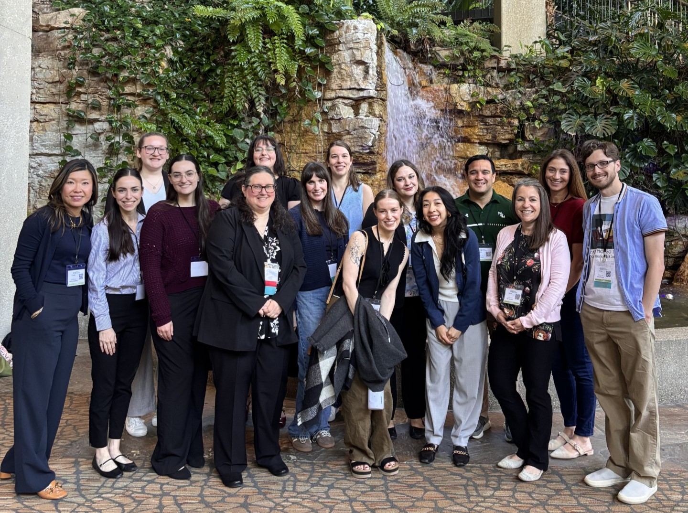
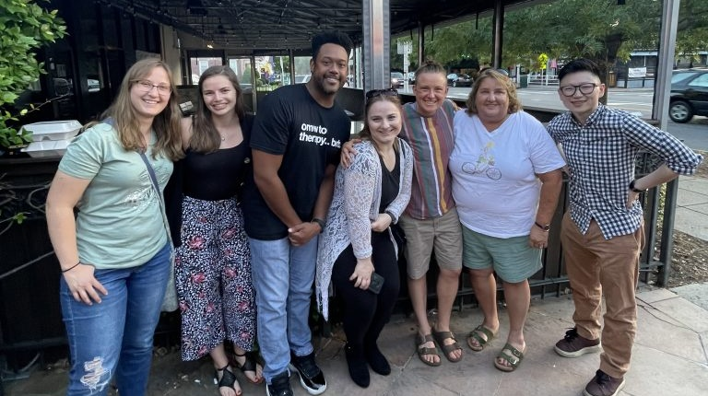
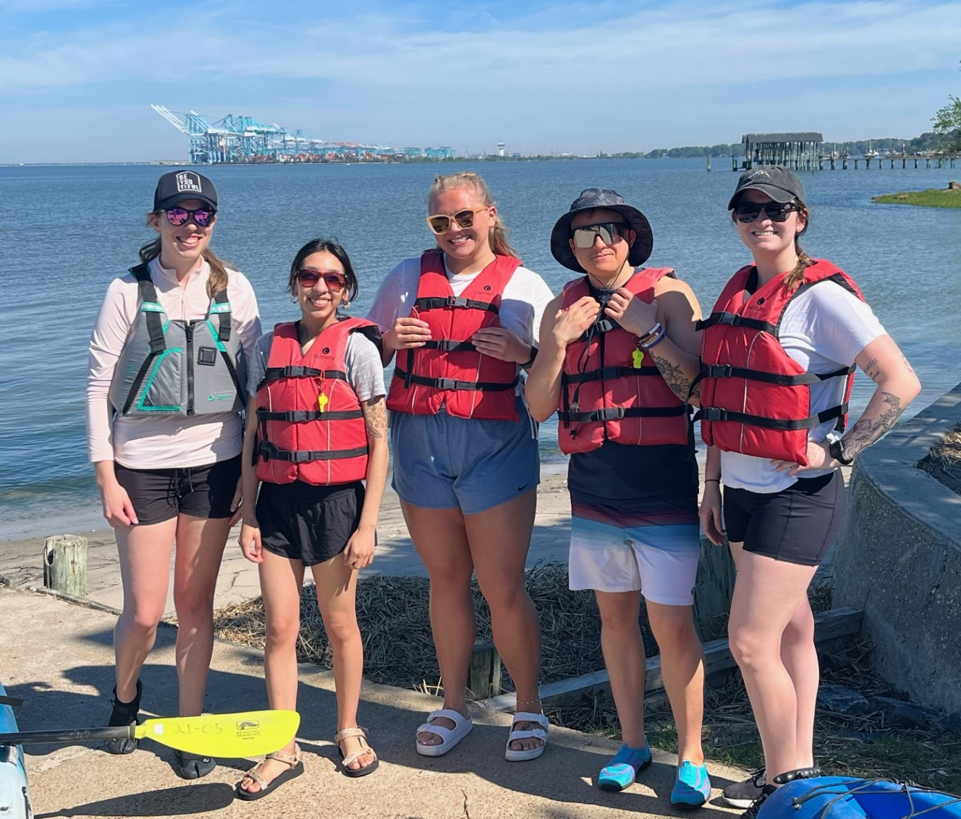
ODU Health Psychology
Current PhD Students

Slide 19
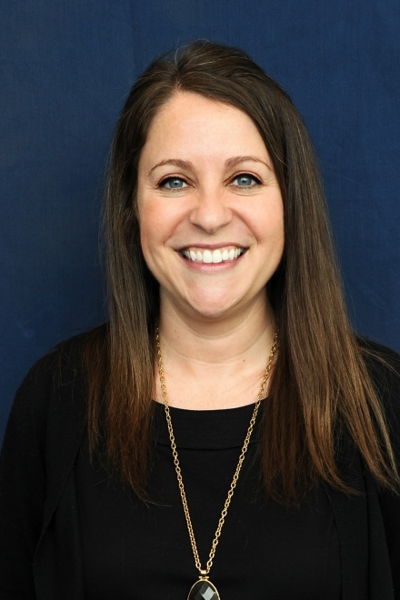
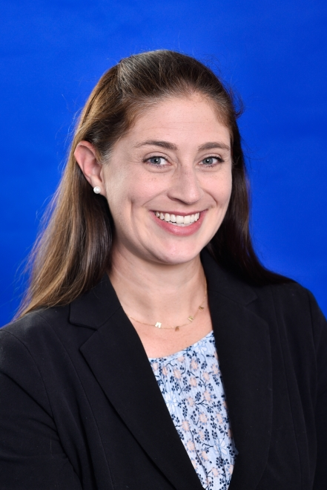

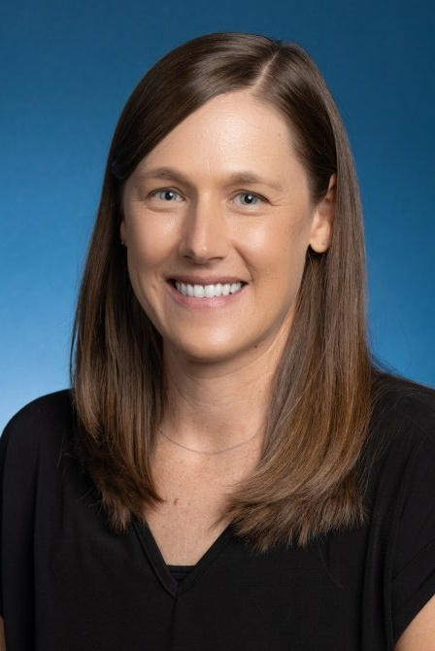
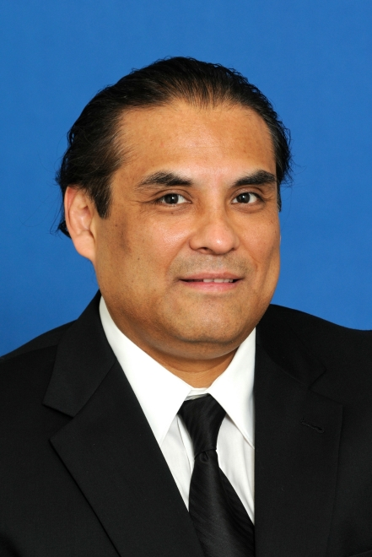
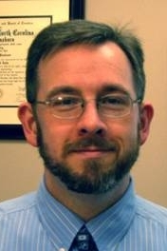
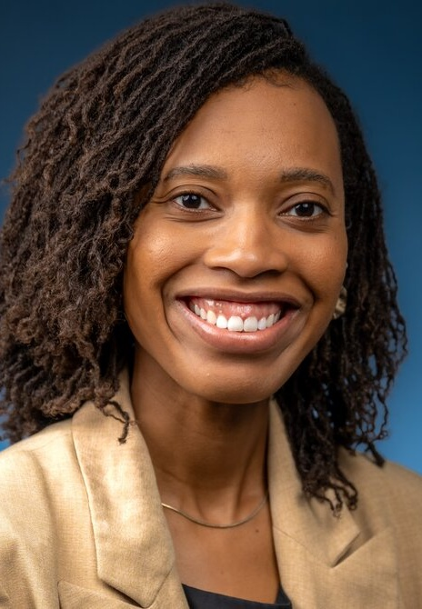

Faculty in Health Psychology

Slide 20
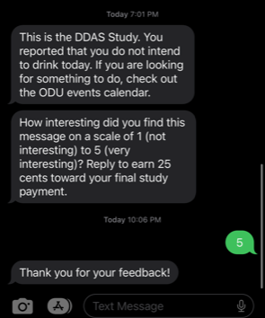



Abby Braitman, Ph.D.
Improving College Student Behavioral Health
Boosters to strengthen/extend online interventions for college drinking
of statistics = fun collaborations
in behavioral health
Intervention
Booster?
Behavior
Daily feedback tailored to context and person
Time

Slide 21






Sarah Ehlke, Ph.D.
Substance Use among Young Adults, particularly LGBQ+ Women
Research focus on alcohol, marijuana, and tobacco use
Broadly the population I focus on is young adults.
Primarily, I focus on alcohol and marijuana use, and simultaneous use
Specifically, sexual minority women.
I have also recently become interested in understanding harm perceptions and reasons/patterns of use of THC beverages
And even more specifically, bisexual+ women

Slide 22

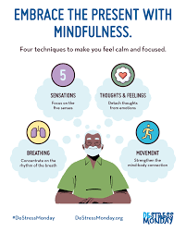

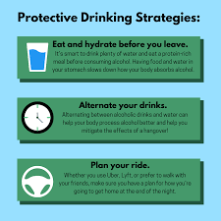

James (Matt) Henson, Ph.D.
Training:
Quantitative Psychology
Applied Research:
Substance use predictors, sequela, and intervention among emerging adults

Slide 23




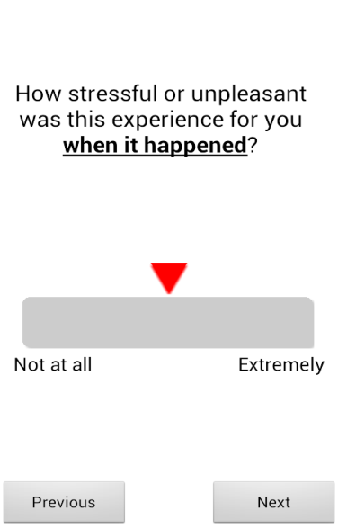



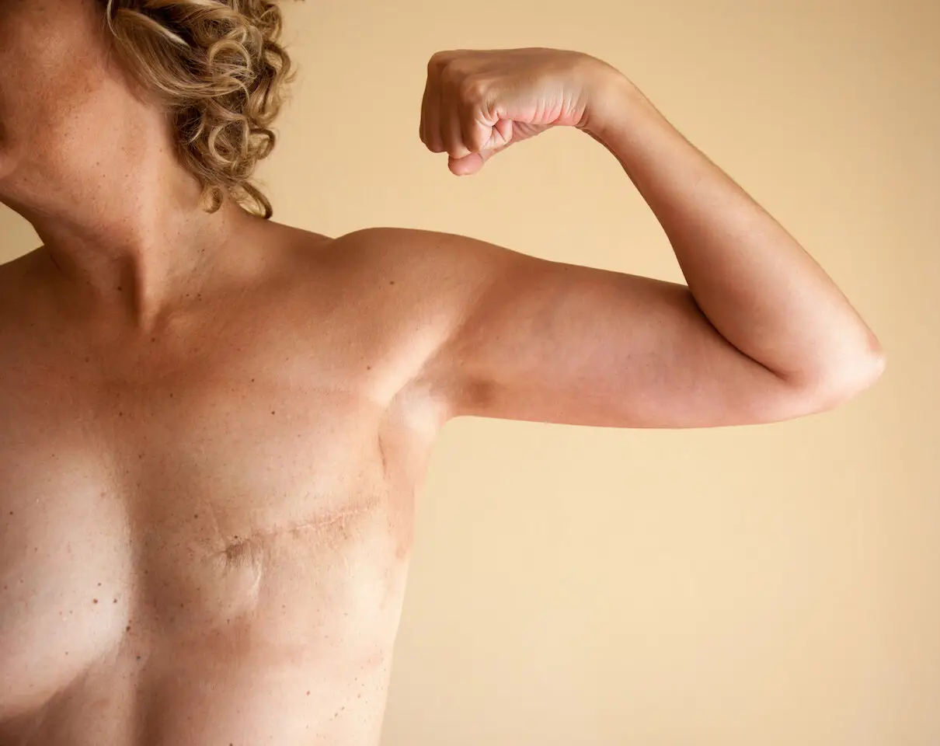
Kristin Heron, Ph.D.
Clinical (& Health) Psychology
CONTENT INTERESTS:
Disordered Eating, Body Image,
& Related Behaviors
METHODS INTERESTS:
Mobile technology for
assessment and intervention
POPULATION INTERESTS: Minority health and specific health conditions
How stressful was this experience for you?

Slide 24








Miguel Padilla, Ph.D.
Methodology and Occupational & Social Health
Psychological Measurement
Health & Well-Being
$$\text{η}\text{ = }\text{Bη}\text{ + }\text{Γξ}\text{ + }\text{ζ}$$
Quantitative Methodology

Slide 25


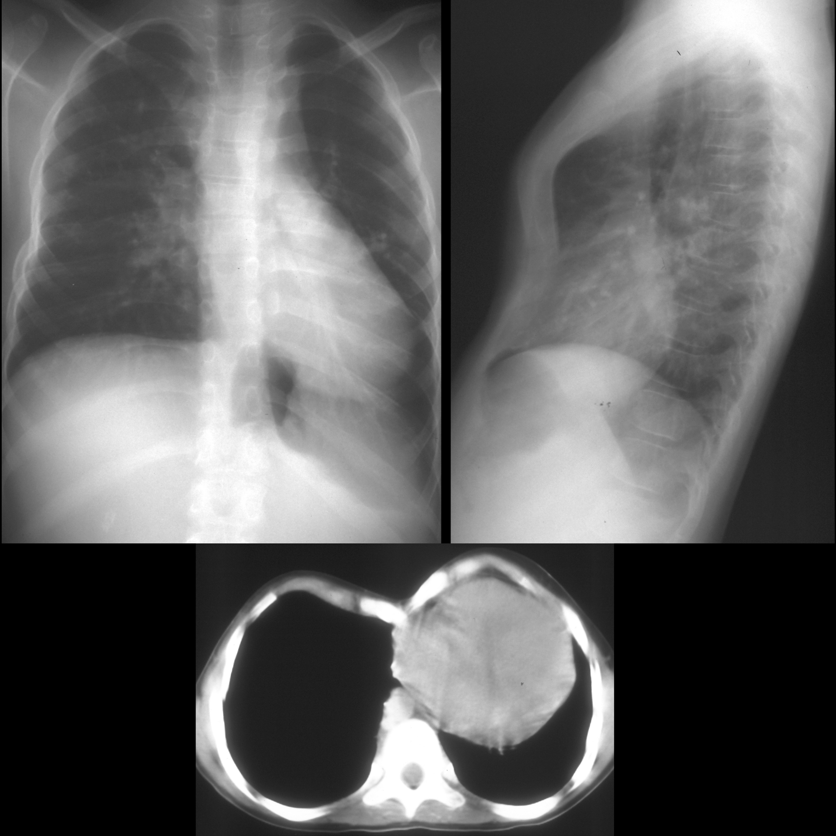
James F. Paulson, Ph.D.
Pregnancy and Postpartum, Family, and Pediatrics
Causes and effects of depression and anxiety
Psychological outcomes of pediatric surgical patients
Training healthcare providers

Slide 26

CYNERGI Research Collaborative
Danyel Smith, PhD
CommunitY-eNgaged research to REduce CanceR health disparities across GeneratIons (CYNERGI)
Vision
Conduct community-engaged science to develop and sustain behavioral interventions to reduce cancer health disparities in diverse families and communities.
Mission
We target ecological factors associated and obesity-related cancer risk and survivorship.
Why
Our research leverages family and community networks for intergenerational impact on cancer prevention and control.
Topics: Diet | Physical Activity | Metabolic Health| Communal Coping | Family Communication| Cancer Risk & Survivorship | Community-based participatory research methods

Slide 27


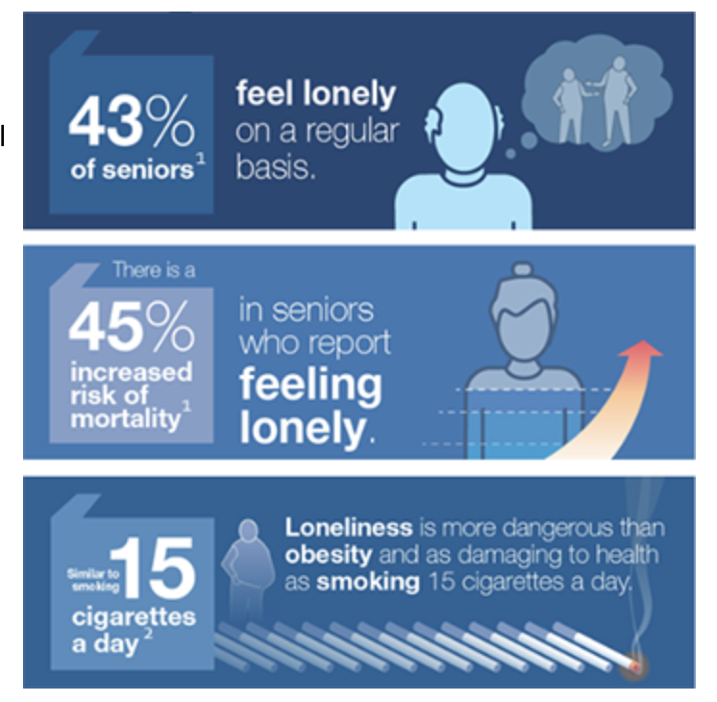
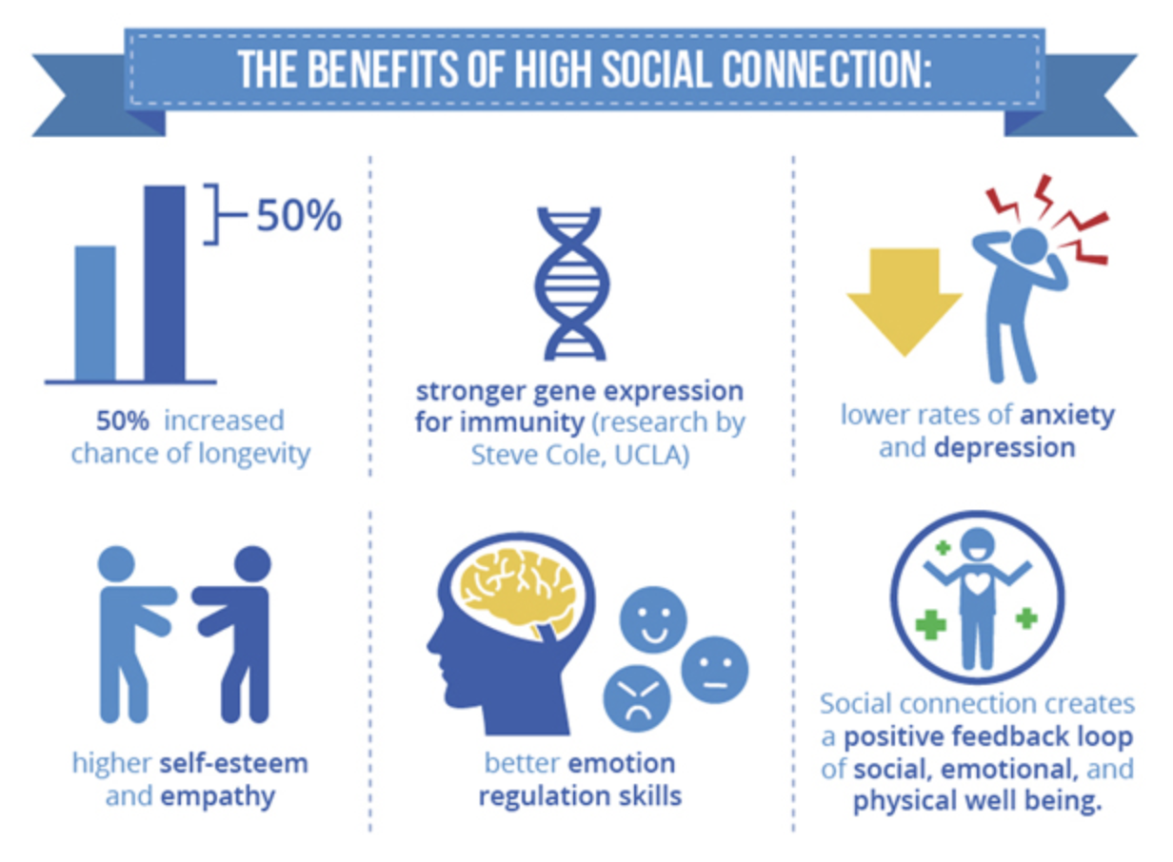



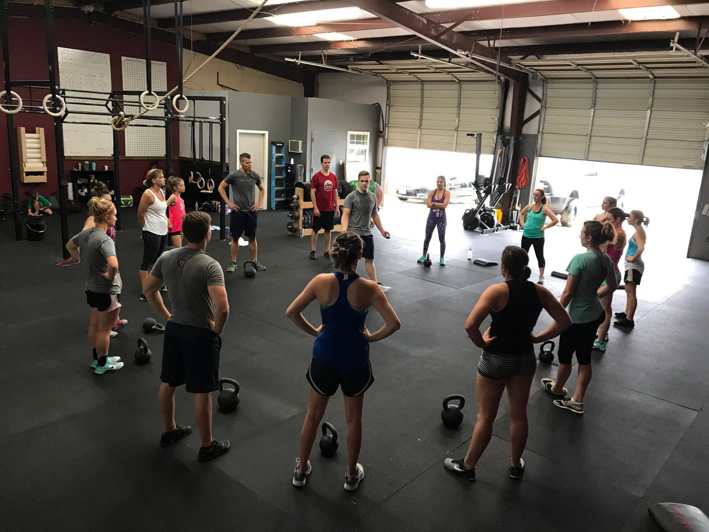

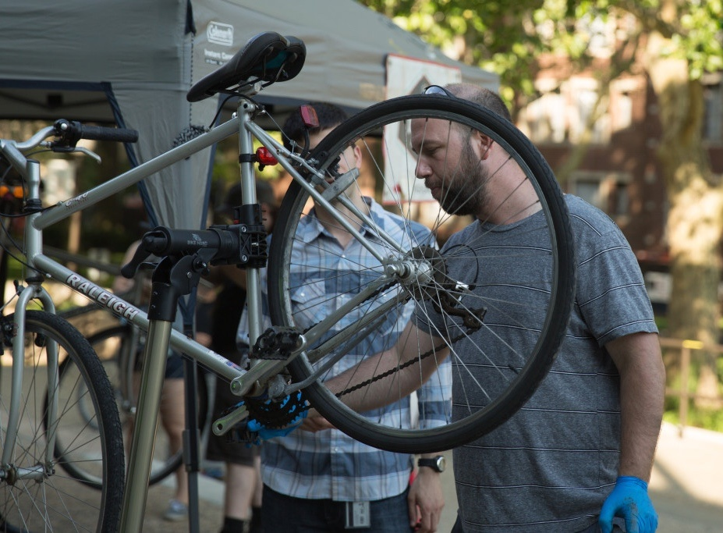







Natalie Yarish, Ph.D.
Physical activity promotion & exercise psychology
1. Physical activity interventions
2. Social connection
3. Physical activity measurement & psychometrics
Physical Activity & Social Support Scale

Slide 28
Faculty in Health Psychology Accepting Students
*Accepting Students This Cycle*

Slide 29
Relevant Links
Health Psychology Program
Health Psychology Faculty
Health Psychology Labs
Ph.D. Admission
Health Psychology FAQ
Health Psychology Student Association
Applications are due December 1
Questions? abraitma@odu.edu

