Slide 1


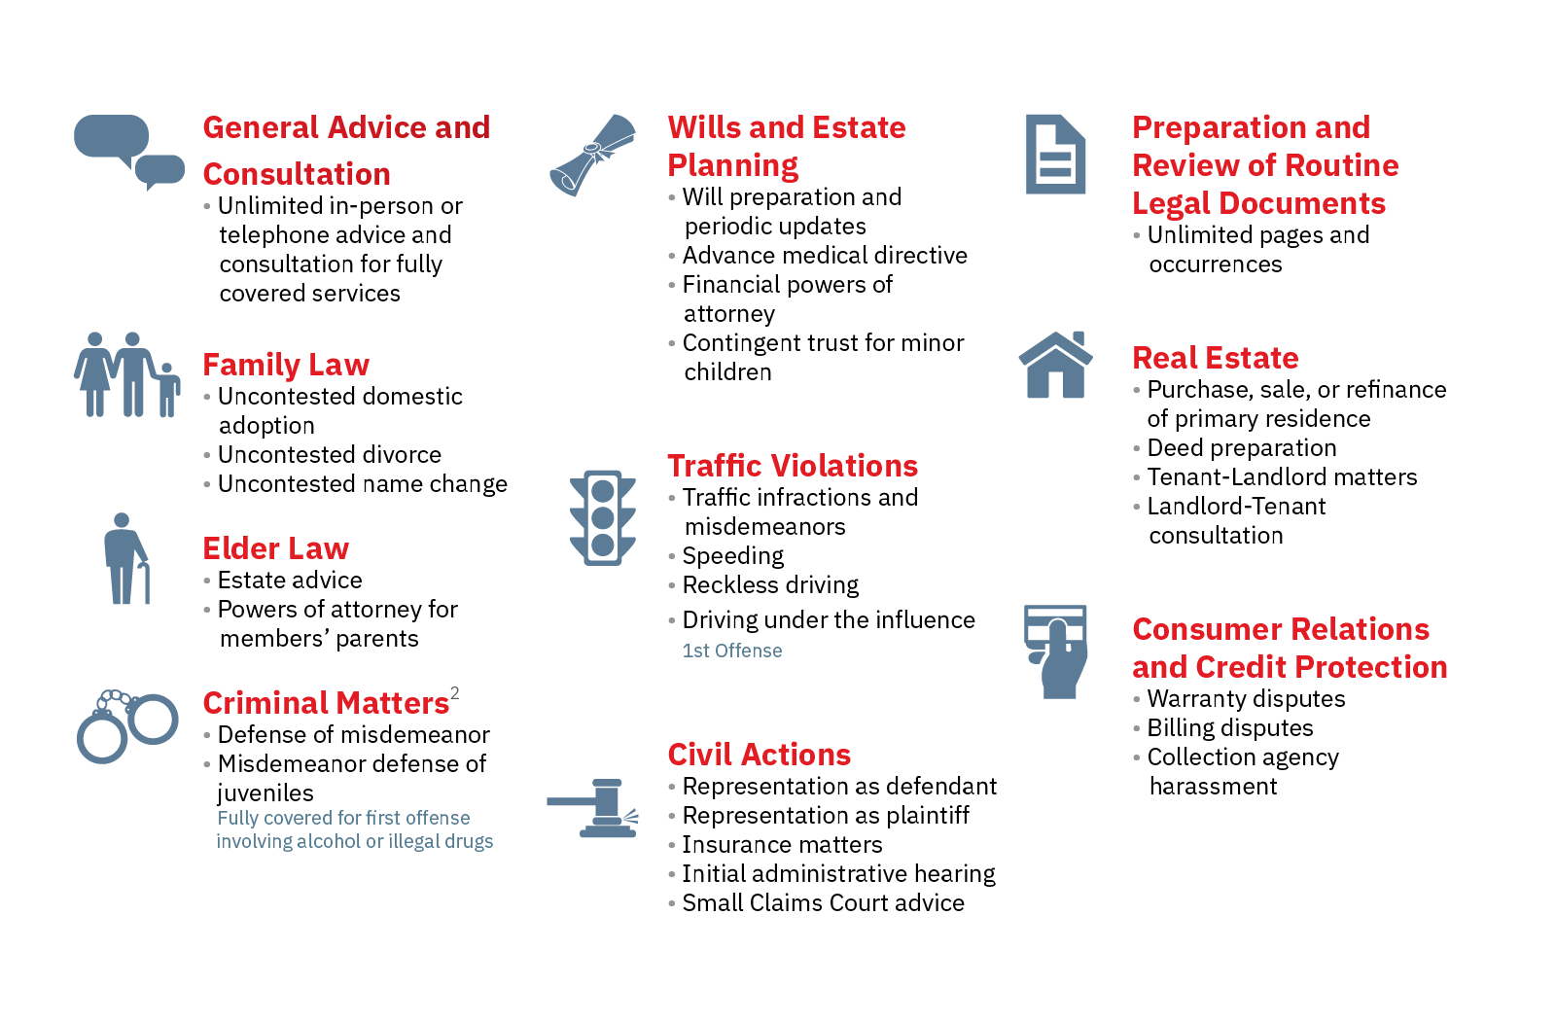
LEGAL PLAN BENEFIT
LEGAL RESOURCES COVERS 100% OF THE ATTORNEY FEES FOR THE MOST FREQUENTLY NEEDED LEGAL MATTERS
Don’t see your
legal need listed?
You are still covered!
The Legal Plan offers a 25% discount on less common legal needs.
Including and not limited to pre-existing legal matters, immigration, small business, tax matters, contested family and more.
This SUMMARY OF COVERAGE is intended to provide a broad general overview of plan coverage.
Please review the Legal Resources Plan Contract, found on the member portal, for a complete description of services.
Since your employer is the participating sponsor, you may not use the Plan in a dispute with your employer.
Coverage may vary by organization. For specific coverage questions, please call Member Services at 800.728.5768.
Notes:
No changes needed to this slide

Slide 2
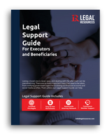

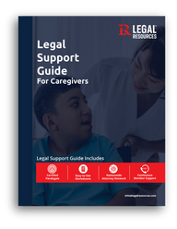





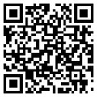
Go to www.legalresources.com
In the Upper righthand corner, click 'Login’
Follow the prompts to gain access!
MEMBER PORTAL
PORTAL FEATURES
PORTAL ENHANCEMENTS
QUICK ACCESS FEATURES - PRINT YOUR MEMBER CARD INSTANTLY THROUGH YOUR PORTAL DASHBOARD.
Caregiving Support Resources
Access essential caregiver legal documents, live seminar series, and professional caregiving assistance—all in your member portal. Legal Resources offers preferred member pricing on the Basic and Premium CareLinx memberships. Learn more about what’s included in each membership in the Plan Resources section of the member portal.
Legal Support Guidebooks
Our Legal Support Guidebooks simplify complex legal topics on caregiving, estate planning, and executor and beneficiary support. These interactive guidebooks are available for download.
Downloadable
Editable
Financial Planning
Enhance your financial well-being with comprehensive financial planning service through Kinnect Advisors, now with Legal Resources. Members can receive:
LRseminar Series
Access expert-led legal, identity protection and caregiving guidance through monthly seminars at LRseminars.com, featuring both live and on-demand sessions.
Financial Plan
Receive a comprehensive financial plan tailored to your unique goals and circumstances.
Live & On-Demand
Interactive
Certified Financial Advisors
Enjoy virtual consultations and continuous support from your personal financial advisor.
LegalSMART
Stay informed with LegalSMART, a monthly collection of articles covering timely legal developments that help you stay current on significant changes in the legal world.
SCAN QR CODE TO SUBSCRIBE TO LEGALSMART!
Goal Tracking Platform
Pursue your financial goals with personalized insights and recommendations.

Slide 3
ENROLLMENT DETAILS
Cost?
Who is covered?
How to Enroll?
How to Use the Plan
$8.31 per pay period.
You, your spouse and qualified dependents up to age 19 or 26 if enrolled as a full-time student. Parents and spouse’s parents also receive a 25% discount when using a participating Legal Resources network attorney.
Enroll online at legalresources.com
Newly enrolled members will receive a welcome email with plan information and access to your Member Card. Call the number on the card directly for service, anytime you have a legal need.
Remember to say, “I’m Legal Resources member!”
The Legal Plan covers the attorney’s time. If applicable, member may be responsible for non-attorney costs such as filing fees, court cost and administrative fees.
PRE-EXISTING MATTERS
SMALL BUSINESS
CUSTODY
IMMIGRATION
FELONY DEFENSE
TAX MATTERS
AND MANY MORE…
Additional Plan Information:
COVERS EMPLOYEE, SPOUSE AND ELIGIBLE DEPENDENT CHILDREN
NO PROBATION PERIODS, USAGE LIMITATIONS, CLAIM FORMS, DEDUCTIBLES, ETC.
PLAN CANNOT BE USED IN A MATTER THAT INVOLVES THE PLAN SPONSOR

Slide 4


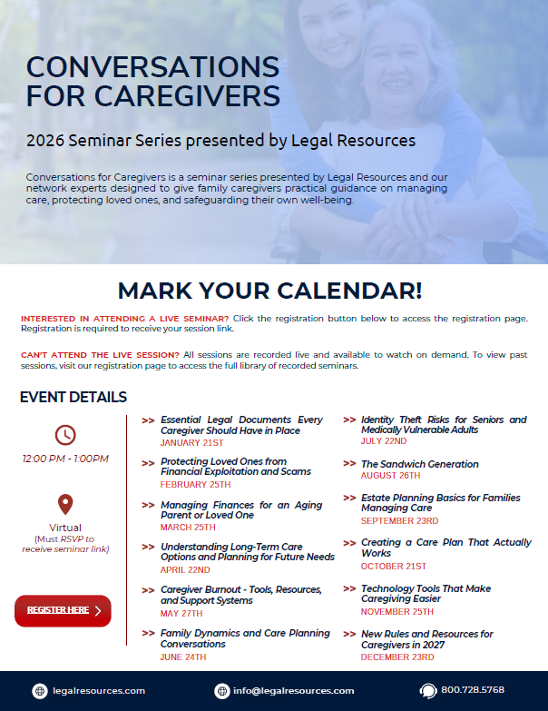
SEMINAR SERIES – Open to All Employees
WWW.LRSEMINARS.COM

Slide 5



QUESTIONS?
Member Services Department
Certified Paralegals are available to assist potential and current members with questions about the plan, our law firm network and more.
800.728.5768
info@legalresources.com
Additional information and resources available at: www.LegalResources.com

