Slide 1
October 2021 | Old Dominion University Norfolk, VA
Higher Education at the Crossroads:
An Education Debt Come Due
Wil Del Pilar Vice President of Higher Education Policy and Practice
@Wil_EdTrust
© Copyright 2018 The Education Trust @EdTrust /edtrust edtrust www.edtrust.org
Notes:
Wil to start

Slide 2
Why this matters to me

Slide 3
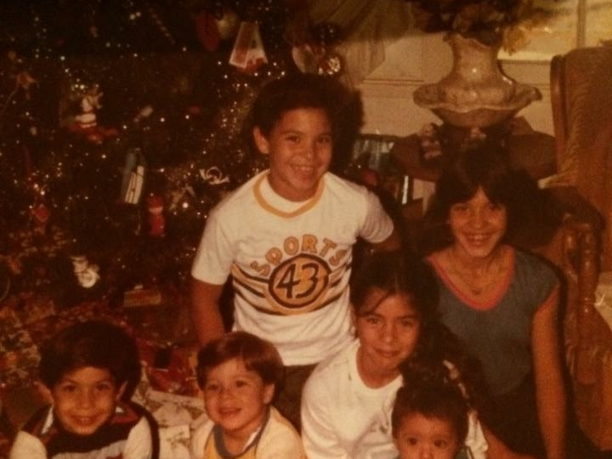

Slide 4
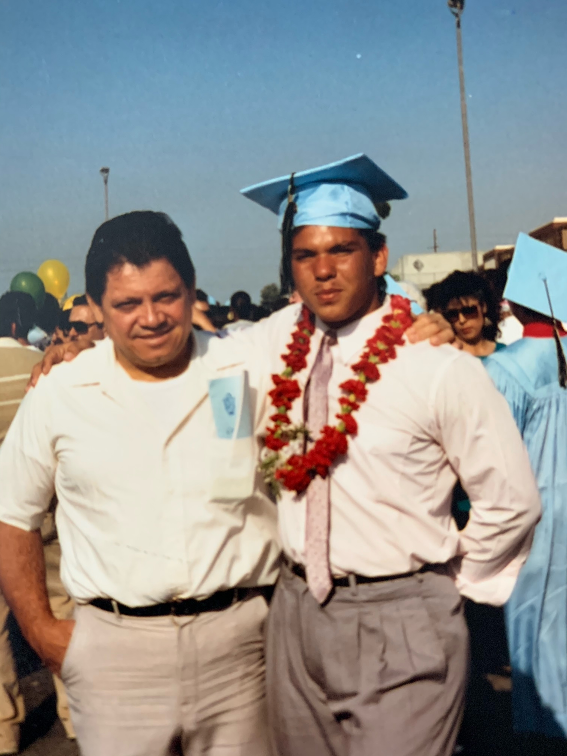

Slide 5
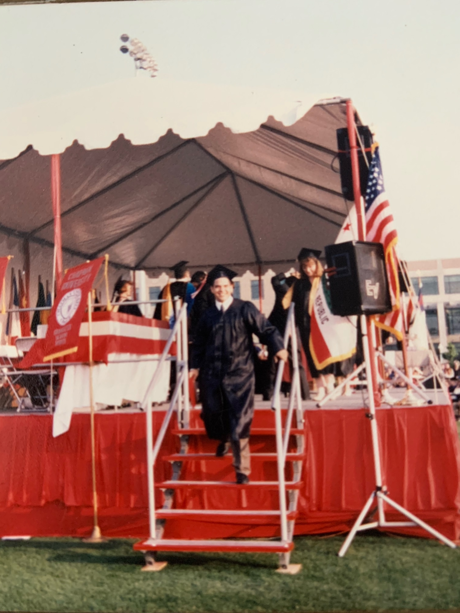

Slide 6
The Education Debt (Ladson-Billings, 2006)
Education Debt
Historical Debt
Economic Debt
Socio political Debt
Moral Debt

Slide 7
Higher Education at the Crossroads

Slide 8
A college degree greatly increases the chances of upward economic mobility for low-income Americans…
Social mobility for non-high school completers born in the bottom quintile
Social mobility for college grads born in the bottom quintile
Source: Brookings Institute, http://csweb.brookings.edu/content/research/essays/2014/saving-horatio-alger.html

Slide 9
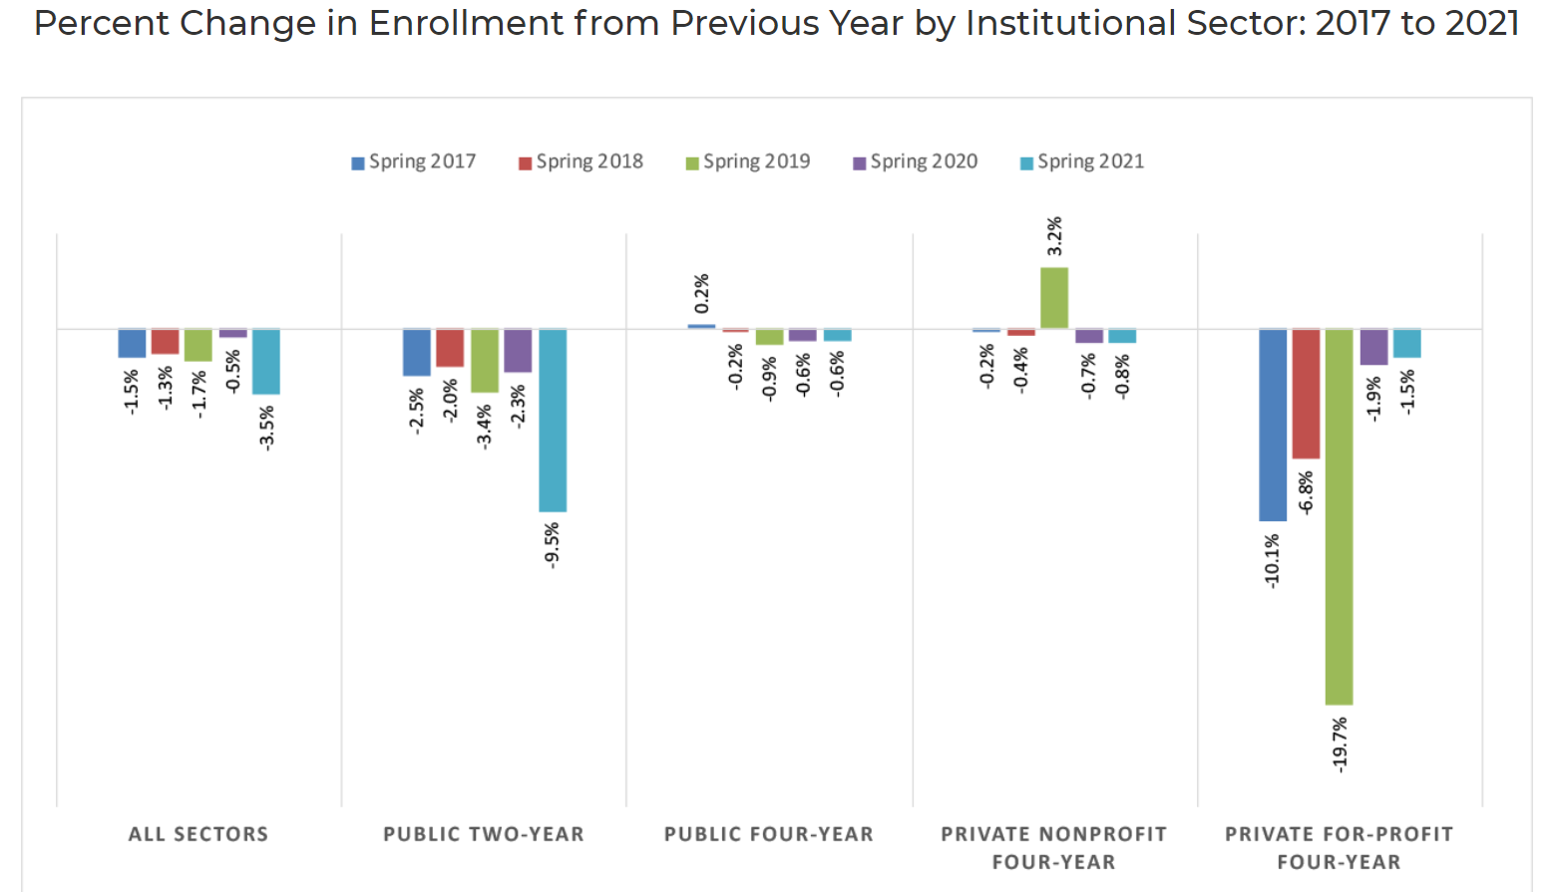
Higher Ed Enrollment (https://nscresearchcenter.org/current-term-enrollment-estimates/)

Slide 10
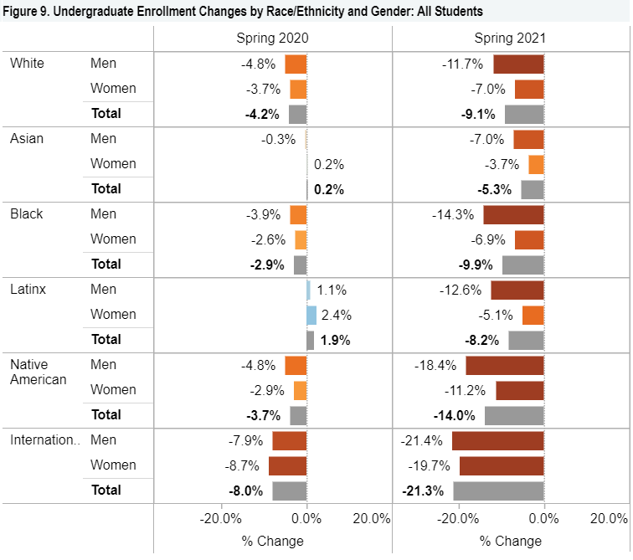
Higher Ed Enrollment by Race/Ethnicity & Gender (https://nscresearchcenter.org/stay-informed/)
Every racial/ethnic group experience decreases
Decreases for students of color increase enrollment gaps.

Slide 11
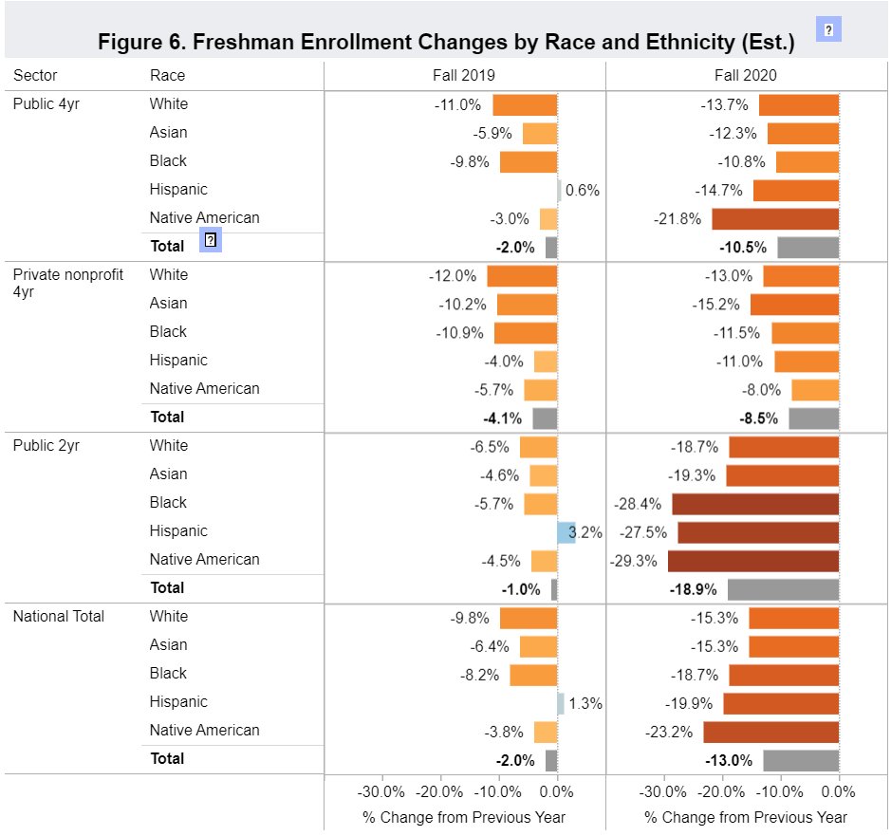
First Time Enrollment (https://public.tableau.com/app/profile/researchcenter/viz/Fall20203asofOct_22/Fall2020EnrollmentNo_3)
Decreases by Race/Ethnicity by Sector
  Every Sector Experienced decreases
  Community colleges experienced the largest decreases for students of color
  Black, Latinx & Native American students experienced the biggest decreases when we look at national totals

Slide 12
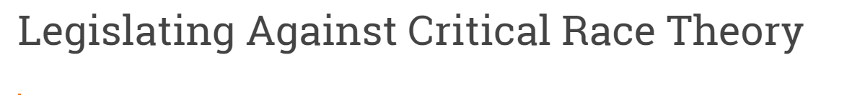
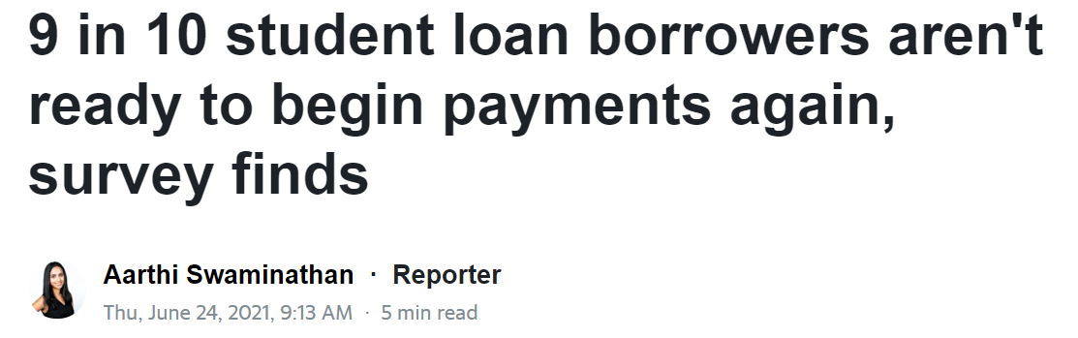
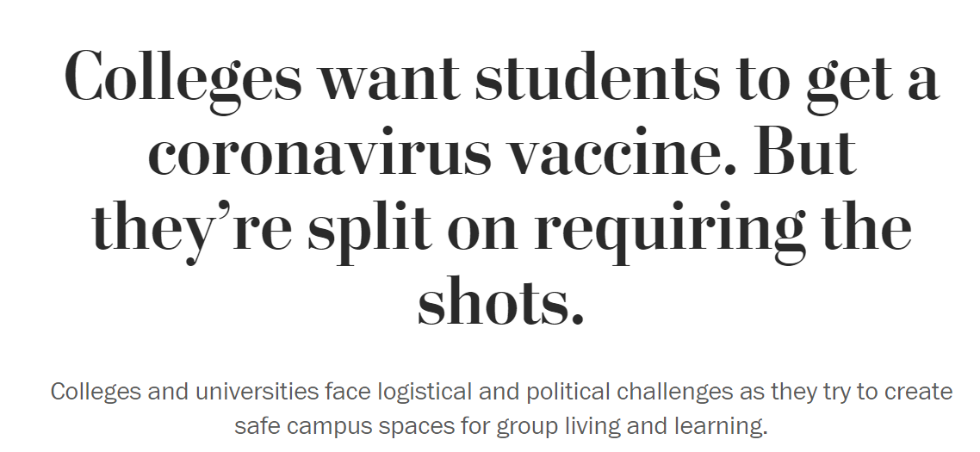
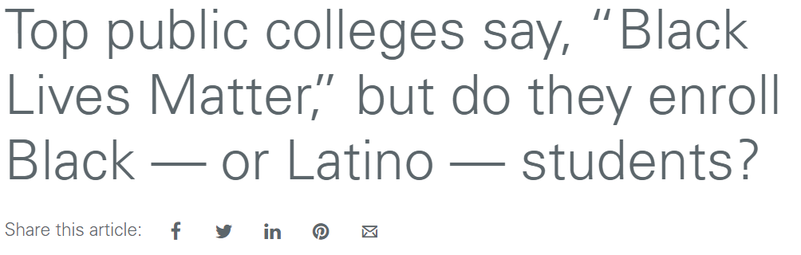
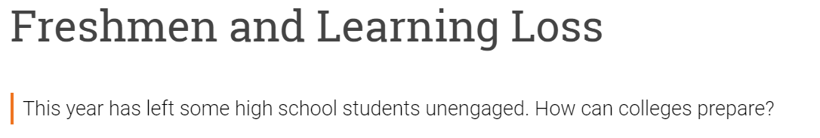
Higher Ed at a Crossroads

Slide 13
Federal Pathways to Equity

Slide 14
Federal Pathways to Equity
Federal Pathways
Appropriations
Reconciliation
Administration

Slide 15
Federal Pathways to Equity
Reconciliation
American Families Plan
Appropriations
Biden budget proposal contained investments in:
Administration
Implementing new simplified FAFSA-pushed to 2024-25
Pell increases (Proposed a path to doubling Pell)
America’s College Promise
Dedicated funds for student support services ($9 Billion proposed)
Pell Grants
TRIO
Educator diversity-Hawkins
HBCUs, MSIs, TCUs
Regulatory overhauls
Gainful employment
Student Debt
Pell Implementation

Slide 16
Get Involved
Get Involved
  Engage with institutional leaders on campus, state and federal issues (Government Relations).
  Write letters email or call and have institutional leaders reach out to federal representatives.
  Hill and State Capital visits to representatives from your district/region are critical, make your presence and voice known.
  Get to know your State Higher Education Executive Officer (SHEEO) they are the policy voice in most states.
  Stay informed! Follow policy organization like Ed Trust, New America, TICAS, NASPA, NASFAA, Robert Kelchen, Century Foundation, Third Way

Slide 17
Higher Ed’s debt has come due: the opportunity to rethink how we serve students

Slide 18
There are Reasons to be Hopeful hopeful
Old normal was not working for low-income students, first-generation students and students of color and there was a lack of urgency to change.
Disrupting patterns of education may create conditions for a reimaging of what equitable colleges look like.
The decisions we make during this crisis will matter for equity

Slide 19
Becoming Serving Institutions
Servingness (Garcia, 2019)
Academic Outcomes
Non academic Outcomes
Experiences

Slide 20
Becoming Institutions Where Students Thrive
Thriving (Perez, et al. 1980)
Engaged learning
Aspirational capital
Academic determination
Linguistic capital
Positive perspective
Familial capital
Social connectedness
Navigational capital
Diverse citizenship
Resistant capital

Slide 21


Slide 22


Slide 23
Thank You!
Wil Del Pilar
Vice President of Higher Education
WDelPilar@edtrust.org //@Wil_EdTrust
Notes:
With that we’d be happy to take any questions

