Slide 1
Is an ODU MBA right for me?
September 22, 2017

Slide 2
David Cook, Ph.D.
Life outside of work…
Assistant Dean
MBA Program Director
20 years with the program
PhD earned from the University of Kentucky
MBA earned from Bowling Green State University
Active in national MBA forums
Family
Grew up in Ohio
Married over 20 years
1 Child 17
Live in Virginia Chesapeake
Active horseback rider
Home theater enthusiast

Slide 3
Shanna Wood, MBA, PHR, SHRM-CP
Life outside of work…
Associate Director
Program Advisor
10 years with the program
HR Certifications
MBA from Georgia State
Undergrad at Gettysburg College
The Planning Council Executive Board
Active in the HR community
Family
Grew up in PA
Married over 20 years
2 Children 10 & 13
Live in Virginia Beach
Active with my Church and neighbors
Garden

Slide 4
Sandra Phillips
Life outside of work…
Assistant Program Manager
Program Admissions Coordinator
19 years with the program
B.A. History at ODU
Family
Grew up in Central VA
Married 10 months
Live in Newport News
Active with Red Hat Society
Makes blankets for various charities
Garden
Caretaker for mother

Slide 5
Why do people choose to get a MBA?
Enhance Career
Change Career
Start New Business
Personal Goal

Slide 6
10 Reasons to consider getting a MBA
Credibility – demonstrates commitment & knowledge
Think like a business person – technicians become holistic managers
Ticket to ride – earn seat at strategy table
Improve communication – reduce technical jargon and move to cross-functional dialog
Prepared to solve business problems – strengthen analytical and integrated reasoning skills
Ability to read and interpret business statements
Opportunity to strengthen technical abilities
Improve written skills
Learn tools for managing business activities and processes
Apply classwork to current work

Slide 7
What does a MBA teach…
A solid MBA program
Business Fundamentals
Strategy
Accounting
Finance & Economics
Operations
Management
Marketing
A Better MBA program
Leadership
Business Analytics
And all the above
Better still
Soft Skills
Global Impact
Best programs
Introspection
Strengths and weaknesses
Career interests & personal passions
Personal ethics
Lots of other stuff
Entrepreneurship
Stock Market Trading
Working with people different walks of life

Slide 8
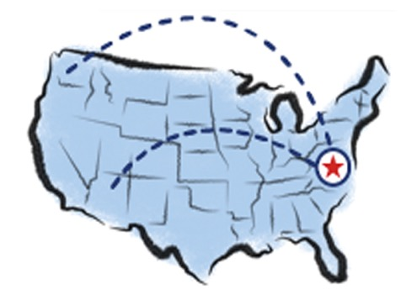
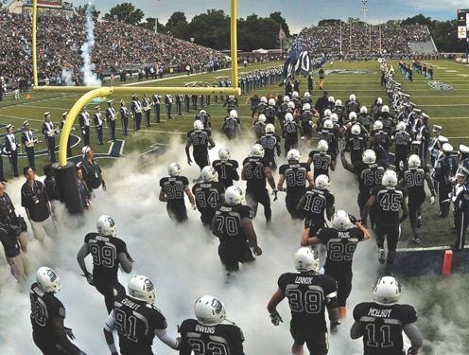
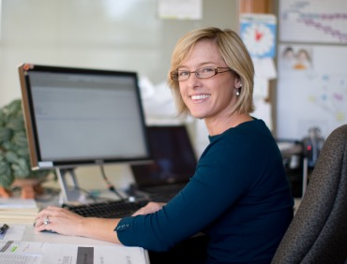
How Does ODU’s MBA Measure up?
Accessible.
Curriculum
Students & Alumni
Tools and Services
Activities
Recognition
Investment
Admissions process
Attainable.
Accomplished.

Slide 9
Curriculum
Classes available to meet any schedule
Online and on-campus options
Various completion timelines
40 – 45 credit hours
ODU's long expertise in distance learning
Adaptability to life situations

Slide 10
Curriculum
Popular specializations
Project Management
Business Analytics and Big Data
Cyber security
Health Sciences Executive Certificate
Maritime Ports and Logistics Management (video)
Public Procurement and Contract Management
Public Administration and Policy
Modeling and Simulation
Engineering Management
Homeland Security
How is it done?
What if I want to specialize?

Slide 11
Students and Alumni
Nearly 200 students.
Approaching 4000 alumni around the globe.
Global Representation – Enhanced by Online
Accomplished before and after graduation

Slide 12
Students
23% affiliated with military
Fall 2016 class by the numbers
41 enrolled = 18 male + 23 female
9 out of state
Average age = 30
Average work experience = 9.47
Average UG GPA = 3.3
Average GMAT = 536
Total Enrollment
12.1% of students attend full-time
28% FT students are international
44% female
7 nationalities represented in MBA, 97 at ODU
Most graduate within 3 years.

Slide 13
From where do our students come and where do they go…
Accenture
Adaptive Aerospace Group
ADS
Alpha Solutions Corp
Anthem BCBS
Armstrong World Industries
Avis Budget Group
BayPort Credit Union
BB&T
Bon Secour
Booz Allen Hamilton
Branscome, Inc.
CACI International Inc.
Canon Virginia Inc.
Capital Group Companies
Cegedim Dendrite
Chartway Federal Credit Union
CHKD
Citicorp Finance Ltd
City of Chesapeake
City of Hampton
City of Norfolk
CMA-CGM America
Coca Cola Enterprises
Dal Tile
Dollar Tree
Dominion Enterprises
Dominion Power
Earl Industries, LLC
Echostorm, Inc.
Eli Lilly & Company
Fulton Bank
Gannett Media Technology
GEICO
General Dynamics
Hampton Roads Sanitation District
Hermes Abrasives
Huntington Ingalls Industries
Issues and Answers
L-3 Communications
Liebherr Mining Equipment Company
LifeNet
Lockheed Martin
Maersk Line Limited
Merck & Co. Inc
Miller Oil Co.
Mythics, Inc.
NASA
NATO
Newport News Public Schools
Norfolk Naval Shipyard
Norfolk Public Schools
Norfolk Southern Corp.
Novonics Corp
Old Dominion University
Old Point National Bank
Operation Smile
PAPCO Oil
Portfolio Recovery Assoc.
Real Estate Info Network Inc.
Riverside Health System
SAIC
Sentara Healthcare
Spirit of Norfolk
Stihl, Inc
Supreme Court of VA
Sysco Hampton Roads
The New York Times Shared Service Ctr.
The Virginian-Pilot
TowneBank
UBS Financial Services
Unilever US
URS Corp
VDOT
Verizon Communications
Virginia Port Authority
Zim American Intl Shipping Co.

Slide 14
Distinguished Alumni
Betsy Duke
Wells Fargo Board Chair
Retired Fed Board Gov.
Marsha Hudgins – CEO, Hudgins Contracting
Gregory A. Lumsden – Chair, Yakkertech
D.R. (Rick) Wyatt – VP & Treas., Huntington Ingalls
John Sanderson – EVP & Pres., BorgWarner
Peter Yngwe – Managing Partner, Yngwe & Partners
Kenneth W. Dobbins – Pres., Southeast Missouri State
Melissa Buffington – Principal, Melissa Buffington Consulting
Ryan P. Williams – Sr. Dir., Nickelodeon
Martin Schwarz – SVP, Stern Value Mgmt.
Dwayne Blake – VP, Huntington Ingalls
Bryan Cuffee – VP, Gold Key / PHR
Bruce Bradley – Pres., Landmark Communications (retired)
Larry Kittelberger – SVP, Honeywell (retired)
Aubrey Layne
VA Secretary of Transportation
Chris Pantoya
Sr VP of mobile strategy for the NBA

Slide 15
Student Enrichment & Connections
Strome Entrepreneurial Center
Lumsden Trading Room
Jensen Communication Lab
Company Projects
MBA Student Association
Propeller Club
Landmark Speakers
Enactus
Student Chapters various fields
300+ clubs
Bloomberg Trading Room
Most terminals in VA & one of the largest in the Nation!
The most students Bloomberg “BMC” certified in VA!

Slide 16
Services
Tools & Resources
Entrepreneurship and Innovation Centers
Career Development: In-Person or Online
Designated MBA Lounge & Conference Room
Counseling and Support Services
Faculty Office Hours offered on-campus and online
Academic Advising available: on-campus, online, email and phone
State of the Art Technology
24/7 Tech support
Online Orientation
Equity, Accessibility & Diversity Resources
Lynda – online training library

Slide 17
Endless Involvement Opportunities
The feel of a private school class, with the activities of a metropolitan university.
The Greatest Value of a MBA is the Network You Build!
Arts
Athletics
Clubs
Concerts
Libraries
MBAA
National Speaking Events
Planetarium
Research Centers
Webinars
Yes, even online students have access to University activities, resources and venues!

Slide 18
Accolades & Recognition
Highest Accreditation a College of Business can attain.
#108 Best Part-Time MBA Program
2018 U.S. News & World Report
#55 Best Online MBA Program
2017 U.S. News & World Report
#16 Best Online MBA Degree
2016 Affordable Colleges Online
Top global performance in CapSim Challenge
Top performance with Enactus

Slide 19
Investment – Fast ROI
Fee | 40 credit hours (5 semesters) | 45 credit hours
Tuition In State ($496/credit hr.) | 19840 | 22320
Tuition Out of State ($1,249/credit hr.) | 49960 | 56205
DL Out of VA/US ($538/credit hr.) | 21520 | 24210
General Services ($9/semester) | 45 | 54
Transportation ($57/sem. Norfolk only) | 228 | 285
Int'l Student Visa Holder Fee ($35/semester) | 175 | 210
Distance Learning Technology ($20/credit hr.) | 800 | 900
Totals
In State (On-Campus only) | 20113 | 22659
Out (On-Campus only) | 50233 | 56544
DL (In VA) | 20685 | 23274
DL (Out of VA/US) | 22365 | 25164
Intl | 50408 | 56754
Student Health Fee (FT & Norfolk only $84.00) | 336 | 336

Slide 20
Graduate Financial Aid
Scholarships make it even more affordable.
2 ODU Scholarships Specific to MBA
External funding sources:
Civic groups
NSHMBA, NBMBAA
Professional organizations (NSPE, SHRM, etc.)
www.finaid.org/loans
www.collegeboard.com
www.collegescholarships.com
www.fastweb.com
www.finaid.org
www.iefa.org
www.scholarshiphelp.org
Scholly App - home.myscholly.com
Federal Loan Programs
Graduate assistantships
Scholarships
University
Third-party
Employer Tuition Assistance Program
Self-pay

Slide 21
Admissions Application
Application Deadlines
GMAT Waiver Requests Due Month Prior Application Deadline
Online application
(Select Online MBA for 100% online, all others select Professional MBA)
Essay
Resume
1 Recommendation letter from a professor or supervisor
$50 application fee*
ALL Official transcripts
TOEFL – non-native English speakers
GMAT/ GRE score
www.mba.com
Preparation is essential
Limited waivers available
*Waived for ODU alumni
 | Applicant Type | Deadline
Fall Semester | Domestic Students International Students | June 1 April 15
Spring Semester | Domestic Students International Students | November 1 October 1
Summer Semester | Domestic Students International Students | March 1 February 1

Slide 22
Q & A
Where to go for help:
MBA Program Office
mbainfo@odu.edu
www.odu.edu/mba
757-683-3585

