Slide 1

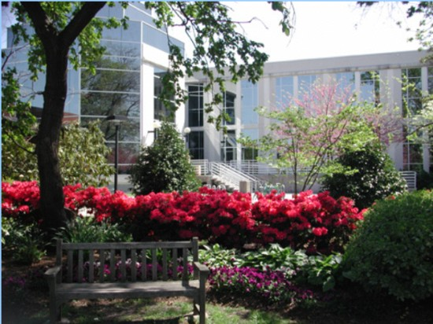
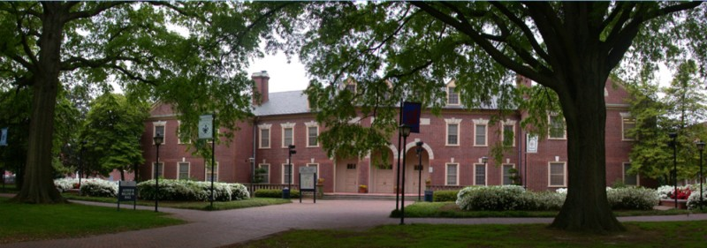
Norfolk, Virginia USA

Slide 2
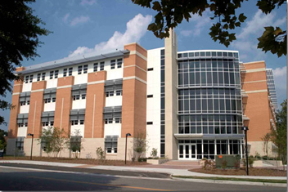
DEPARTMENT OF COMPUTER SCIENCE
http://www.cs.odu.edu
22 FACULTY MEMBERS
8 Professors
(1 Eminent Scholar, 2 Endowed Chairs)
6 Associate Professors
3 Assistant Professors
5 Lecturers
25 Adjunct/thesis Faculty
5 Adjunct courses/semester
http://www.cs.odu.edu
346 undergraduate majors
121 graduate students

Slide 3
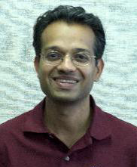
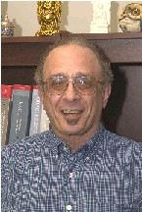
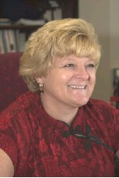
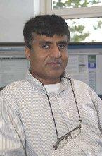

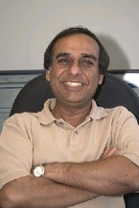
Departmental Administration
Chair:
Desh Ranjan
Assistant Chair & Chief Undergraduate Advisor:
Janet Brunelle
Director of Computer Resources:
Ajay Gupta
Assistant Chair:
Irwin Levinstein
Graduate Program Director: PhD program
Mohammad Zubair
Graduate Program Director: MS program
Ravi Mukkamala

Slide 4
Enrollment Comparisons
Students/course - Fall

Slide 5
SCH/Semester Students

Slide 6
Headcount Majors

Slide 7
GRADUATES

Slide 8
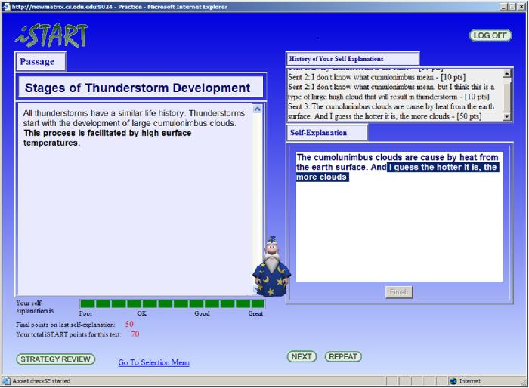
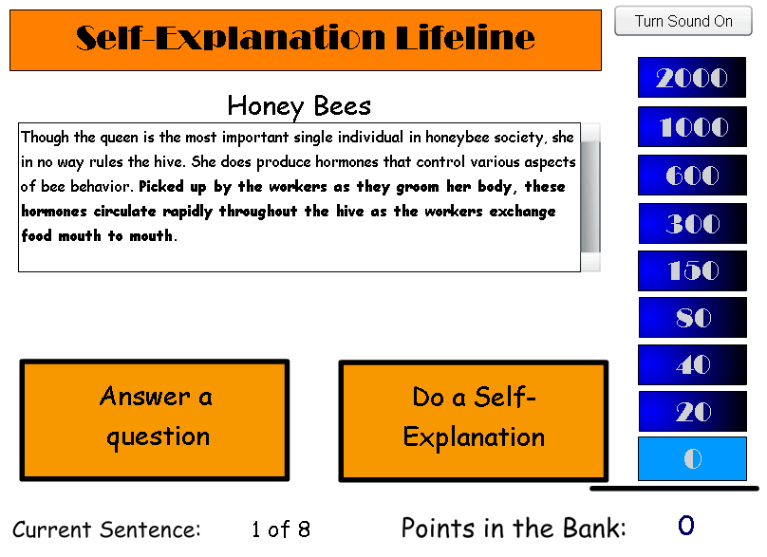
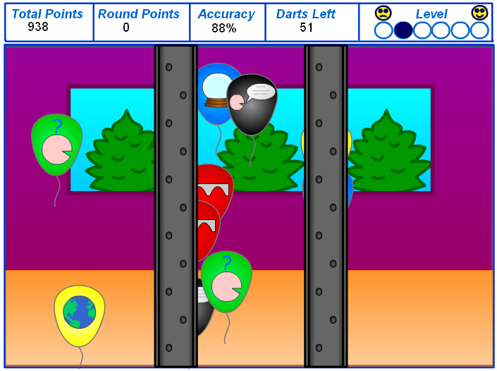
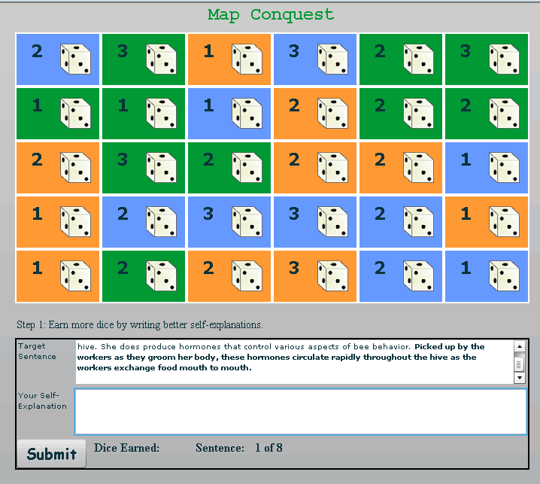
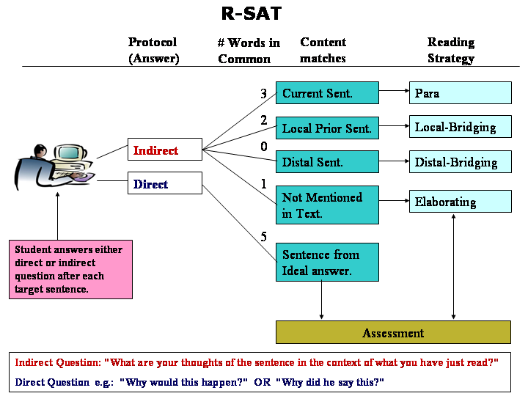
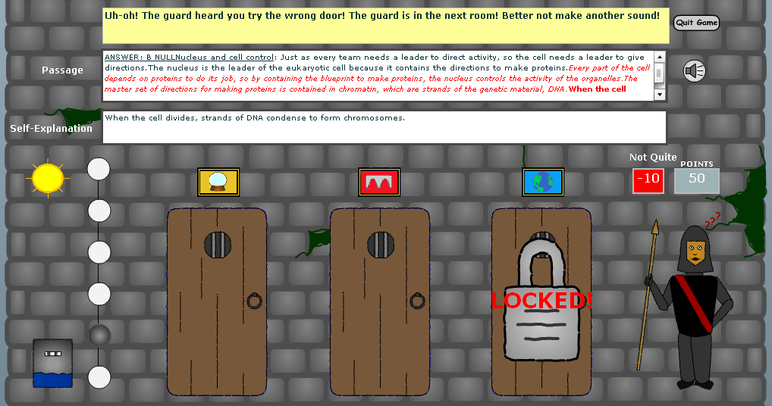
Irwin Levinstein: Intelligent Tutoring
Improving reading by interactive teaching of reading strategies
Use of games in tutoring
Interactive assessment of reading strategies

Slide 9

web science &
Michael L. Nelson
digital library
www.cs.odu.edu/~mln/
research
web science, social media, semantic web
interoperability, architecture, protocols
digital libraries, preservation, repositories
research:
funding:
PI or Co-PI on 14 grants, > $6.4M USD since 2001
NASA, NSF, Library of Congress, Andrew Mellon Foundation
NSF Career Award 2007-2011
current phd
students:
2 graduated; employed at Harding University & Emory University
7 current students in various stages
research activity: ws-dl.blogspot.com
future phd
students:
publish in top conferences and travel to present your results
collaborate with world renowned WS&DL researchers
find quality academic & research positions after graduation

Slide 10
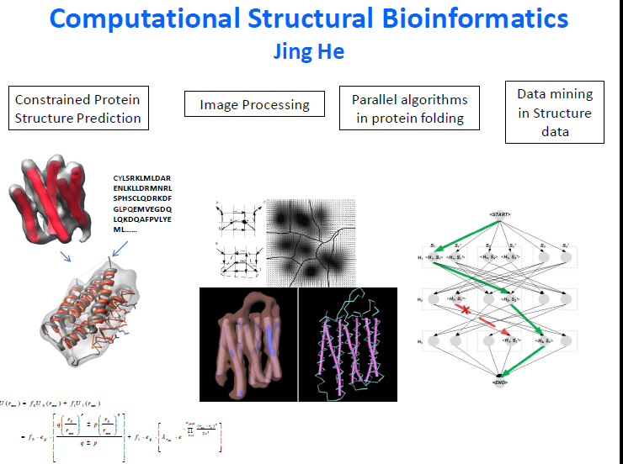

Slide 11
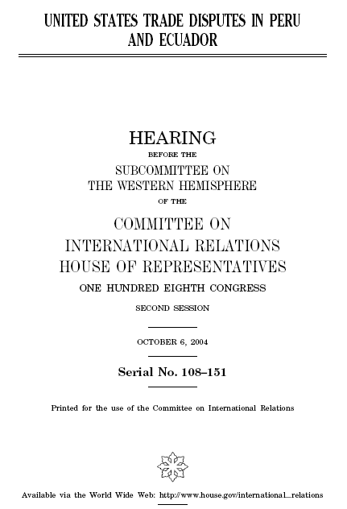
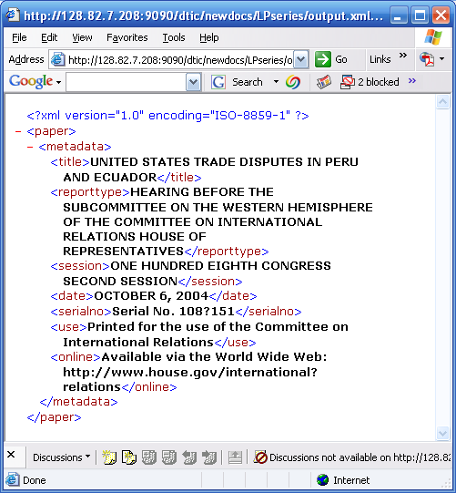
digital
Kurt Maly, Mohammad Zubair, and Steve Zeil
library
(maly, zubair, zeil)@cs.odu.edu
research
Scienceweb: qualitative query system of collaboratively built information network about science
Exploring social classification on a cloud: Collaborative classification of large, growing collections with evolving facets
Automated metadata extraction:
projects:
funding:
7 grants, > $2 M USD since 2005
NASA, NSF, DTIC, Andrew Mellon Foundation

Slide 12
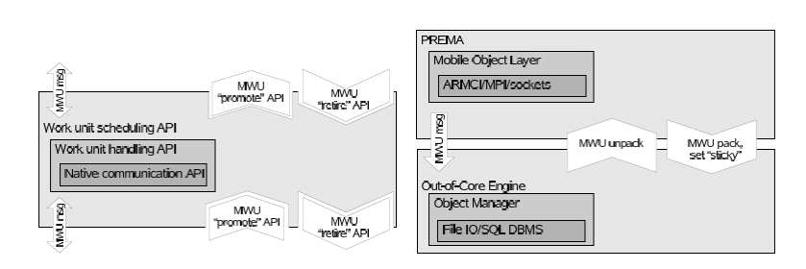
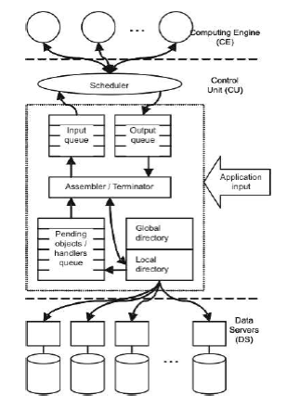
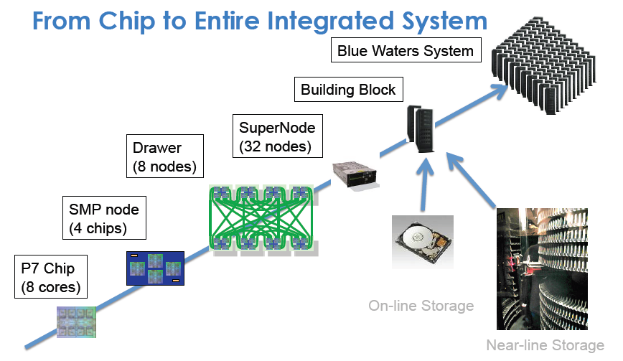
High-End Computing: Nikos Chrisochoides
Courtesy NCSA, UICl
Blue Waters will be installed at NCSA (UIUC) by 2011, $200M (IBM) nikos@cs.odu.edu

Slide 13
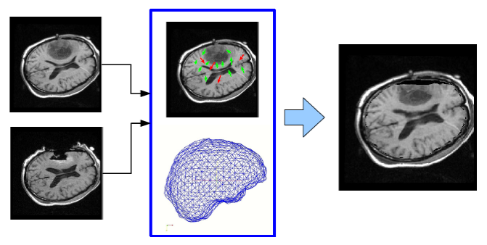
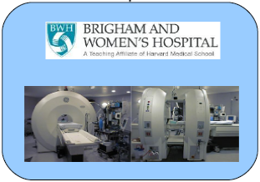
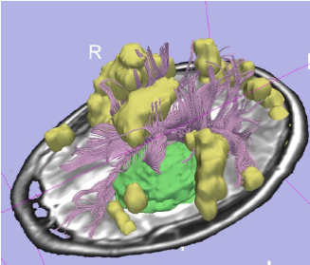


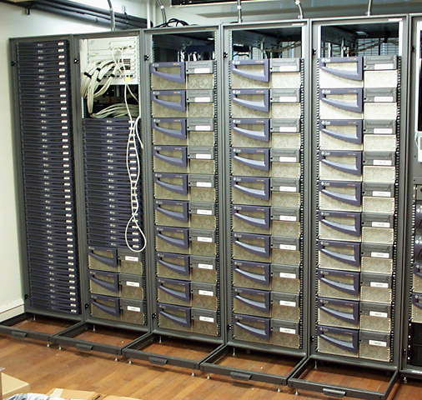
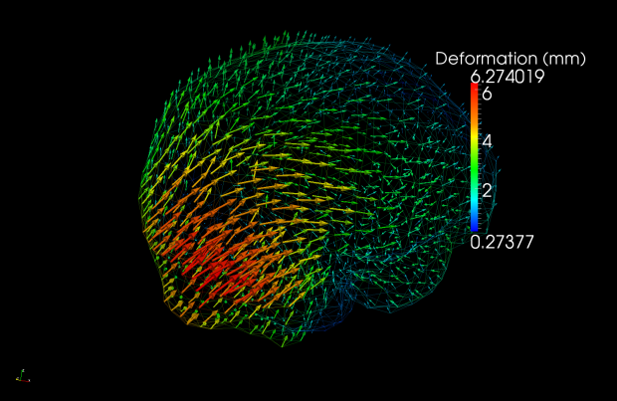
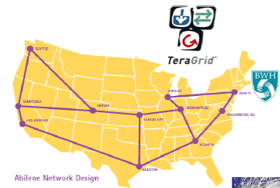
First ever clinical study using volume tracking at BWH, Harvard Medical School and CRTC: Nikos Chrisochoides N Nikos Chrisochoides
Dynamic Data Driven Computation Server
nikos@cs.odu.edu
Toward Real-Time Image Guided Neurosurgery Using Distributed and Grid Computing, ( with
A. Fedorov , A. Kot, N. Archip, P. Black, O. Clatz, A. Golby, R. Kikinis, S. Warfield), in ACM/IEEE SC06.

Slide 14
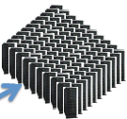
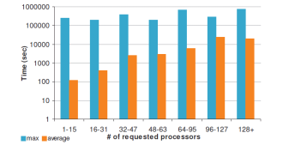
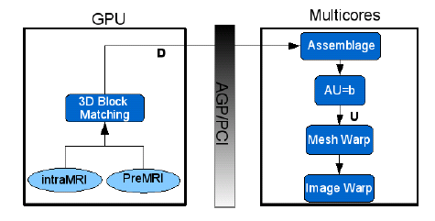

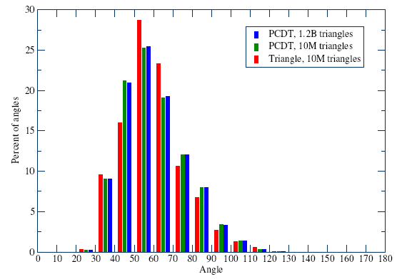
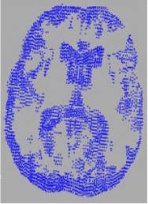
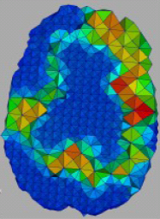
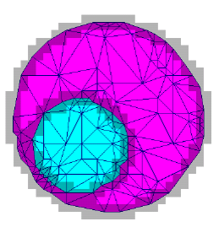
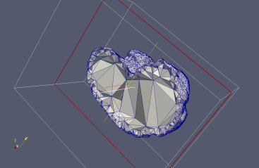
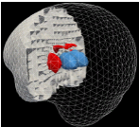
Parallel Mesh Generation: Nikos Chrisochoides
Performance
  Scalability (in terms of problem size and resources i.e., CPU, memory)
  Wall clock time
Stability: the elements of the global mesh should retain the same quality as the elements of sequentially generated meshes;
  no new small features (e.g.. angles, segments.. ) due to parallelism
Code re-use: leverage the ever evolving basic sequential meshing algorithms/software
  Sequential industrial strength meshers take 100 man-years years to develop and they are open ended in terms quality, speed, and functionality
Application specific: distribution of mesh points, gradation of elements and optimal size of mesh (real-time), multi-tissue, etc., …
http://crtc.wm.edu/html_output/publications_by_subject.php nikos@cs.odu.edu

Slide 15
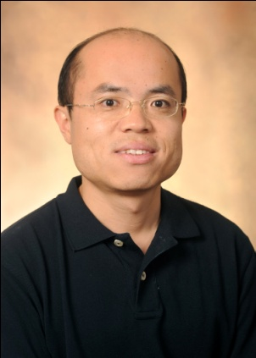
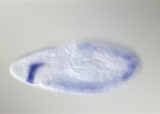
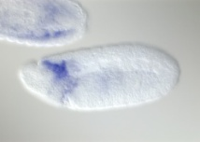
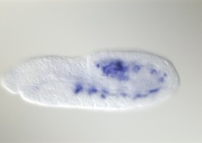
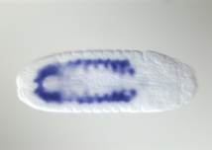
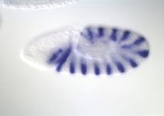
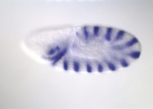
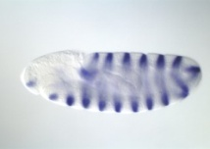
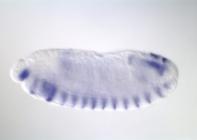
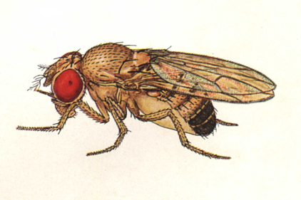
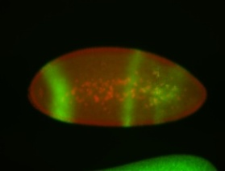
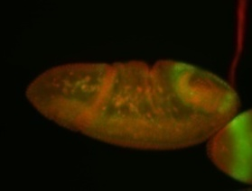
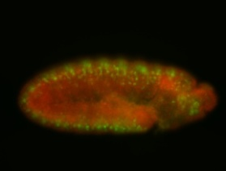
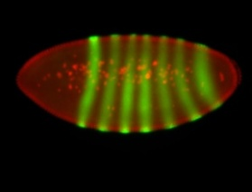
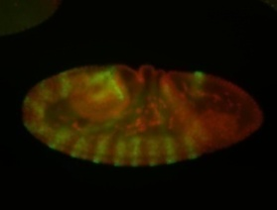


Shuiwang Ji, Assistant Professor
Computational Biology, Machine Learning,
Data Mining, Computer Vision http://www.cs.odu.edu/~sji/
Computational analysis of spatiotemporal gene expression patterns to uncover the genomic regulatory networks in fruit-fly
Learning fully automated, hierarchical, multi-instance, multi-task deep models for complex visual recognition tasks

Slide 16










Computational Biology
Yaohang Li http://www.cs.odu.edu/~yaohang
Computational Protein Modeling
Understand Protein Structures, Interactions, and Functions using Computational Approaches
Applications
Research supported by
Sampling Protein Conformation Space
Accurate Protein Energy Estimation
HPC
Protein Folding
Protein-Ligand Docking
Protein-Protein Interaction
Inhibitor Design

Slide 17






Vehicular Networking
Michele Weigle and Stephan Olariu
http://oducs-networking.blogspot.com
Provide safety applications and traffic congestion notification to travelers using vehicular communication
NOTICE (funded by NSF, 2007-2011)
Prototype built using sensor motes to detect and communicate with passing vehicles.
Demo Video @
http://bit.ly/notice-reu-2010

Slide 18
Ravi Mukkamala, Professor
Security, Privacy, Data Mining, and Cloud Computing http://www.cs.odu.edu/~mukka/
Privacy-preserving Data Mining (PPDM): developing algorithms to preserve privacy through data perturbation while retaining the underlying association rules.
Preserving Consistency and Security of Outsourced Data (over a cloud): employing signal-processing techniques for a client to ensure the correctness of outsourced data with minimal local overhead.
Tradeoff study: Model and analyze the tradeoffs among Computational cost, Storage cost, Throughput, Availability, Privacy and Security in an outsourced cloud environment. The study involves modeling different stakeholders (cloud owner, data owner, data miner, and the end user. The analysis includes probabilistic analysis, simulation, and empirical studies,

Slide 19













Data Owner
Data Perturbation
Results
Privacy&Accuracy Options
Original
Binning
Association Rules
No k (#bins).
Predefined k.
Exact k.
Modified
Privacy Preserving Mapping
Clusters
Modified Data
Data Mining
Data Miner

Slide 20


Sensor networks
ANSWER: AutoNomouS netWorked sEnsoRs
An integrated multi-layer design methodology with cross-layer optimization for networking autonomous sensor systems will enable secure, QoS-aware information services to in-situ mobile users
Funded by NSF 2007-2011
S. Olariu - http://www.cs.odu.edu/~olariu

