Slide 1
Office of Intercultural Relations

Slide 2
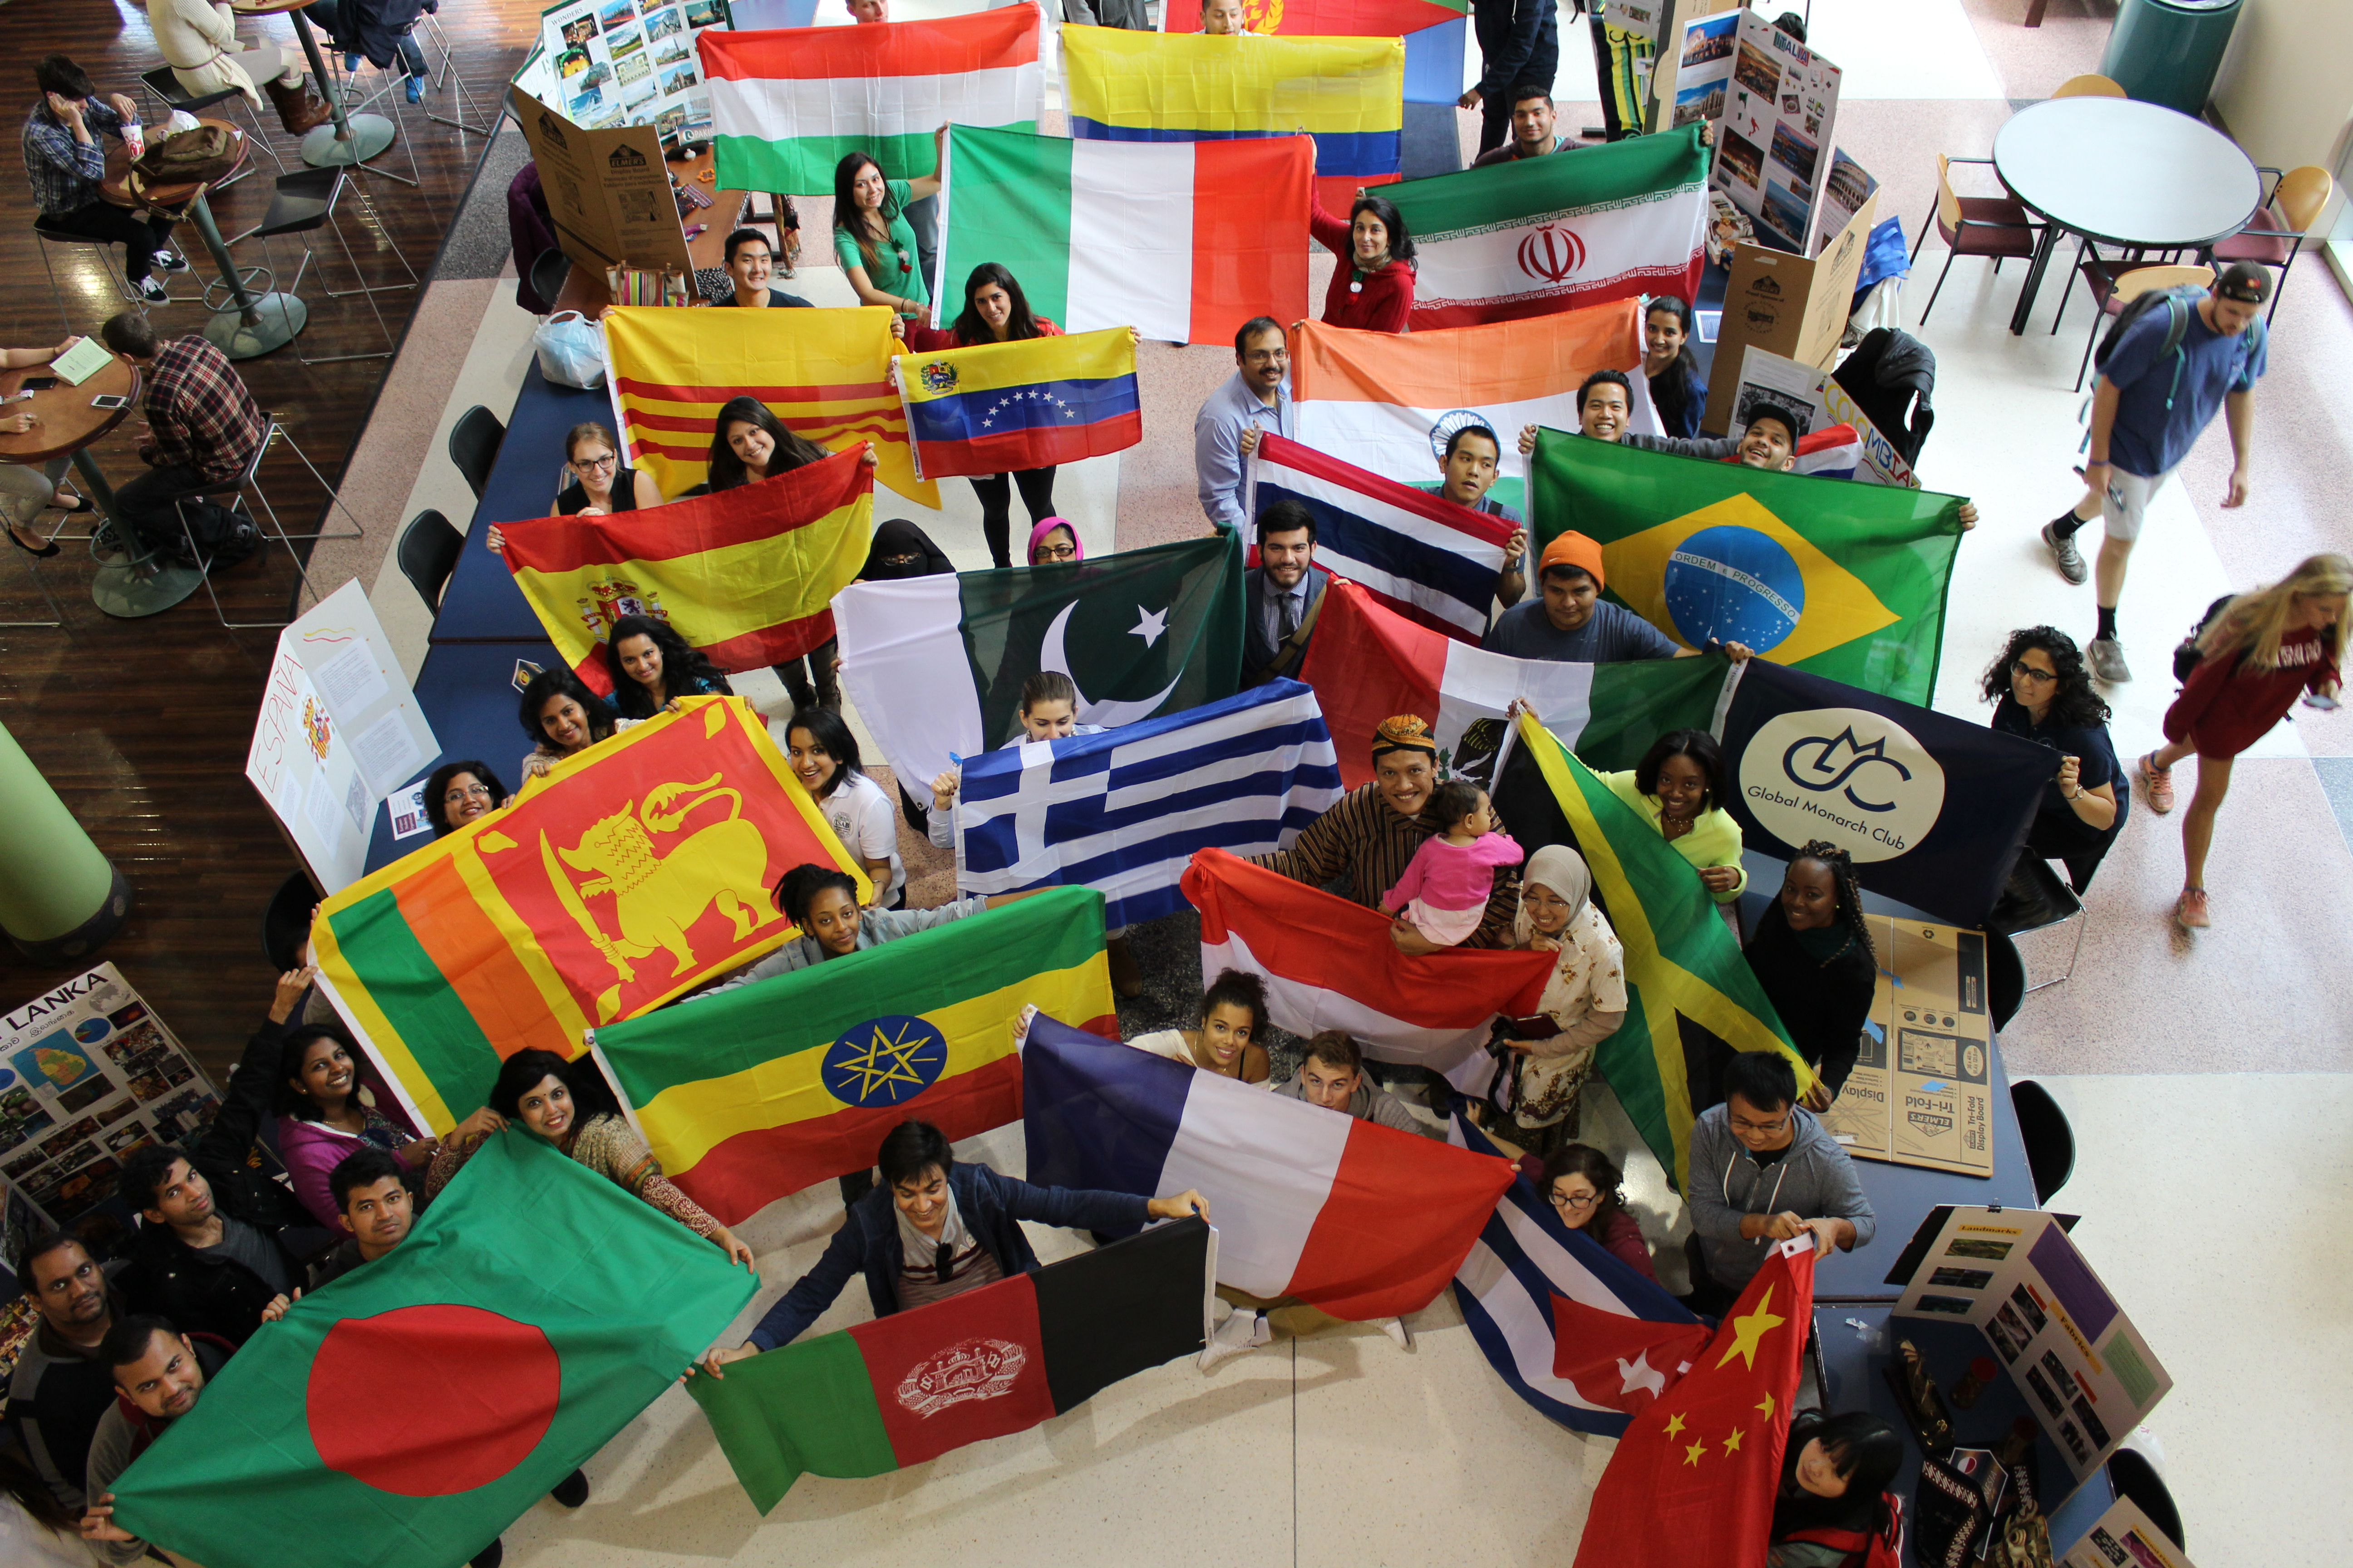
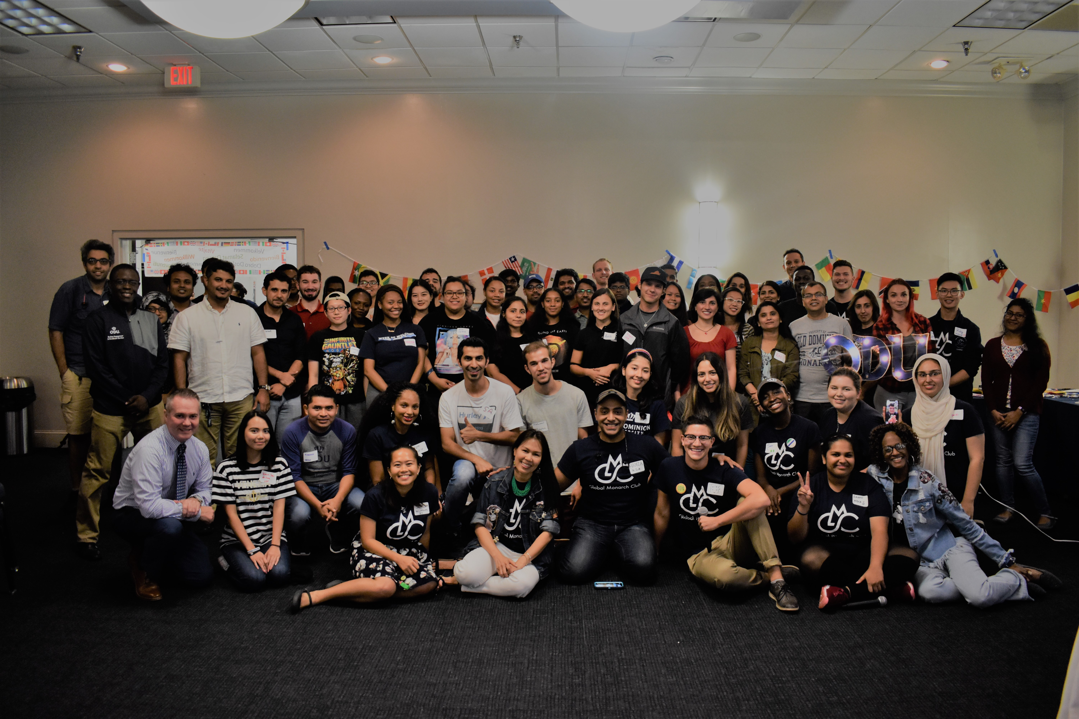
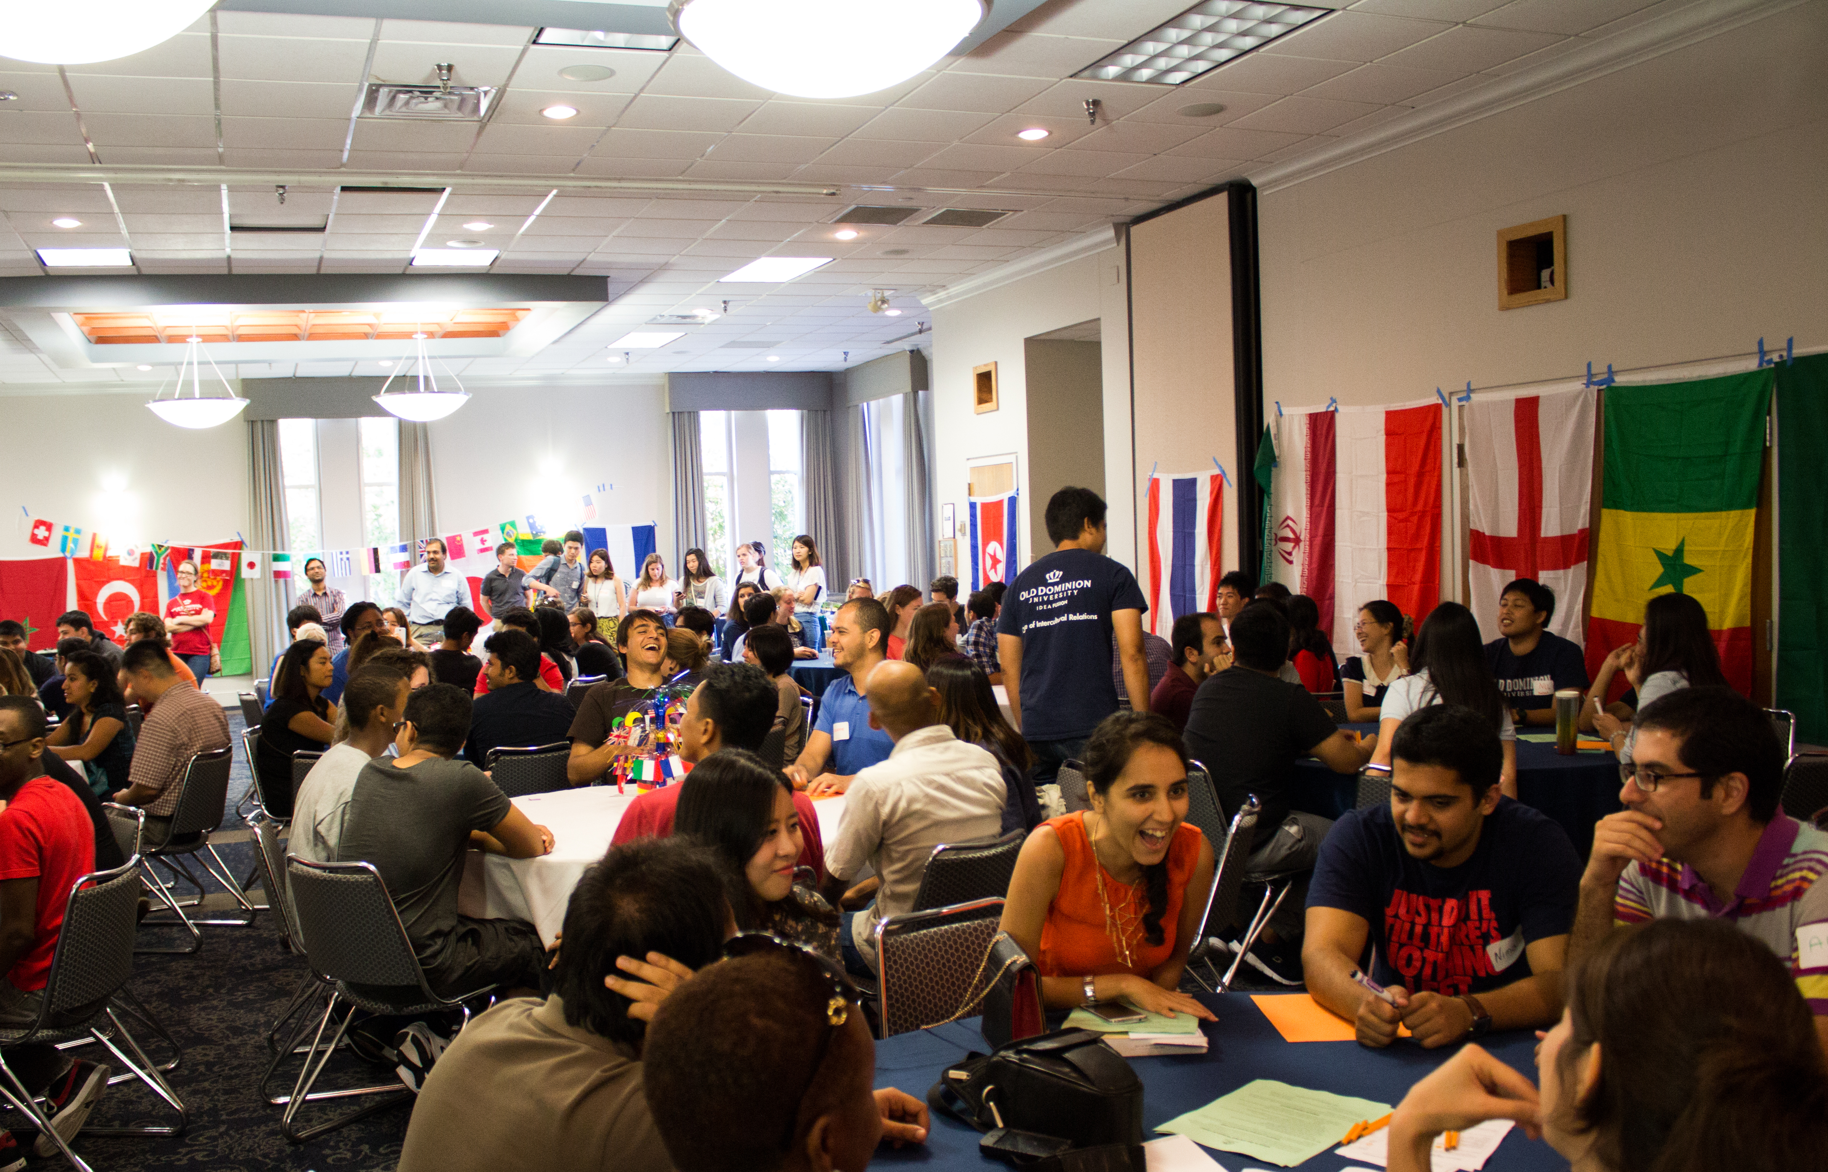
Our “Why”:
“Engagement with diversity is essential for democracy, and learning outcomes for all students to improve when a campus community provides opportunities for students to engage with people who are different from themselves.” ~Milem, Chang & Antonio, 2005

Slide 3
Office of Intercultural Relations Commitment
Inclusion I Diversity I Unity
Cultural Competence Globalization I Authenticity
Promote an inclusive and equitable campus community whose members have knowledge of one's own cultural identity and the culture of others
Cultivate a climate of awareness, understanding, and learning experiences
Develop and implement opportunities and trainings for cross cultural understanding, communication, cultural empathy and humility, critical thinking skills, awareness of structural power relations
Intentional and strategic planning for international and domestic authentic and meaningful interaction that prepares students to lead and participate in a global society

Slide 4
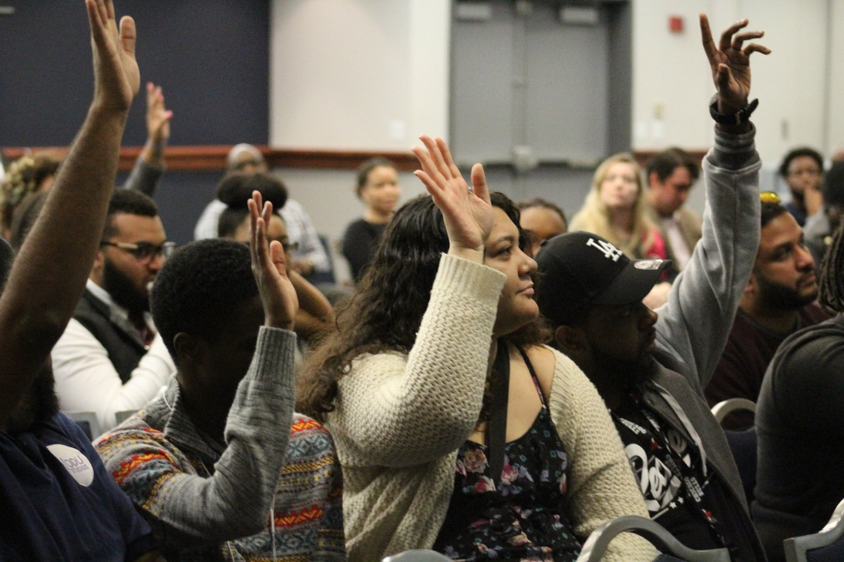
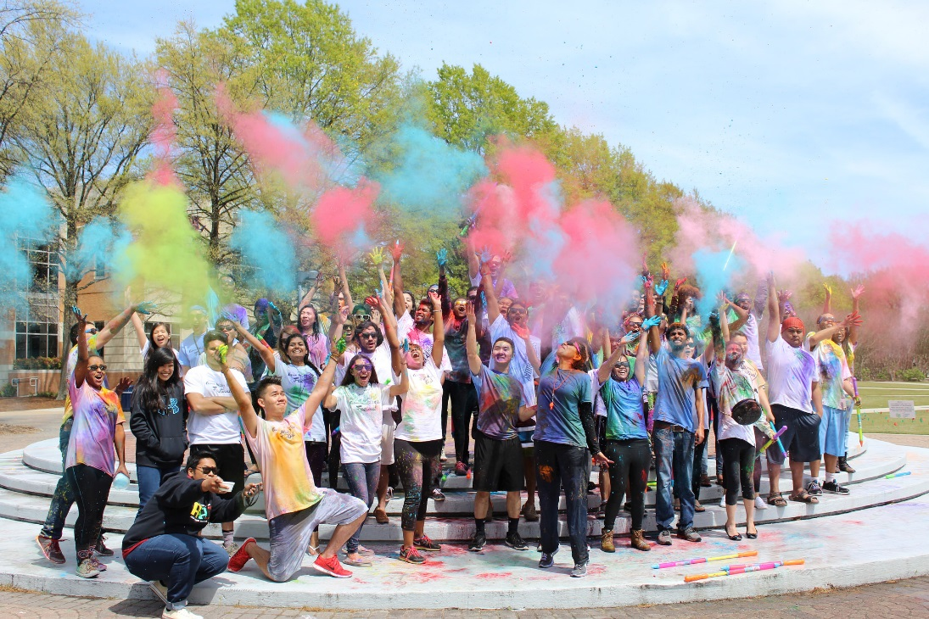
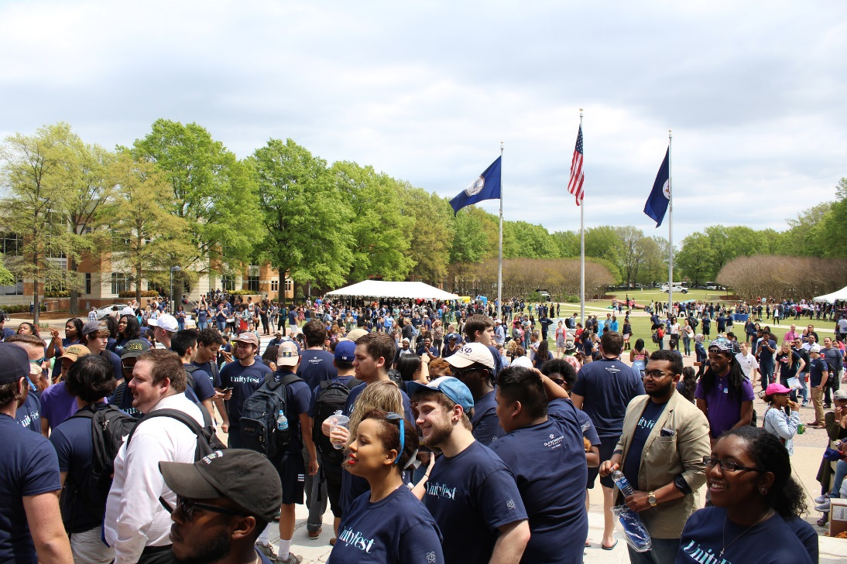
An Evolving Philosophy
Multicultural Student Services
1980
Hugo A. Owens African American Cultural Center
1991
The Office of Intercultural Relations
2009

Slide 5
Building Inclusive Communities
Authentic Cultural Transformation
OIR
Intercultural Initiatives
Multicultural
Initiatives
Interfaith
Initiatives
International Initiatives
LGBTQIA+
Initiatives
Diversity
Education

Slide 6
Intercultural Initiatives
Works closely with Asian-American, Multi-ethnic, Native American, and Interfaith student affinity groups to promote intercultural learning and engagement.
Objectives
Initiatives
Support all cultural demographics awareness and knowledge of cultural humility, identities, and intersectionality of self and others
Educate and promote intercultural interaction through education, training and cultural programs
Develop Inclusion Competencies: Cultural Knowledge; Cultural Transformation; Intergroup Coalition Building
Asian Students in America (A.S.I.A)
Asian Student Welcome Dinner
Cultural Explosion
Cultural Competency workshops & professional development seminars
Head of the Family Dinner
Native American Heritage Month Celebrations
Unity Fest

Slide 7
International Initiatives
Connect Globally, Engage Locally
"Internationalization at Home is the purposeful integration of international and intercultural dimensions into the formal and informal curriculum for all students within domestic learning environments" (Beelen & Jones, 2015).
Objectives
Initiatives
Campus Internationalization. Supporting the academic, social, and cultural integration of the international student population.
Global Learning. Providing educational, experiential, and cultural programs that enhance global awareness and international perspectives.
Intercultural Engagement. Stimulate cultural engagement of globally diverse populations in inclusive, local environments.
Discover America Series
Academic Integration and Success
Intercultural Learning/Community Connection & Engagement
Personal and Professional Development
Student Life/Life in the U.S.
International Student Advisory Board
International Student Success Advisory Council
Global Monarch Club
MINT (Monarch International Newcomer Transition) Program
International Education Week (IEW)

Slide 8
Multicultural Initiatives
Provides intentional programs, culturally-relevant celebrations, events, safe-spaces and cross-cultural trainings that fostered Black and Latinx student engagement, sense of well-being, and academic success
Objectives
Initiatives
Create a university climate that welcomes and values the cultural identities and lived experiences of our Black and Latinx Monarch communities
Support these communities through intentional programs, cultural celebrations, activities, events, and cross-cultural trainings
Foster Black and Latinx student engagement, sense of wellbeing, and academic success
Embrace students’ voices, unique personality, talents, and abilities
Sankofa Dinner
Umoja Conference
Barber Shop Talks
Family Reunion
Black Male & Sisterhood Symposiums
Adelante
Hispanic Heritage Month
Hispanos & Latinos Unidos
Latinx Mentorship

Slide 9
LGBTQIA+ Initiatives
Strives to reduce homophobia, transphobia, and heterosexism on campus through educational and interactive programming, mentorship, and advocacy. Creates a wider network of support for LGBTQIA+ students through interdepartmental collaborations and co-sponsorships.
Objectives
Initiatives
Reduce homophobia, transphobia, and heterosexism in the ODU community
Provide interactive programming, mentorship and advocacy
Be the number one educational resource for LGBTQ+ at Old Dominion University
Engage the community in the creation of a safe and open campus environment
Support the development of students of all gender and sexual identifies through advocacy, programming, and social outreach
ODU Sexuality and Gender Alliance (SAGA)
Safe Space
Lavender Reception
Rainbow Graduation
World AIDS Day
HIV/AIDS Testing
LGBTQ+ Mentor Program
Queer-EDU

Slide 10
Interfaith Initiatives
Interfaith affinity group are committed to promoting an inclusive university culture that provides opportunities for positive interactions, engaged learning and celebrations that respects the multi faiths and beliefs of all Monarchs.
Objectives
Initiatives
Interfaith Initiatives helps one to understand and see faith through another person's eyes.
It helps one to experience their own faith in a whole another dimension by experiencing another person's faith.
It helps one to spear through the various racial and religious challenges.
It helps one to be a better leader in the society.
Monarch Interfaith Community (MIC)
Monarch Interfaith Dialogues
Interfaith discussions
University Chaplains - Student discussion
Partnering with University Faith Organizations such as Hillel, Campus Crusade for Christ, Muslim Student Association, Global Student Friendship, Buddhists Association and many others.

Slide 11
Diversity Education
provides opportunities for students to gain knowledge, self-awareness, and skills needed to engage and lead from a culturally inclusive paradigm.
Objectives
Initiatives
Educate and promote cultural humility as acquisition of knowledge and self awareness to effectively navigate, negotiate and cooperate in diverse settings
Develop and enhance self-awareness and cultural competence
Create space for dialogue, with an emphasis on voices often marginalized
Build skills and capacity to address emerging social issues and create positive social impact
DiversABILITY (In partnership with Office of Educational Accessibility)
Diversity Institute
Own Your Narrative Series
Workshops on dialogue skills, intersectionality, and social identity recognition
Spill the Tea

Slide 12
IMPACT
Self Awareness and Identity I Cross Cultural Engagement Enhance Global Learning, Interest and Experience I
Sense of Belonging/Community
“Afro-Latino's face more discrimination that I knew. I learned that I am not alone here.”
“I enjoy learning about the diversity of our student community”
"When thousands of people discover their story is also someone else's story, they have a chance to write a new story together"
“I probably never would have this amazing experience, and this is why this program is so vital for any person who has not fully opened their mind to other(s) cultures or people who may not be “Like them”.
“There are many different cultures represented in the Global Monarch Club.
“I’m glad there’s an opportunity to find others like me. Knowing other queer people are here and thriving gives me hope.”

Slide 13
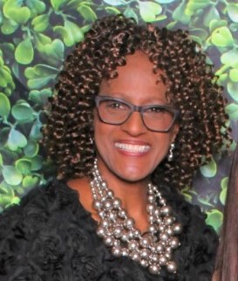
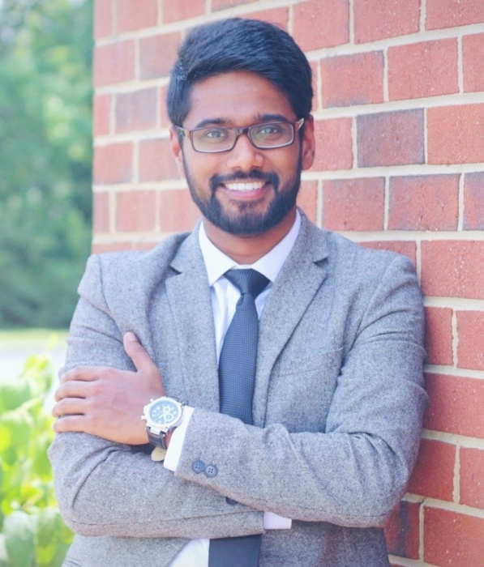
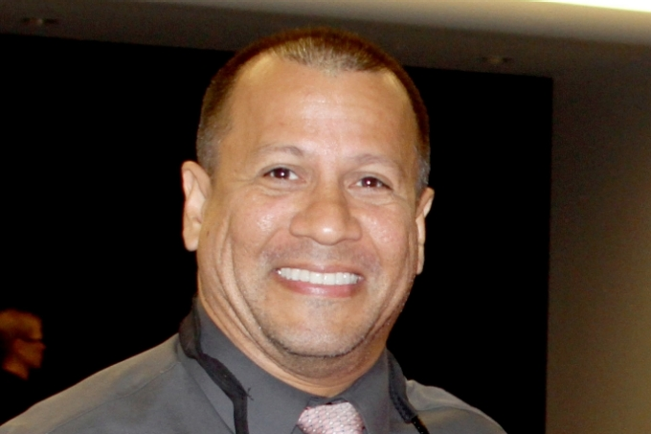
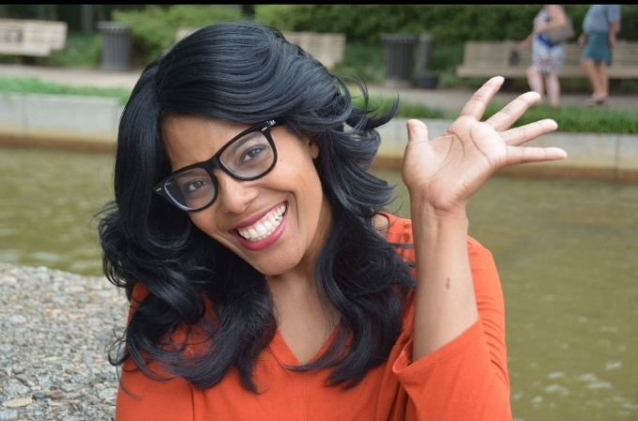
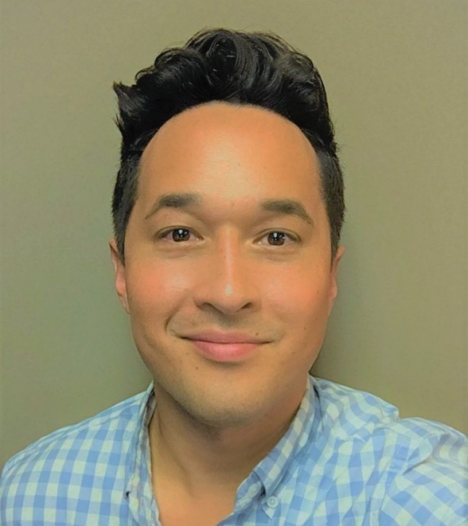
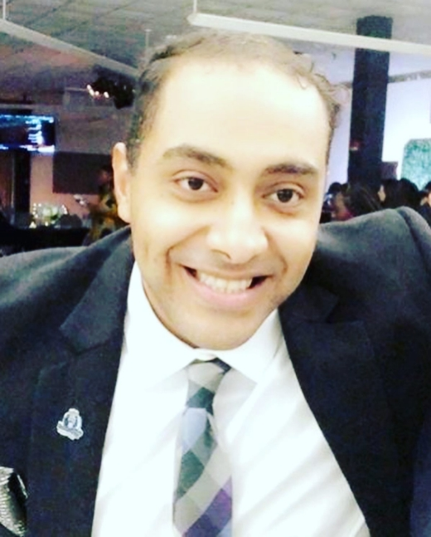
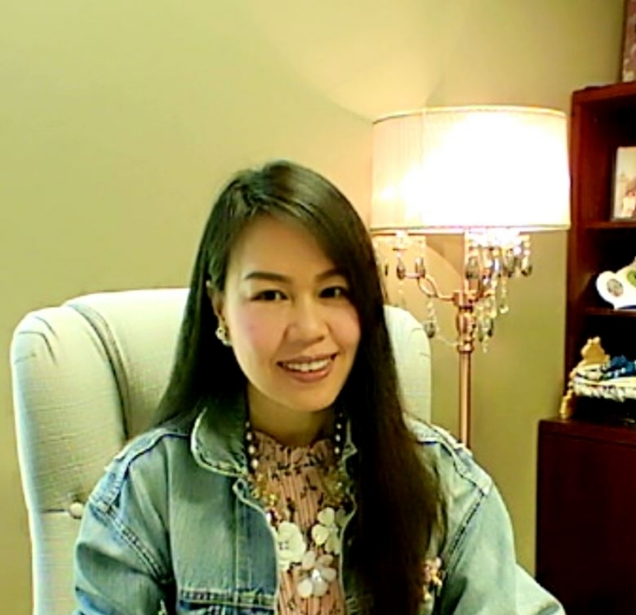
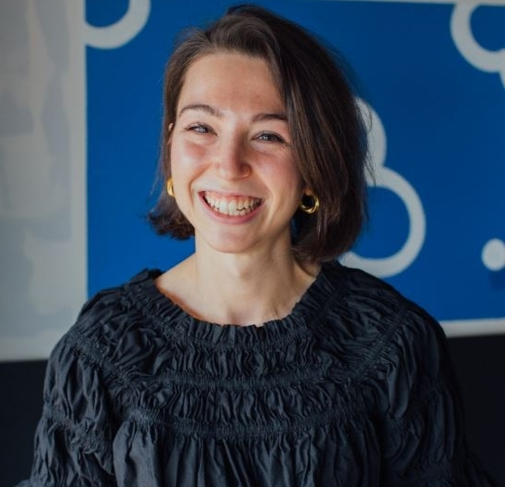
Jose Ramose Associate Director Intercultural Initiatives
jeramos@odu.edu
Pettie Perkins Graduate Assistant Multicultural Initiatives
iperkins@odu.edu
Edward Moses Selvaraj Graduate Assistant Diversity Education
esamselv@odu.edu
Lesa Clark
Executive Director lclark@odu.edu
Rachawan Wongtrirat Associate Director
International Initiatives
rwongtri@odu.edu
Andrew Garber Coordinator LGBTQIA+ Initiatives
agarber@odu.edu
Hamza Khalid Graduate Assistant Intercultural Initiatives
hmohamme@odu.edu
Mary Wilcox Graduate Assistant International Initiatives
mwilcox@odu.edu

Slide 14
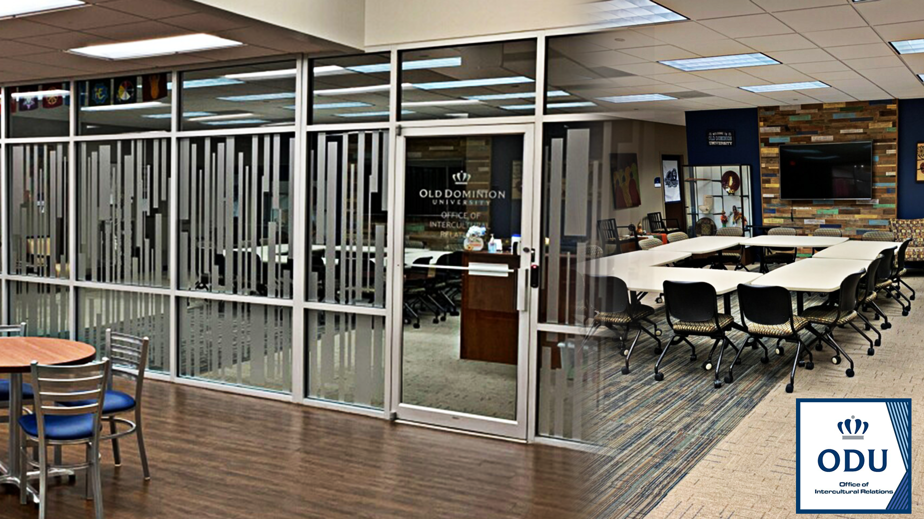
Office of Intercultural Relations 1200 Webb Center (1st floor) I 757.683.4406
odu.edu/OIR I OIR@odu.edu

