Slide 1
Recruiting & Retaining Diverse Faculty
COS Workshop
Thursday, September 24, 2020
Barbara Hargrave, Professor
Department of Biological Sciences and The Frank Reidy Center for Bioelectrics

Slide 2
Several Reasons for Minority Faculty Attrition include (but are not limited to):
Isolation and Lack of Inclusivity
How Does This Picture Make “YOU” Feel?

Slide 3
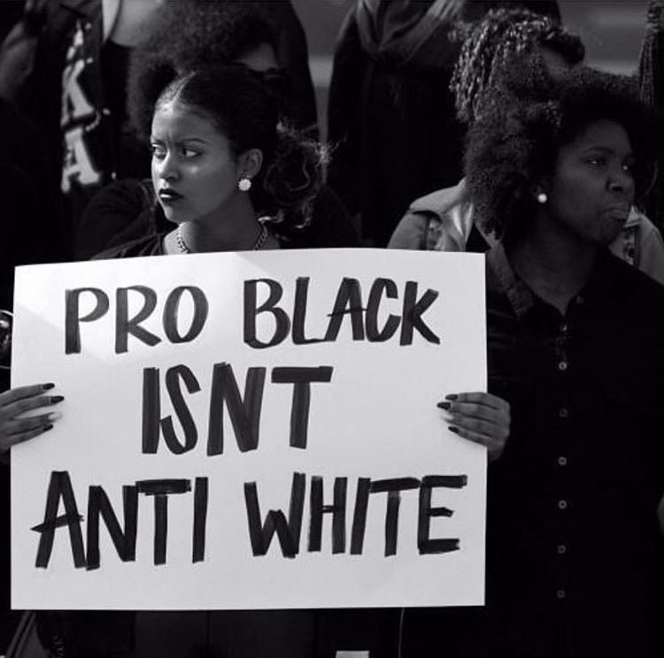
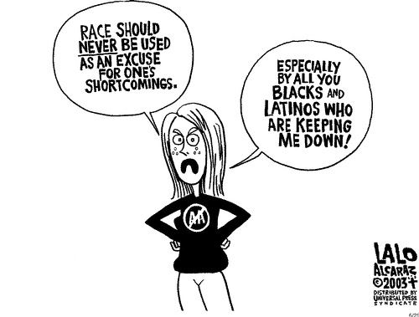
Stereotyping (or racism)

Slide 4
Lack of Mentorship

Slide 5
Final Thoughts:
Creating a supportive and welcoming environment benefits all faculty; leadership should consider the challenges that members of underrepresented groups face (Gasman, Kim and Nguyen 2011).
To build outstanding and diverse departments we need to take a page from competitive athletics and the world of business by aggressively pursuing diverse candidates.
Indeed, we might have to help in developing these candidates when the potential is there.
Resources:
Tomorrow's Professor Postings, Stanford University
https://leadatanylevel.com/when=do you-feel-included/
Guide to Best Practices in Faculty Retention-Draft Online https://provost.columbia.edu/sites/default/files/content/RetentionGuide_0.pdf

Slide 6
Thank You for Your Attention

