Slide 1
Integrating Social Media into the Classroom
Richard N. Landers, Ph.D.

Slide 2
Social Media (as if you need an introduction)
Everyone’s Using It
500+ million users on Facebook alone
96% of college students in 2009 use it almost daily
Correlation with GPA in the past, not so much now
More time on Facebook than on Google
(Sources: FB.com, 2009 UNH study, comScore Inc)

Slide 3
A Little Learning Theory
Learning Happens in Businesses Too
Most of it is informal, which is perceived as more valuable
Informal learning supports scaffolding
Affects perceived relevance, and ultimately learning/training motivation
Informal mechanisms of learning may be more valuable/effective at engaging learners

Slide 4
Social Media Capitalizes On…
Informal interactions abound
Time students are spending anyway
Students are generally comfortable with technology (“digital natives”)

Slide 5
…But it Does Create Problems
Where are the boundaries?
Friending
What should be required/graded?
General conversation
The “extra credit” solution

Slide 6
…But it Does Create Problems
Which medium should we use?
Facebook
Facebook Groups
Twitter
Ning
Something else?

Slide 7
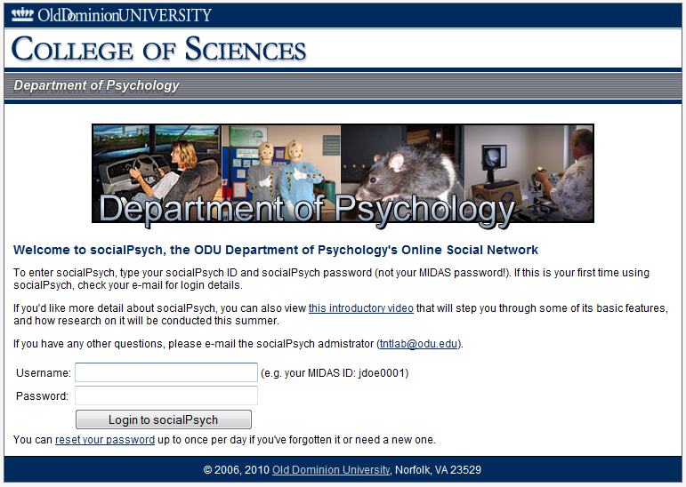
socialPsych

Slide 8
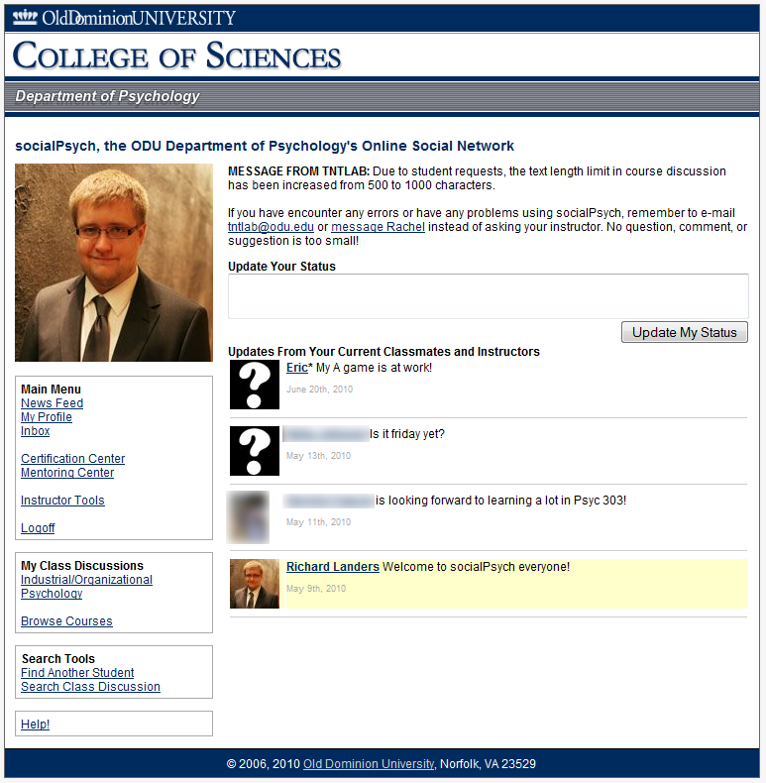

Slide 9
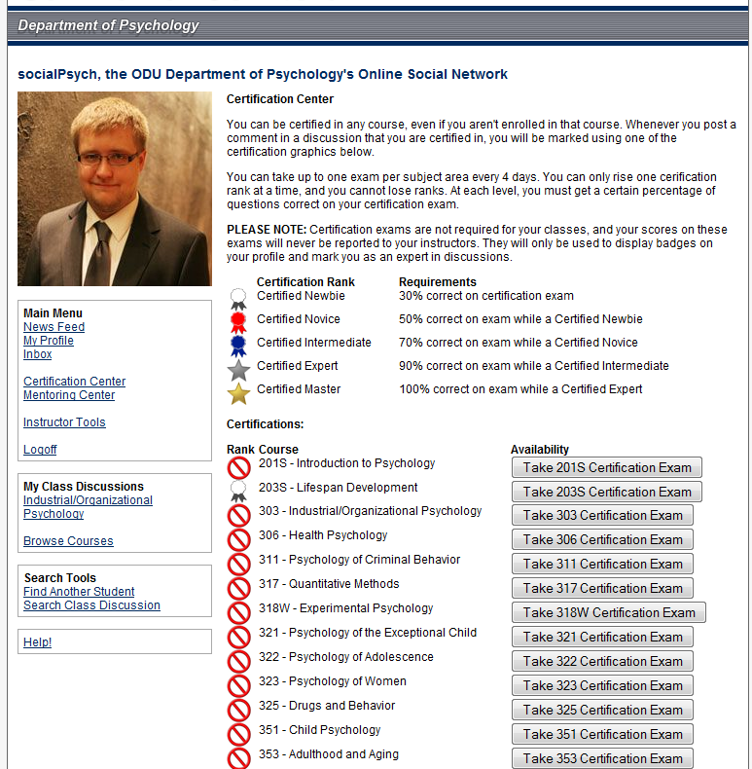

Slide 10
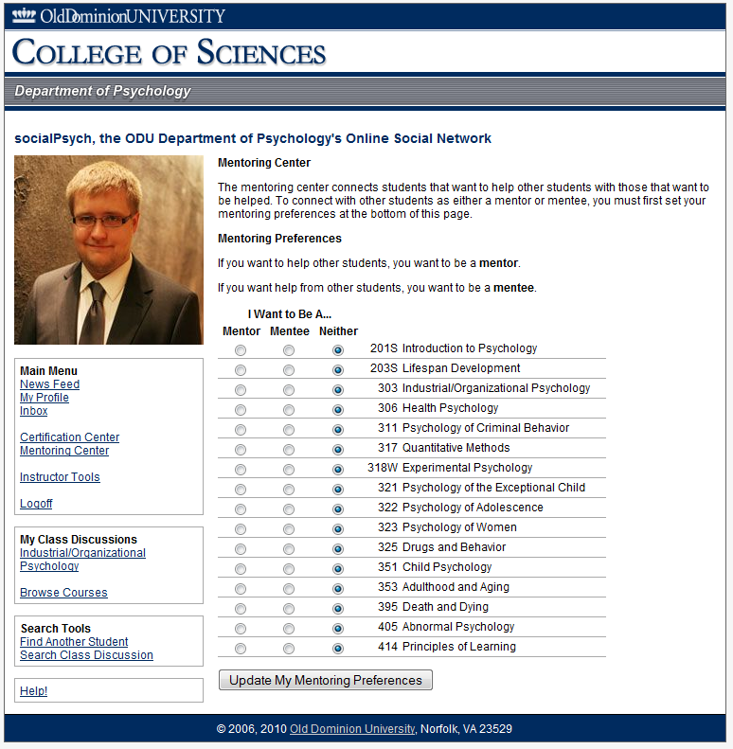

Slide 11
The Verdict?
Looks promising, but many implementation concerns with little research to guide them
Ethical boundaries are fuzzy
Student expectations are changing

Slide 12
Questions?
Richard N. Landers, Ph.D. Industrial/Organizational Psychology Blog: http://neoacademic.com rnlanders@odu.edu
socialPsych Introduction http://vimeo.com/11500513

