Slide 1

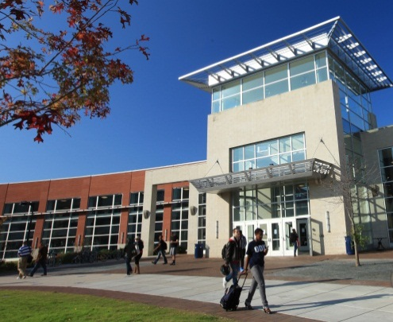
Board of Visitors Orientation
August 18, 2014

Slide 2
Legal Issues
Earl Nance
Assistant Attorney General and General Counsel

Slide 3
Powers of Board of Visitors
Hold property of University
Accept gifts, grants and bequests
Control and expend university funds
Set policy, tuition and fees
Buy and sell property

Slide 4
Powers of Board of Visitors
Hire and fire University President
Confer degrees
Jointly control Virginia Beach Higher Education Center with Norfolk State University

Slide 5
Duties - Fiduciary
Common sense – Oversight
Good business judgment
No personal profit – Contracts & Gifts – COIA
Avoid deficits – Personal Liability
Follow meetings law – FOIA – Closed Sessions – Personal Liability

Slide 6
Liabilities
None if acting in good faith
No personal liability for University’s contracts
If sued, attorney general may defend; commonwealth pays

Slide 7
FOIA Issues and Responsibilities
Affirmative duty to read and be familiar with FOIA
Public meetings presumed open, unless exemption properly invoked
“Meeting” = 3 or more members conducting public business
“Executive Session” = Obsolete; Now “Closed Meeting”

Slide 8
FOIA
Procedures to properly convene a closed session:
  Motion in a public meeting
    Identifies subject matter and purpose
    States specific statutory exception
    Minutes must reflect motion
  During closed meeting
    Only discuss matters identified
    No votes nor decisions
    Minutes are not open for public inspection

Slide 9
FOIA
Procedures to properly convene a closed session:
  Board must reconvene in open session and record votes with individual certification
  Decisions only effective if Board votes upon them in open meeting

Slide 10
FOIA
Closed session authorized to discuss:
  Personnel matters
  Admission or discipline of identifiable student; or disclosure of scholastic record information
  Acquisition or disposition of real property
  Personal matters unrelated to business
  Investing public funds where competition or bargaining is involved
  Matters in consultation with legal counsel
  Fund-raising activities, and service contracts
  Honorary degrees or special awards

Slide 11
FOIA
3 days notice required for date, time and location of meeting
Emergency meetings – unforeseen circumstances
Minutes required for open meetings
Board cannot vote by written or secret ballot
Public may make their own record of open meetings if not disruptive
Those who intentionally violate FOIA will be individually liable

Slide 12
COIA Responsibilities
Training is required every 2 years
Applies to BOV members
Officers generally may not have a personal interest in a contract with the University
Officers generally may not have a personal interest in a university transaction

Slide 13
Support and Assistance to the Board
President and other administrators
General Counsel
University Auditor

Slide 14
Board of Visitors Orientation
August 18, 2014

