Slide 1
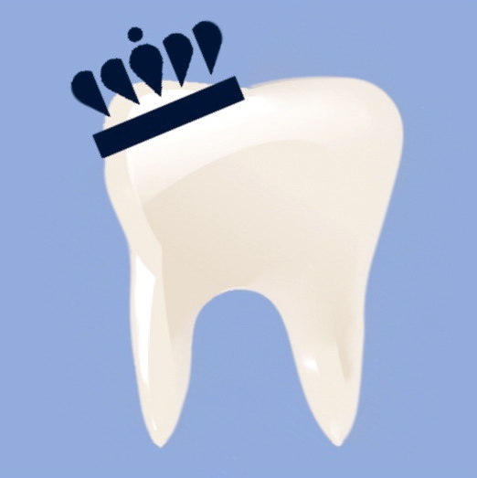
DENTAL RESEARCH STUDY
Interactive Immersive Visualization
During Dental Hygiene Treatment
IRB APPROVAL # 12-225
Free Dental Cleaning
We are looking for people who are anxious during dental hygiene treatment.
YOU must:
Be generally healthy
Adults males or females 18 -65 years of age
No severe dental caries
No severe periodontal disease
Be able to wear visualization headsets for 60 minutes or less.
Old Dominion University
Dental Hygiene Research Center,
Health Science Building # 1103
Requires 1 short screening visit (15 minutes) and
1 treatment visit (approximately 90 minutes)
CALL 757-683-4719
For Screening Appointment

