Slide 1
Analyzing CLAS12 Data
David Payette

Slide 2
Outline
CLAS12 Software Scheme
Groovy vs ROOT
Groovy process and useful documentation and tools
Groovy Advantages/Disadvantages
ROOT process and useful documentation and tools
ROOT Advantages/Disadvantages
Results
Cuts
Elastic and Spectator Proton Results

Slide 3
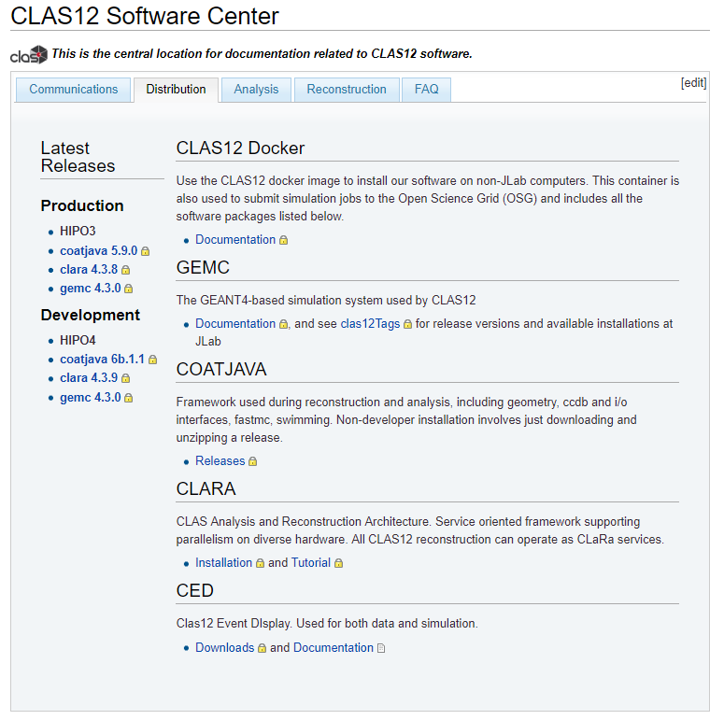
CLAS12 Software
https://clasweb.jlab.org/wiki/index.php/CLAS12_Software_Center#tab=Distribution

Slide 4
CLAS12 Software: COATJAVA
CLAS12 Offline Analysis Tools JAVA
Used for reconstructing simulated or real data, including packages for event reconstruction in all “standard” CLAS12 detectors
Raw data files are “cooked” using this software and the cooked files are what we use for analysis
Needed for groovy communication with CLAS12 analysis tools
Can be installed using CLARA (easiest way) or the source code can be built on its own, although many of the tools provided with COATJAVA will have to be edited to use a new file path
“Framework used during reconstruction and analysis, including geometry, ccdb and i/o interfaces, fastmc, swimming. Non-developer installation involves just downloading and unzipping a release.” –software center

Slide 5
CLAS12 Software: CLARA
CLAS Analysis and Reconstruction Architecture
A service-oriented software which can be used to run COATJAVA including running the software multi-threaded for improved performance
Improves the user-interface with COATJAVA and allows for easy use locally or on the JLAB farm
Makes installing the software significantly easier
“CLAS Analysis and Reconstruction Architecture. Service oriented framework supporting parallelism on diverse hardware. All CLAS12 reconstruction can operate as CLaRa services.” –software center

Slide 6
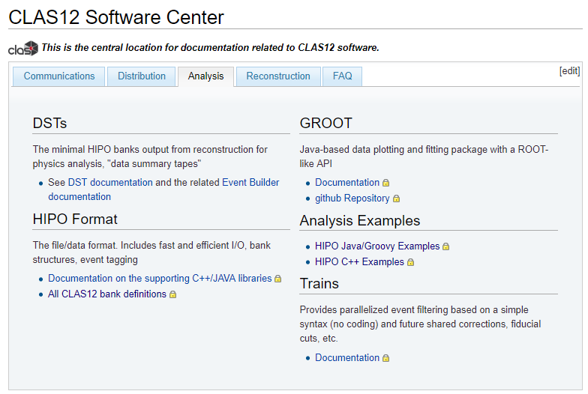
CLAS12 Data Analysis

Slide 7
Groovy vs ROOT

Slide 8
Groovy vs ROOT
Two main ways of analyzing CLAS12 data
Groovy supports JAVA syntax, while ROOT supports C++ syntax
Both Groovy and ROOT are supported on the JLAB farm

Slide 9
Groovy
Java syntax compatible
The process for compiling and executing groovy scripts comes included in COATJAVA installation under /bin/run-groovy
Using this method of execution allows for all the included libraries from COATJAVA to be used including GROOT
GROOT is the plotting and fitting package included with COATJAVA which was developed with ROOT-similar syntax and objects (TH1, TF1, etc.) in mind

Slide 10
Groovy Advantages/Disadvantages
Advantages
Compile and Execute with all libraries included as part of the COATJAVA installation
Syntax light
Several examples in the Software Center
Less work needed to process HIPO files as input
Disadvantages
Having to use GROOT means not having all the plotting and fitting power associated with ROOT as GROOT is a smaller subset of ROOT’s plotting and fitting
Need to know JAVA which is less common for physics-based analysis

Slide 11
ROOT
C++ syntax compatible
In order to read HIPO files as input using a ROOT script you can execute the following command from the Jlab farm:
/group/clas12/packages/hipo-io/bin/hipo --code myfile.hipo
This creates a script automatically which will allow you to read all the banks in your hipo file and store them into branches
The full tutorial for this can be found at the software center page

Slide 12
ROOT Advantages/Disadvantages
Advantages
Robust fitting and plotting tools
Highly optimized for Data Analysis
Tons of online support
More commonly used for Physics-based analysis
Disadvantages
Reading HIPO files is slightly more complicated, without the auto-script it would be much more challenging (outdated)

Slide 13
Where to find data
On the jlab farm, cooked data can be found at: /work/clas12/rg-a/
Here you can use either full data files in /data/ or you can use the various trains they have under /trains/
Keep in mind this data moves fairly often and sometimes files will disappear and reappear as new versions of the reconstruction are used to re-cook the data

Slide 14
Using HIPO Banks /bin/hipo-utils –dump
Event.json

Slide 15
Using HIPO Banks
Event.json

Slide 16
Using HIPO Banks
Event.json
https://clasweb.jlab.org/wiki/index.php/CLAS12_DSTs_-_Bank_Links
For a tutorial on reverse index mapping:

Slide 17
Analysis Cuts
Global Cuts:
Electron-Proton Coincidence
Number of Photoelectrons > 2
Electron in the forward detector (5 < Theta < 40) with energy > 10% beam energy
Elastic Cuts:
Proton in the central detector (Theta > 40)
Delta Phi between proton and electron (175 – 185)
Proton Mass + Beam Energy – (Ep + Ee) < 0.5
Invariant Mass W < 1
Spectator Proton Cuts:
Proton with backward angles (Theta > 90)
W > 1.5

Slide 18
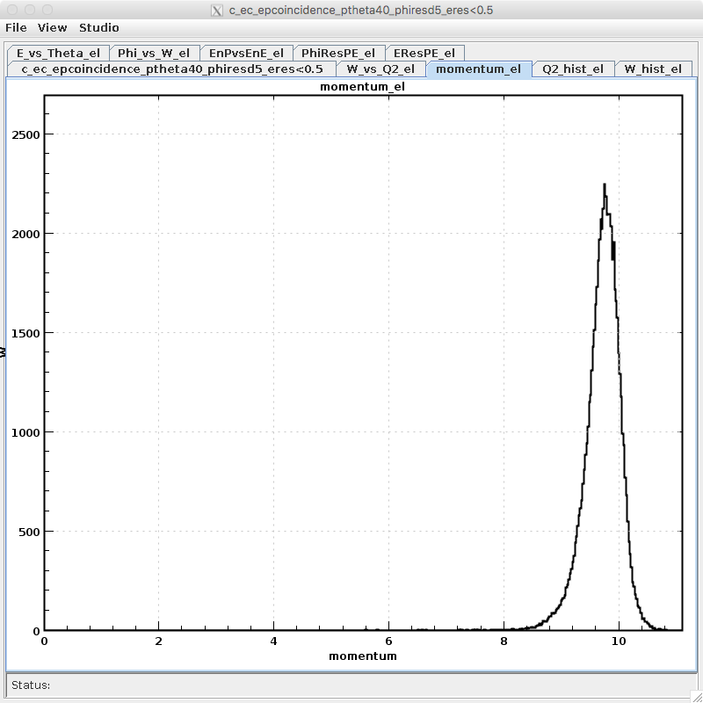
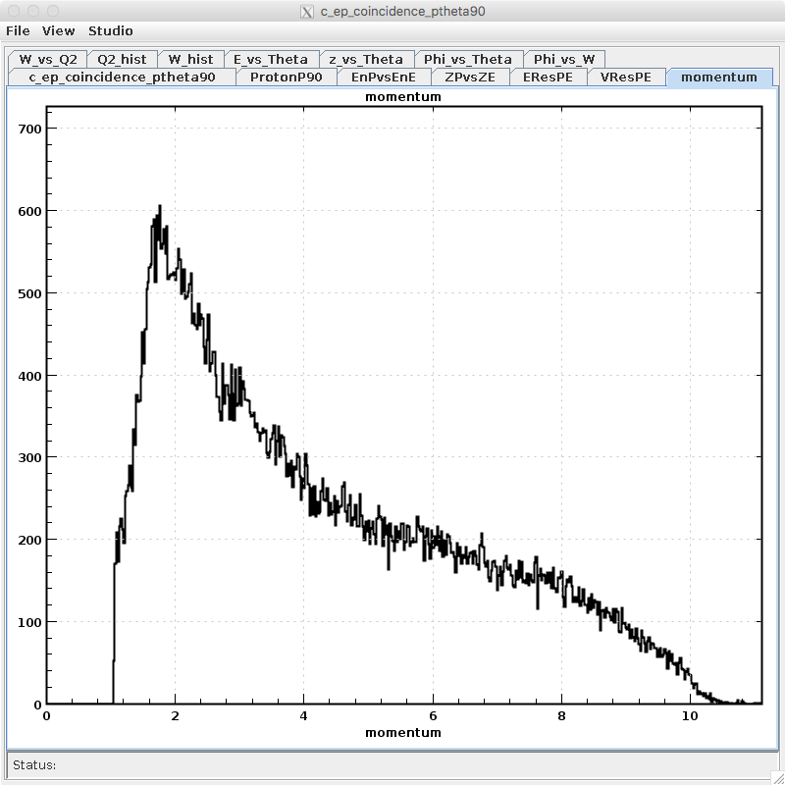
Results – Electron momentum
Elastic
Spectator Proton

Slide 19
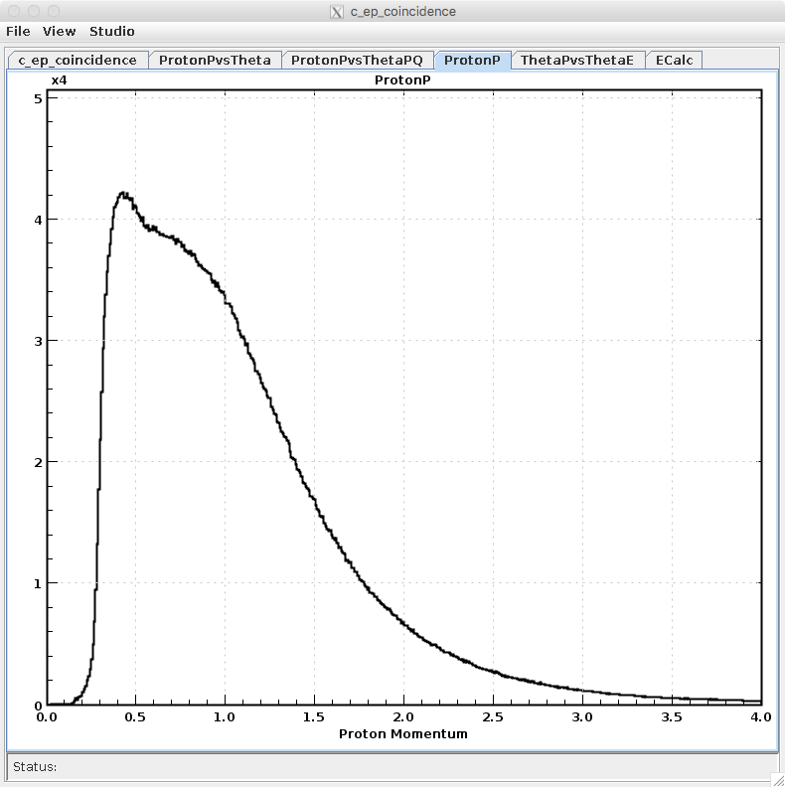
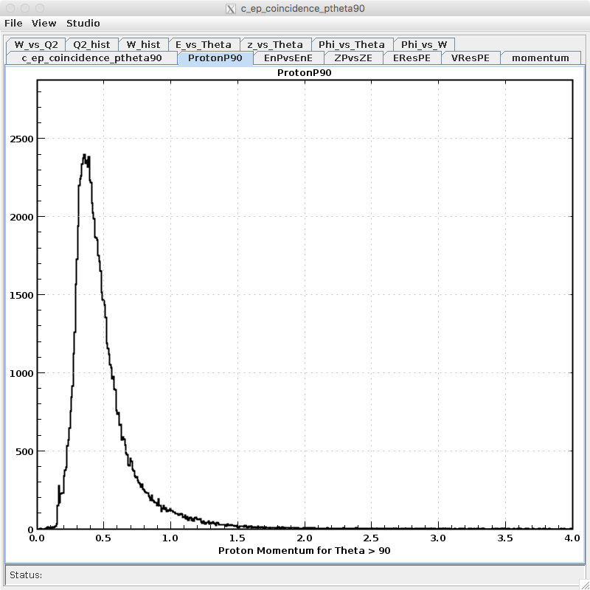
Results – Proton momentum
EP Coincidence
Spectator Proton

Slide 20
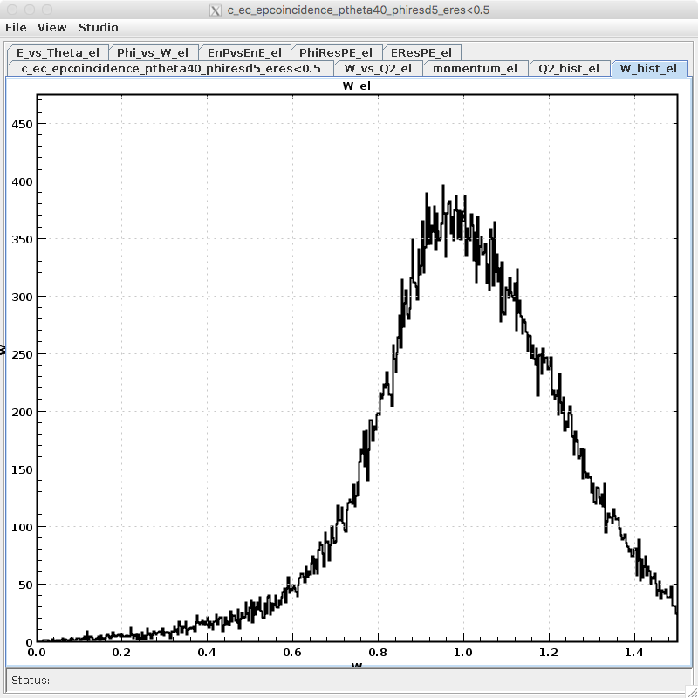
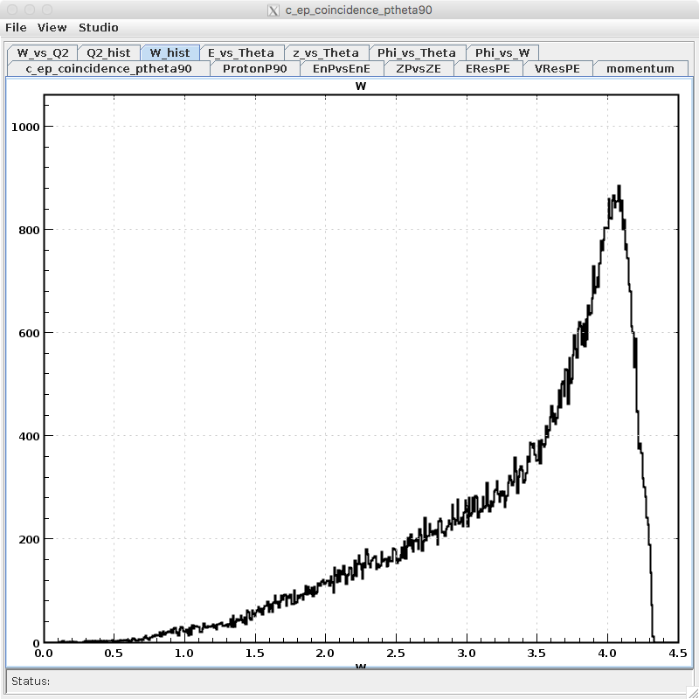
Results – Invariant Mass W
Elastic
Spectator Proton

Slide 21
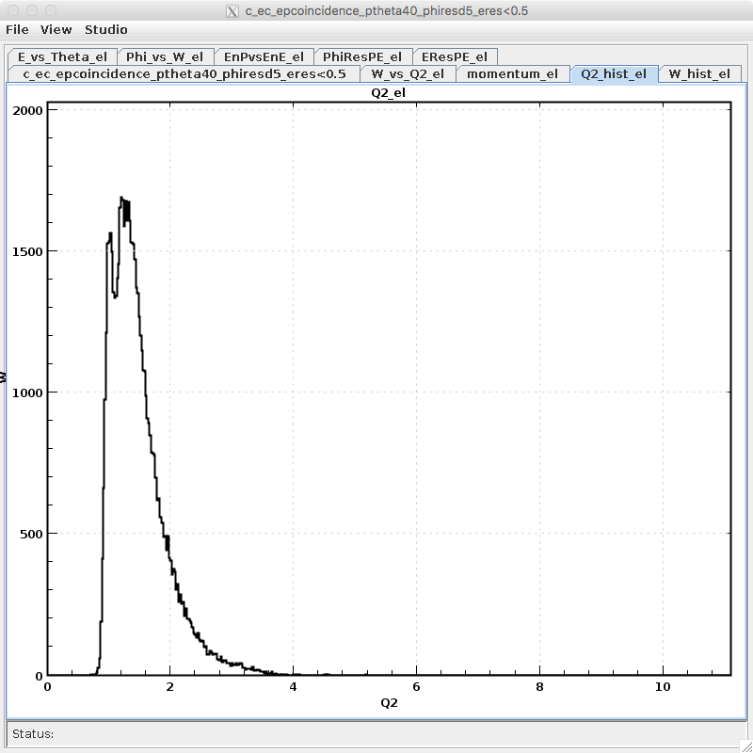
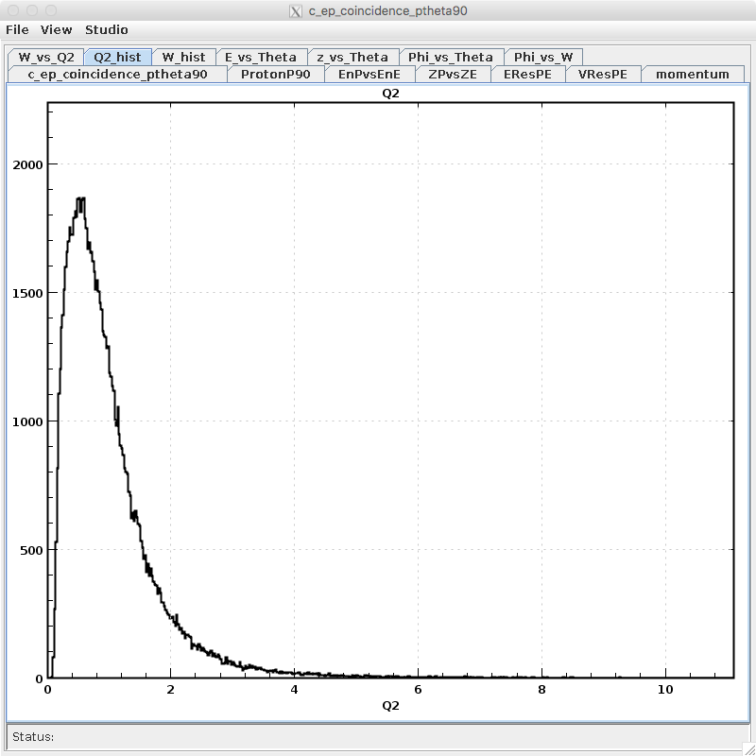
Results - $Q^{2}$
Elastic
Spectator Proton

Slide 22
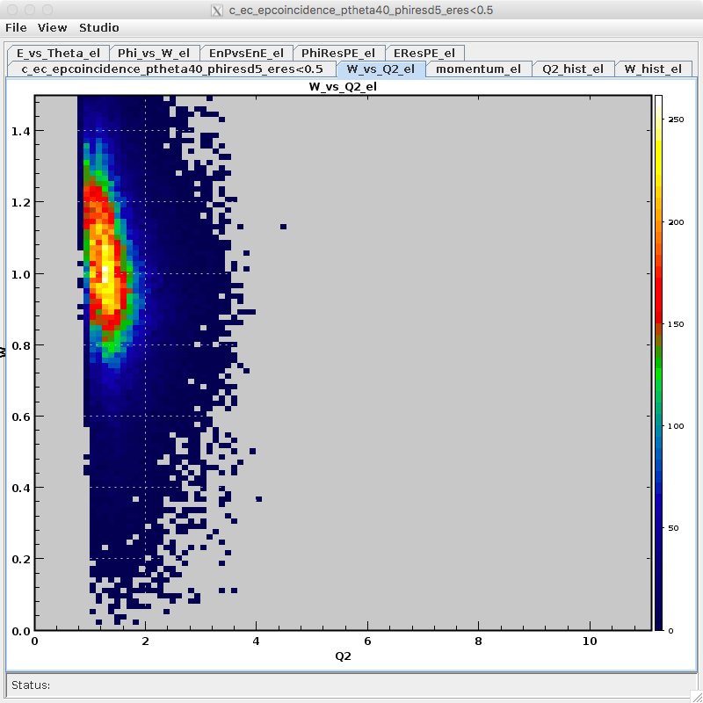
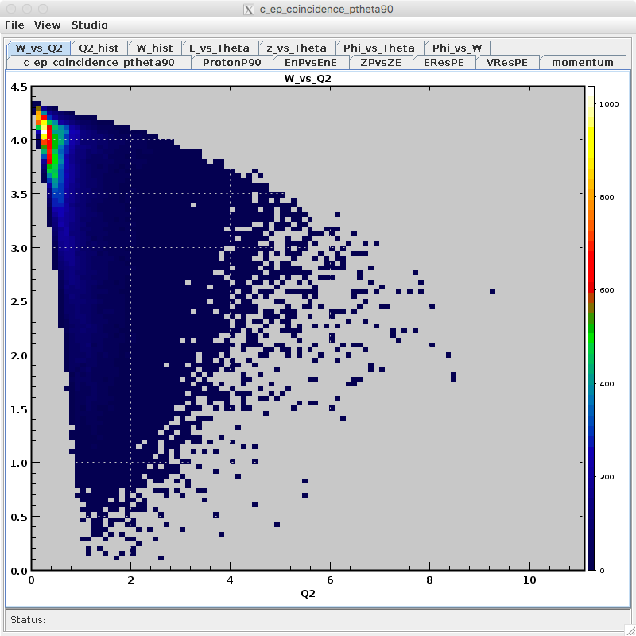
Results – W vs $Q^{2}$
Elastic
Spectator Proton

Slide 23
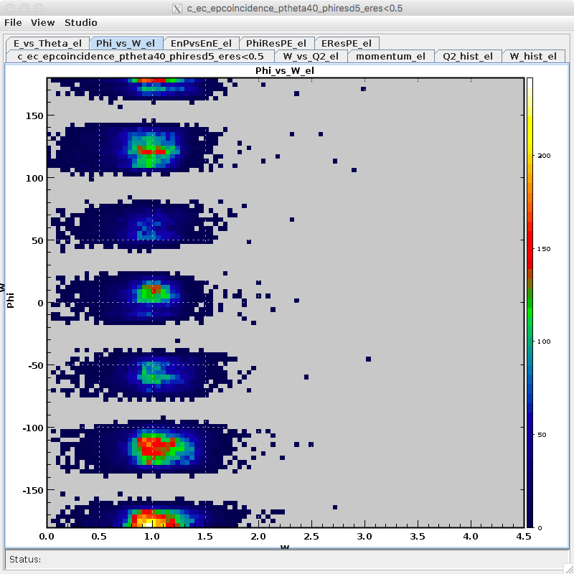
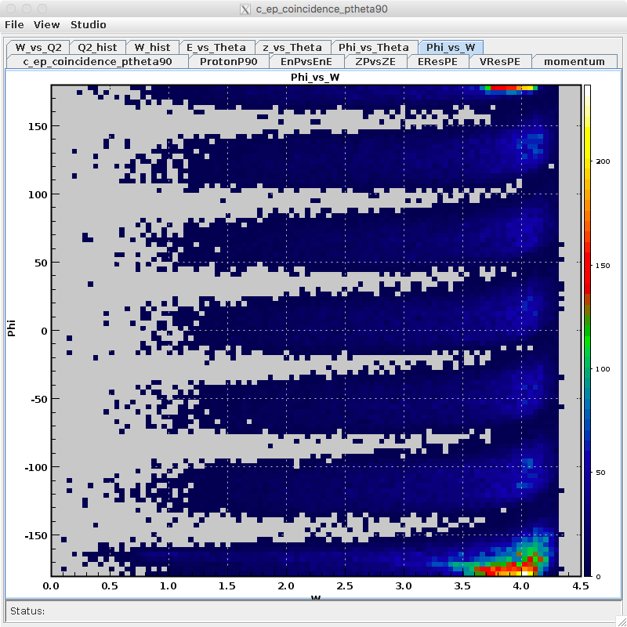
Results – Phi vs W
Elastic
Spectator Proton

Slide 24
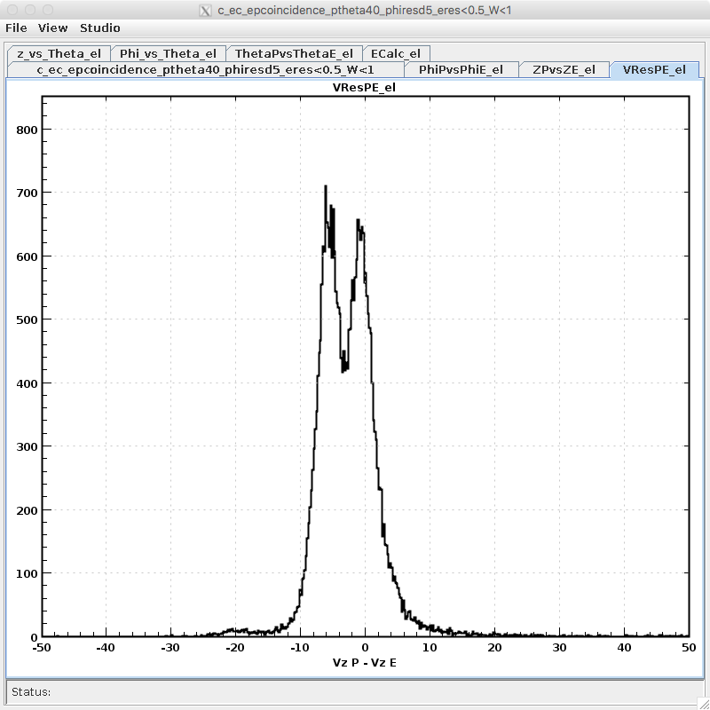
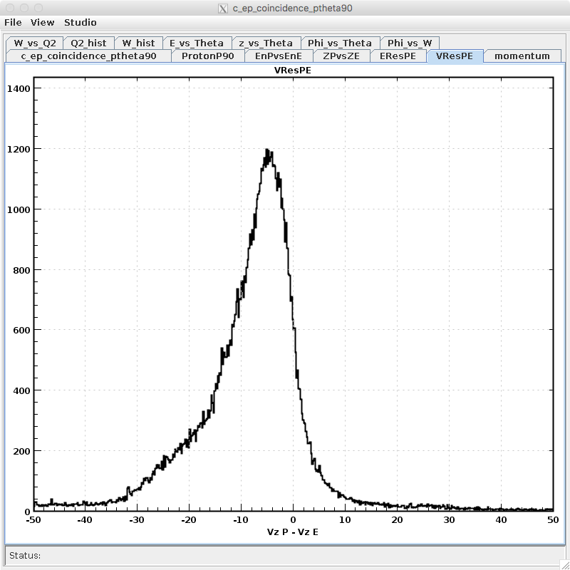
Results – Vertex difference
Elastic
Spectator Proton

Slide 25
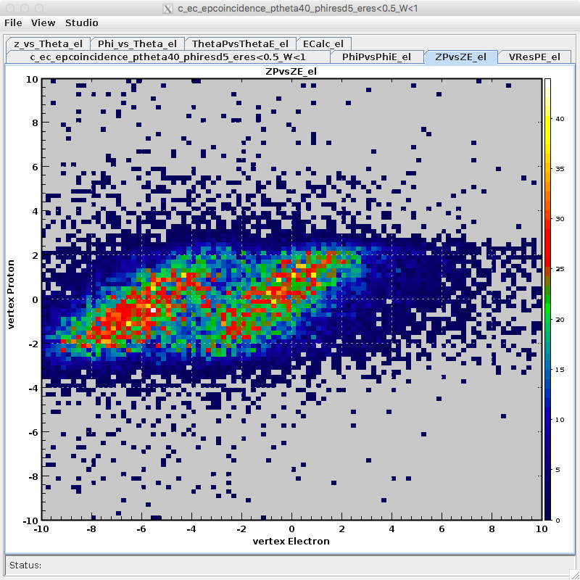
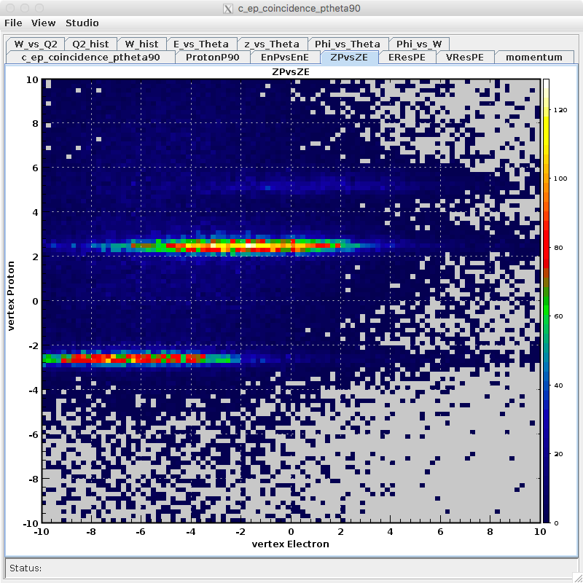
Results – Vertex Proton vs Electron
Elastic
Spectator Proton

Slide 26
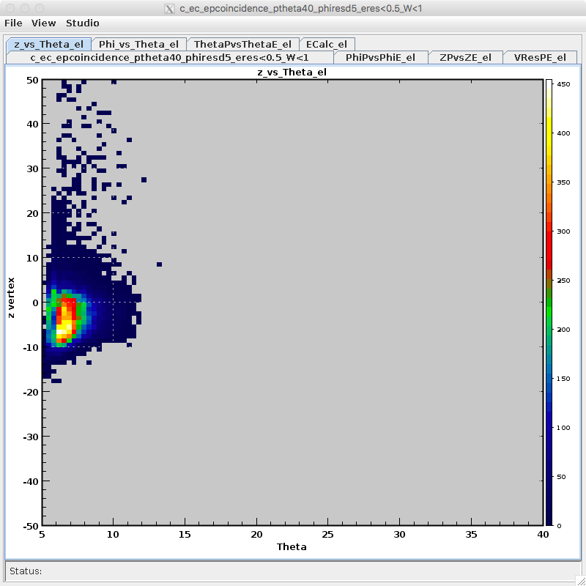
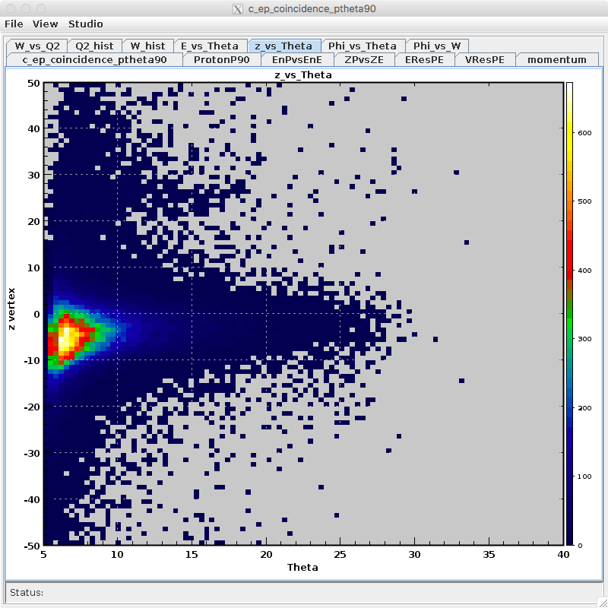
Results – Z vs Theta
Elastic
Spectator Proton

Slide 27
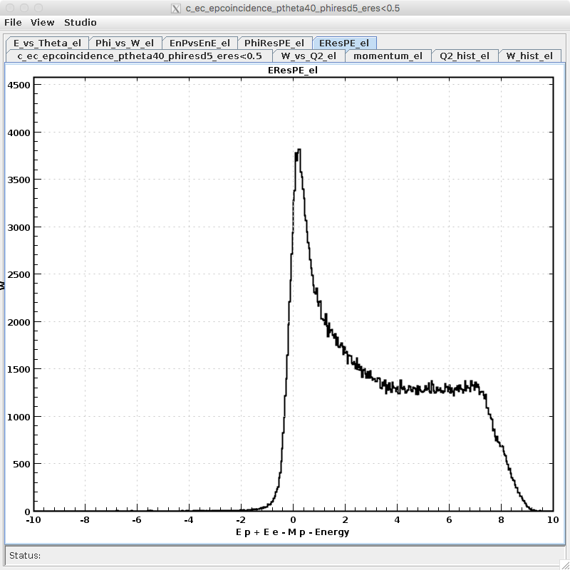
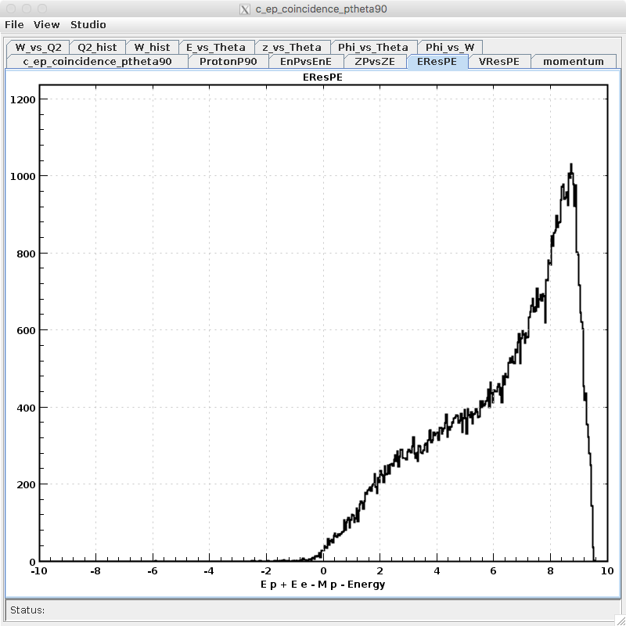
Results – Beam Energy + Mp – (Ep + Ee)
Elastic
Spectator Proton

Slide 28
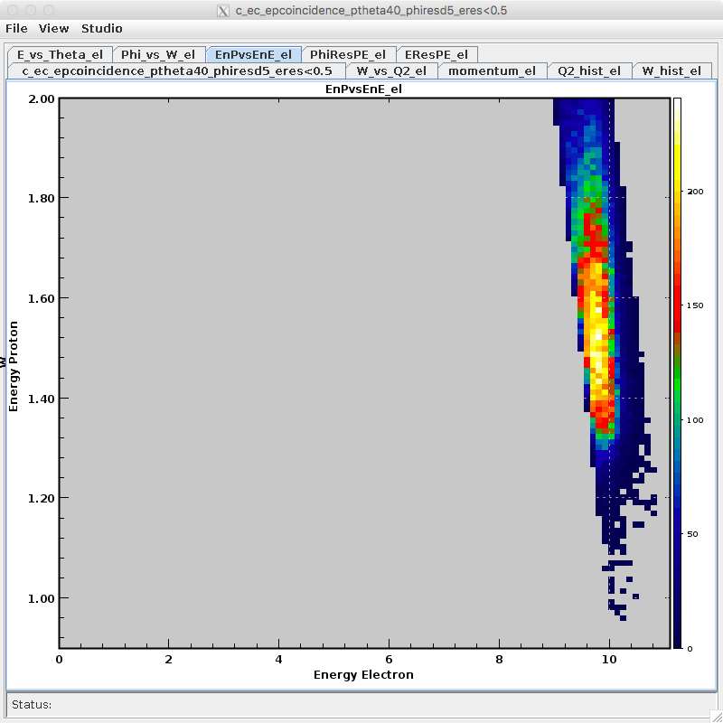
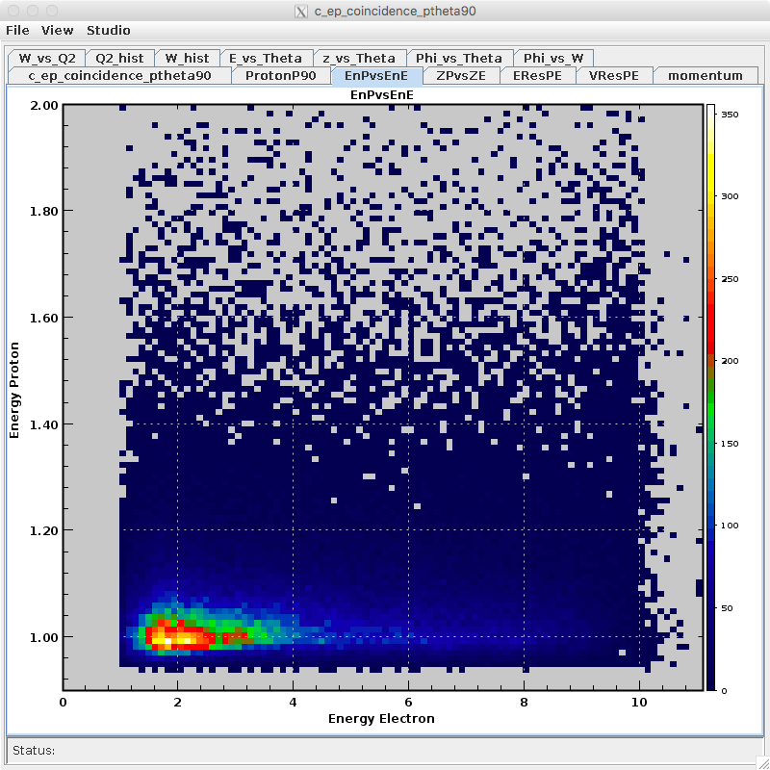
Results – Energy Proton vs Electron
Elastic
Spectator Proton

Slide 29
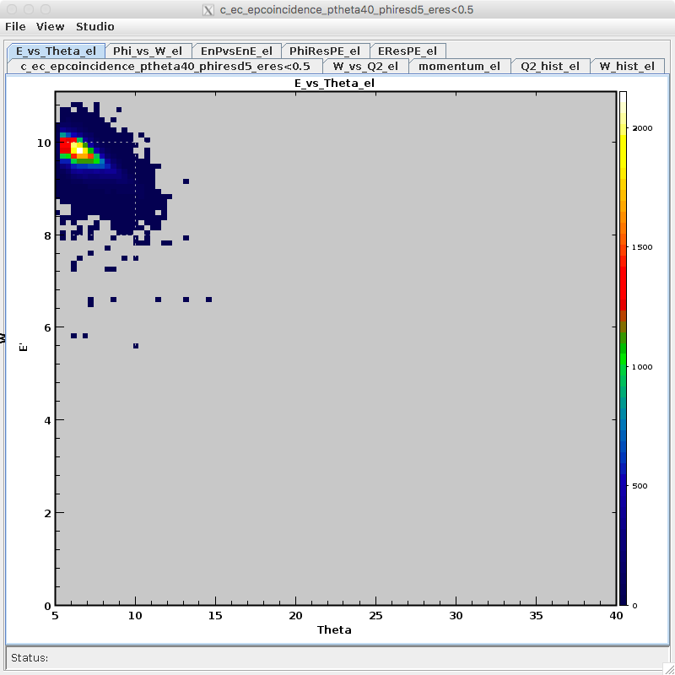
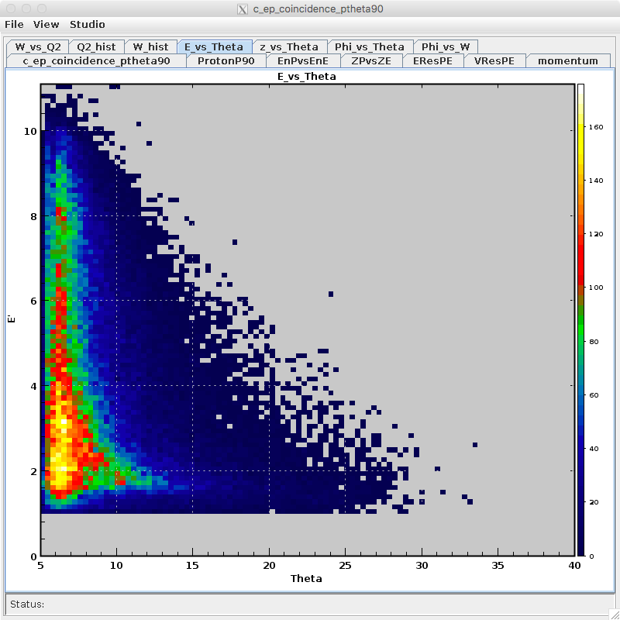
Results – E’ electron vs Theta
Elastic
Spectator Proton

Slide 30
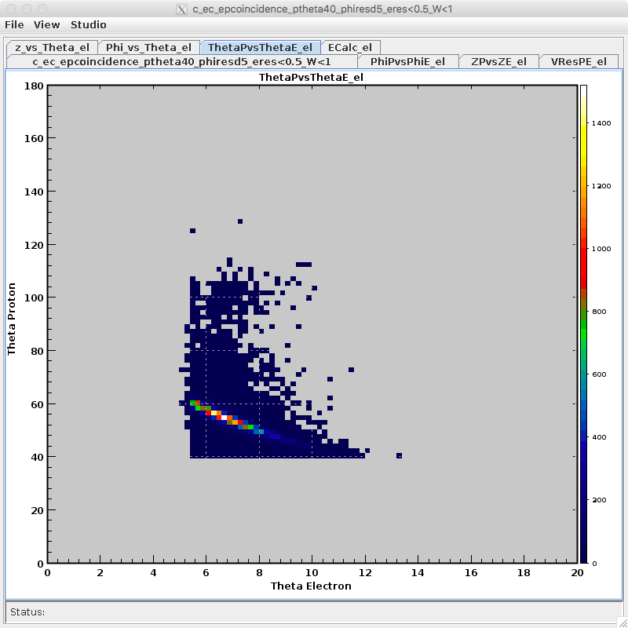
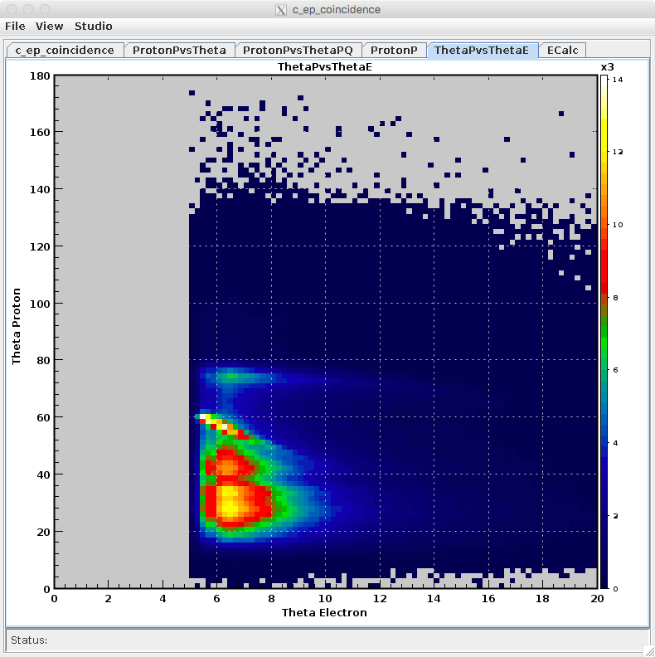
Results – Theta Proton vs Electron
Elastic
EP Coincidence

Slide 31
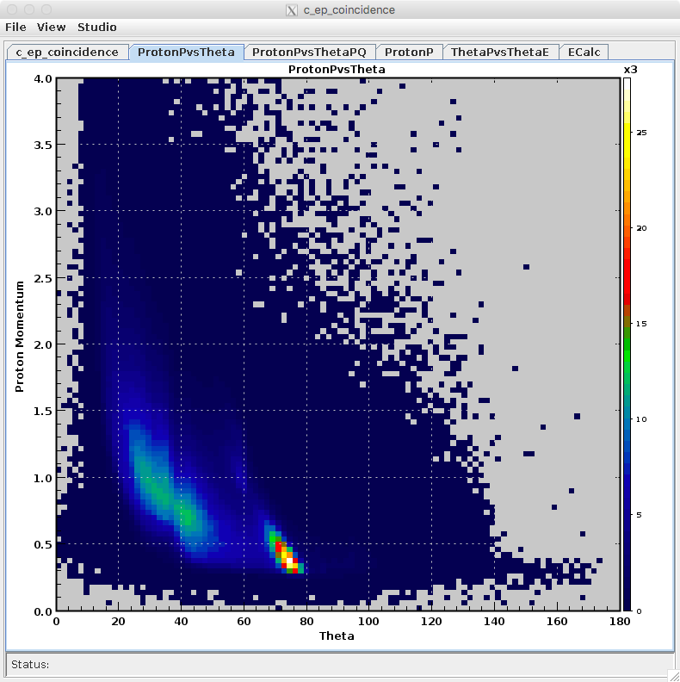
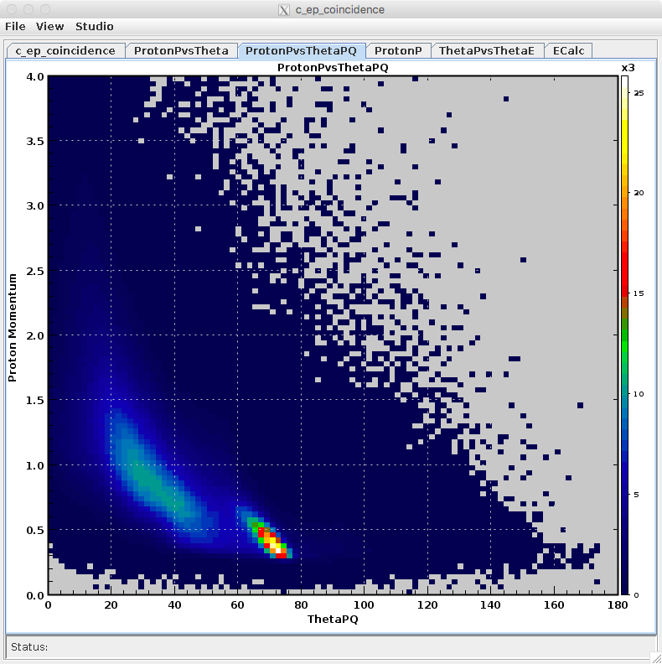
Results – Proton Momentum vs Theta
Elastic+Inelastic
EP Coincidence

Slide 32
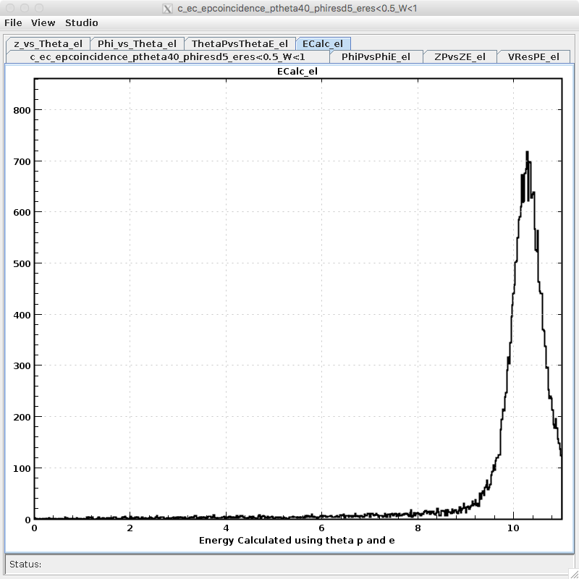
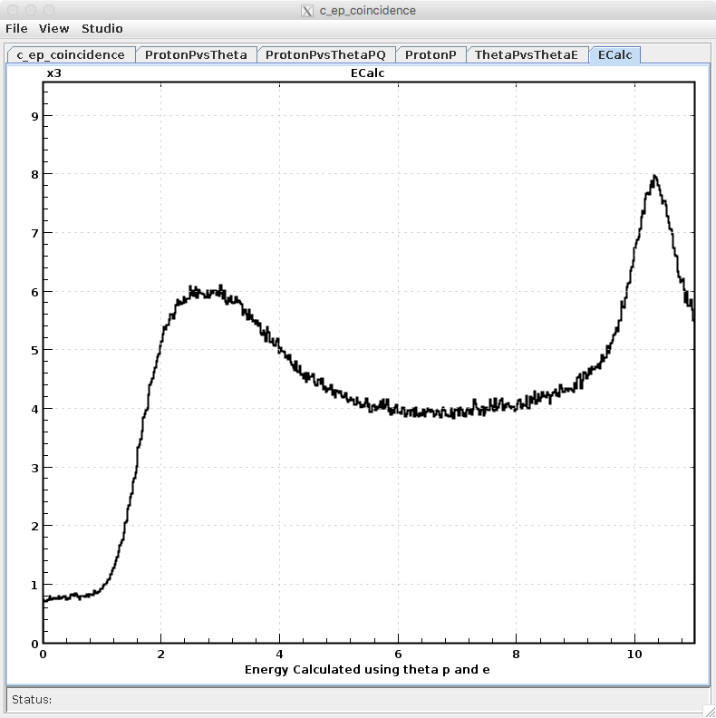
Results – E (calculated from theta p and e)
$$E=m_{p}(tan⁡(\frac{θ_{e}}{2})/tan⁡(θ_{p})−1)$$
Elastic
EP Coincidence

Slide 33
Sources
https://clasweb.jlab.org/wiki/index.php/CLAS12_Software_Center
By Zorak1103 - Own work, CC BY-SA 3.0, https://commons.wikimedia.org/w/index.php?curid=13358930
https://root.cern.ch/img/logos/ROOT_Logo/misc/logo_full-plus-text-hor.png

